Slide 1
Dolphin® 75e Handheld Device Market Introduction Webinar
Presented by:
Steve Ortley, Sr. Product Marketing Manager

Slide 2
Key Topics
The Business Challenge (Why?)
Introducing Dolphin 75e (How?)
Dolphin 75e Advantages (What?)
Target Use Cases (Voice of Customer Examples)
What to Expect Next
Call-to-Action

Slide 3
The Business Challenge
Stock outs deflate customer experience, share of wallet, revenue
Workers need improved decision making and faster reactions to out-of-stocks
Need to reduce overall transaction costs
Growth of SKUs is causing growth of errors
Staffing limitations, rising worker turnover
Peak seasons put strain on customer service
Workers want a business device that is as easy to use as their personal device but with expanded capabilities for business needs

Slide 4
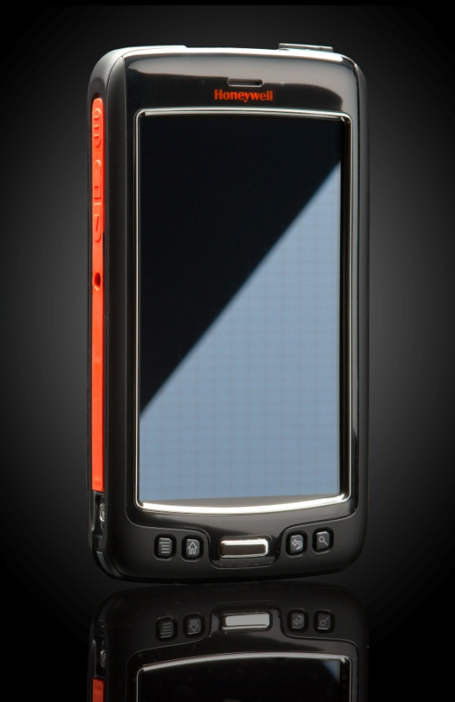
Dolphin 75e Value Proposition
Dolphin 75e offers enterprises in a variety of workflows; including inventory and asset management, shelf stocking, customer engagement, check-in and reservations:
Easy-to-use touch interface that significantly reduces training/ adoption time, making it ideal for enterprises with seasonality or high turnover
Increased operational and labor efficiencies
The ability to access multiple applications and systems 25-50% faster than the next best alternative
A field-proven solution that is as sleek and pocketable as a personal device, making it ideal for customer-facing workflows
Comprehensive data capture capabilities
Easy implementation and deployment with the flexibility to choose either Android 4.4 KitKat or Windows 8.1 Handheld

Slide 5
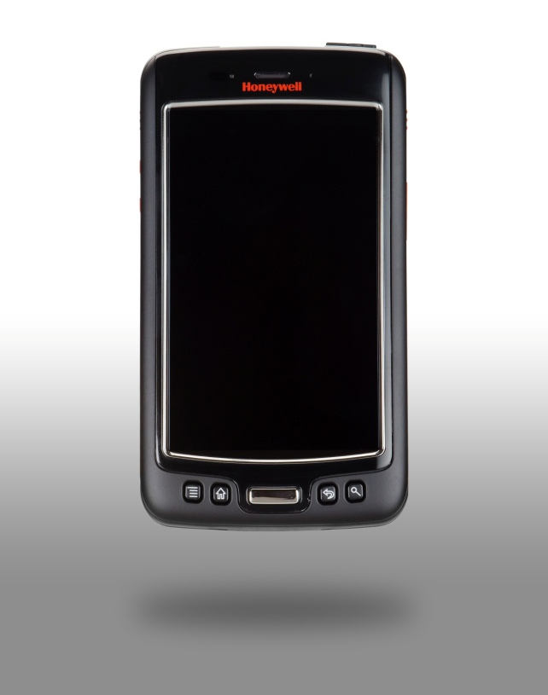
Dolphin 75e Summary
The first Windows Embedded 8.1 handheld device is here! Honeywell expands the enterprise hybrid device platform with industry-leading processing power and the flexibility to support both Windows 8.1 and Android 4.4 O/S configurations to deliver the ultimate flexibility in mobile computing.
Program Summary
Key Product Differentiators | Powerful, Versatile Platform: Industry-leading Qualcomm Snapdragon 800 processing power with 2.26GHz quad-core CPU enables advanced performance and power efficiencies with the flexibility to support both Windows and Android O/S configurations. Dedicated 1D/2D Scanning: Increases productivity and throughput with an integrated and easy-to-use imager that provides aggressive scanning of linear and 2D bar codes; when using a camera is not enough for enterprise. Field-Proven Durable Design: Lowers total cost of ownership and reduces downtime with an IP67 rated design for protection from dust and water and the ability to withstand multiple 1.2 m drops to concrete and 1,000 0.5 m tumbles. Crystal Clear Touch Screen Display: Capacitive touch technology and readability in various lighting conditions combine to provide an offering that is perfect for inside or outside use cases. Fast and Reliable Wireless Connectivity: Delivers full WLAN coverage, the latest Bluetooth 4.0, and wide-band speech support. Extensive Software Options: Value-add software options include Diagnostic Information, RF Network Tools, Printing SDK, Scan-based provisioning and more.

Slide 6
Positioning HON Touchscreens
Dolphin 70e Black
Dolphin 75e
Latest NPI
Stable O/S
Purpose-built application environment
Require rugged device, but want a touchscreen user interface experience
Durability/ Serviceability (<5% ARR)
Entry-Level Touch Screen WWAN Device
Latest O/S
Multiple application environment
Require rugged device, but want a touchscreen user interface experience
Critical connectivity
High Performance Architecture (i.e. Galaxy S5)
WiFi only
Latest O/S
Multiple application environment
Require rugged device, but want a touchscreen user interface experience
Ruggedization upgrade
High Performance Architecture (i.e. Galaxy S5)
LTE enabled
Next Gen Scan Performance
Comprehensive Accessory Ecosystem

Slide 7
Target Use Cases
Shelf Stocking/ Re-Stocking Workflows
Order picking
Stock replenishment
Receiving
Arrange displays
Price checking/ markdown
Returns management
Key Business Advantages
Increased sales
Better customer service
Faster response time to out of stocks
Improved worker productivity
Inventory/ Asset Management Workflows
Order management
Stock valuation
Receiving
Inventory maintenance
Loss prevention
Asset protection
Key Business Advantages
Increased sales
Better customer service
Faster response time to out of stocks
Improved cost control
Fewer data errors
Customer Engagement/ Check-In Workflows
Price/ inventory checks
Loyalty apps
Item locator
Price management
Line busting
Clienteling
Electronic couponing
Cross channel fulfillment
Gift registry lookup
Key Business Advantages
Increased sales
Better customer service
Faster response
Multi-Modal Workflows
Multi-use case environment
Barcode scanning
Customer engagement
Inventory management
Shelf stocking
Quality/ audit
General purpose devices required
Key Business Advantages
Eliminates manual entry
Multiple apps for single user
Optimized hands-on tasks
Quality/ Audit Workflows
Inspection
Quality control
Supplier performance
Records maintenance
Product testing
Fault finding
Documentation
Results analysis
Process improvement
Reporting
Compliance
Key Business Advantages
Cost-effective regulatory compliance
Improved productivity
Fewer data errors

Slide 8
What to Expect from Honeywell
 | March | April | May | June | July
Product
Marketing/PR
Sales Readiness/ Management
Distys Stocking Orders;
Pricing/Skus Loaded
Production Begins
MS/HSM
Joint Press
Release/ D75e
Public
Launch
Developer
Program
D75e
Product
Announce/ Marketing Collateral Available
Change Your Perspective Campaign Materials Available
Microsoft/ Honeywell
Enterprise Mobility Summit
Apr 13- May 11
Solution Architect
Training Complete
Partner/ Disty/ Sales Training

Slide 9
Call-to-Action
Load qualified leads into SFDC to drive early visibility of forecase demand and priority response times:
Use 75e-Windows-NPI for All Windows Deals
Use 75e-Android-NPI for All Android Deals
All deals should be loaded with complete information:
Primary ERP system
Software expected to run on the device
Primary ISV (if any)
Enter workflow (1-10) – see table below
Total mobile devices deployed
Total number of mobile workforce
Possible workflows

