Slide 1
Dolphin® 75e Handheld Device Selling Tool-kit
Presented by:
Steve Ortley, Sr. Product Marketing Manager

Slide 2
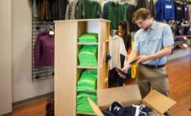
Who is your Audience? – Use Case
Shelf Stocking/ Re-Stocking Workflows
Order picking
Stock replenishment
Receiving
Arrange displays
Price checking/ markdown
Returns management
Key Business Advantages
Increased sales
Better customer service
Faster response time to out of stocks
Improved worker productivity
Inventory/ Asset Management Workflows
Order management
Stock valuation
Receiving
Inventory maintenance
Loss prevention
Asset protection
Key Business Advantages
Increased sales
Better customer service
Faster response time to out of stocks
Improved cost control
Fewer data errors
Customer Engagement/ Check-In Workflows
Price/ inventory checks
Loyalty apps
Item locator
Price management
Line busting
Clienteling
Electronic couponing
Cross channel fulfillment
Gift registry lookup
Key Business Advantages
Increased sales
Better customer service
Faster response
Multi-Modal Workflows
Multi-use case environment
Barcode scanning
Customer engagement
Inventory management
Shelf stocking
Quality/ audit
General purpose devices required
Key Business Advantages
Eliminates manual entry
Multiple apps for single user
Optimized hands-on tasks
Quality/ Audit Workflows
Inspection
Quality control
Supplier performance
Records maintenance
Product testing
Fault finding
Documentation
Results analysis
Process improvement
Reporting
Compliance
Key Business Advantages
Cost-effective regulator compliance
Improved productivity
Fewer data errors

Slide 3
Who is your Audience? – Decision Maker
Customer Needs
Importance to the Customer
Low
High
Processer Speed
1
3
2
Operating System
1
3
2
Battery Life
2
3
1
WLAN Only
3
1
2
Terminal Emulation
1
2
3
Rapid time to operation
3
1
2
Comfort/Hygiene
3
2
1
Durable
Primary Segment: IT Managers
1
2
3
Multipurpose
1
2
3
4.3” Display
2
3
1
Segment | Segment Description
1 | Highly Mobile Professionals: Professionals who are highly mobile inside 4 walls, where activity is dominated by “hold and carry” and activities that require advanced 1D/2D barcode scanning
2 (Primary) | IT Managers: IT managers that need to control costs and maintain flexibility in their mobile IT solutions; multiple application on a single device plus security concerns via WWAN/BYOD
3 | Business Managers: Business managers that want to improve and expand their service offering to increase profitability

Slide 4
Mobility Overview
Standard in all Decks

Slide 5
Who We Are Working To Become
Delivering Power to the Edge to become the
Workflow Performance Company

Slide 6
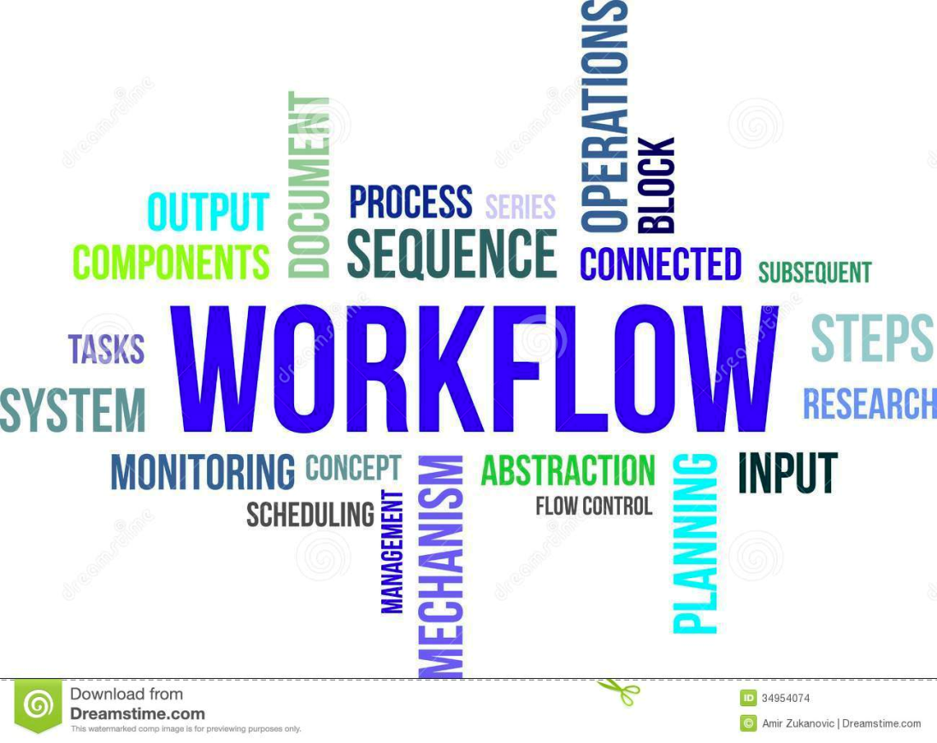
Workflow
The Sequence of Processes to Accomplish a Desired Outcome

Slide 7
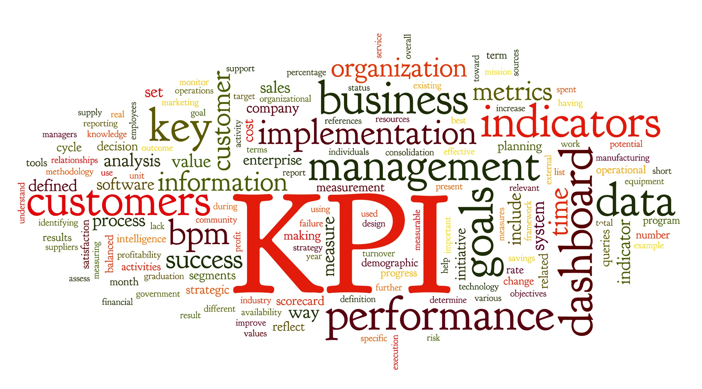
Performance
How Effective or Successful Something or Someone is

Slide 8
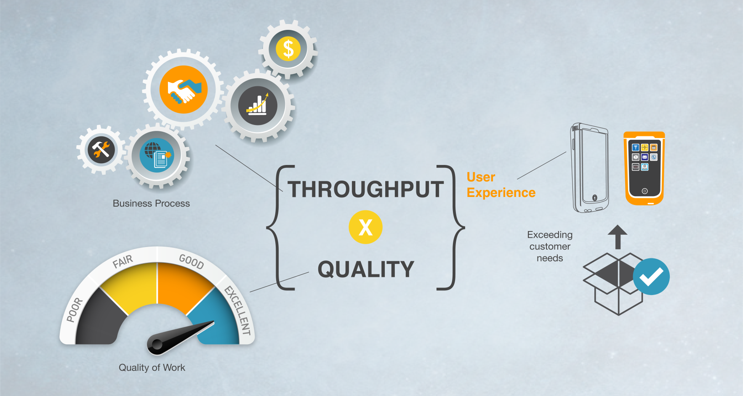
Workflow Performance
Accomplishing a Desired Outcome as Efficiently as Possible

Slide 9
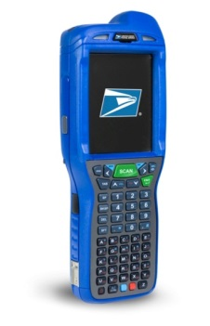
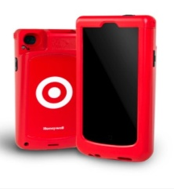
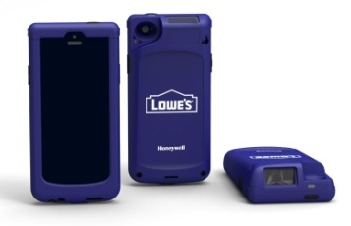
2014 Notable Wins in Mobility – Now We Execute
LATIN AMERICA:
Sab Miller, CN70, $10M
ENTERPRISE MOBILE: USPS, Lifecycle Services, $10M
NORTH AMERICA:
FedEx Freight, CN70, $12M
EMEIA: Sainsbury, CN3, $2.5M
$250M +
Dolphin 99EX + Peripherals $65M
Remote Mastermind $2M
Service $2M
Enterprise Mobile $10M
75k units delivered; 200k more coming
Delighting the customer every day
LATIN AMERICA: EPM Colombia, D99EX & D7800, $6M
APAC:
TNT, CN51
$1.3M
$30M+
50,000+ Units
Multiple Use Cases
Customized Exterior Sleds
NORTH AMERICA:
Publix, CK3X, $6.5M
NORTH AMERICA:
Michael’s Stores, D7800, $10M
EMEIA: Swiss Post, CN51, $13M
EMEIA: Schenker AB Sweden, Dolphin 70e
Black, $3M

Slide 10
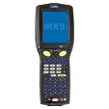
Honeywell mobility architecture strategy
Hardware
Architecture
Option 1
Option 2
Vehicle Mounts
Customer Facing Handhelds
Task-Based Handhelds

Slide 11
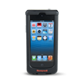
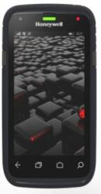
Handheld Mobile Computer Portfolio
BYOD
Durable
Rugged
Ultra Rugged
SL22/42
Sled
D60s
Scanphone
D70e/D75e
Hybrid
CT50
“Sweet Spot”
CN51
EDA
CN70
EDA
CN70e
EDA
99EX
PDT
“Consumer”
Apple® iPhone®
“Entry Level”
Pocketable
Device Consolidation
“Hybrid”
Consumer Style & Usability
“Touch Only”
First HSM LTE Device Consumer Speed for the Enterprise
“Versatile”
Compact & Lightweight
Best Imaging Technologies
Larger Display with Keypad
“No Compromise”
Heavy Industrial Use
Best Imaging Technologies
Most Durable Displays
Multiple Keypad Options

Slide 12
75e Use Case Selector
Select the 2-pager that aligns with the target…

Slide 13
Shelf Stocking/ Re-Stocking
The Business Challenge:
Stock outs deflate customer experience, share of wallet, revenue
Workers need improved decision making and faster reactions to out-of-stocks
Need to reduce overall transaction costs
Growth of SKUs is causing growth of errors
Staffing limitations
Rising worker turnover
Peak seasons put strain on customer service

Slide 14
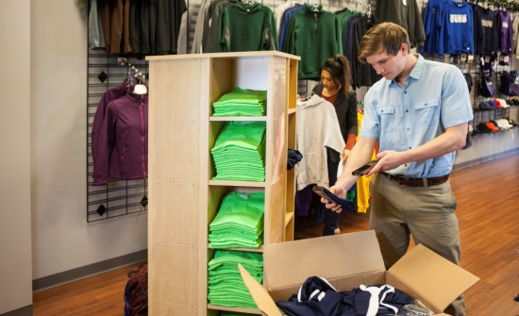
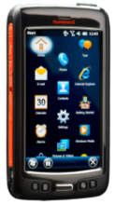
Shelf Stocking/ Re-Stocking
Process:
Maintain and proactively order, coordinate and stock all inventory in various commercial environments
Environment:
Back of Store - Scan incoming shipments, take periodic inventories to determine when to order additional supplies, track items on the shelves and/or warehouse equipment - such as forklifts, conveyors, etc.
Front of Store – Perform quick barcode scan to find inventory levels on stock-out on shelf / order new asset. Perform inspection of perishable goods for check and re-stock.
User Persona:
Ease of training, especially with seasonality or high-turn-over
Highly mobile – needs for ergonomic design and easy pocketability
Performance to paper-process process, current purpose built mobile terminal/PDA or legacy PCs
Secure rapid roll-out of multiple applications
Key Benefits/Attributes:
Just-in-time stocking/re-stocking
Improved productivity, reduce out-of-stock
Fewer data errors
Increase shelf usage
Increase “fresh” perspective of goods to consumers
Focused on Reducing Waste/ Spoilage and Eliminating Stock-outs

Slide 15
Inventory/ Asset Management
The Business Challenge:
Stock outs deflate customer experience, share of wallet, revenue
Need to reduce overall transaction costs
Growth of SKUs is causing growth of errors
Staffing limitations
Rising worker turnover
Peak seasons put strain on customer service

Slide 16
Inventory/ Asset Management
Process:
To collect and audit various assets throughout operations; tied to an ERP system the data is used for order management, customer fulfillment, etc.
Environment:
Scan incoming shipments, take periodic inventories to determine when to order additional supplies, track items on the shelves and/or warehouse equipment - such as forklifts, conveyors, etc.
In the yard a quick barcode scan can enable the automatic completion of asset tracking paperwork, ensuring that accurate costing and condition information is captured. WIFI provides real-time visibility
User Persona:
Ease of training, especially with seasonality or high-turn-over
Highly mobile – needs for ergonomic design and easy pocketability
Performance to paper-process process, current purpose built mobile terminal/PDA or legacy PCs
Secure rapid roll-out of multiple applications
Key Benefits/Attributes:
Automated collection of asset management & inventory count data
Improved Productivity
Fewer data errors
Reduced cost of ownership for assets
Integration with related business systems
Focused on Bottom-line Performance and Optimization

Slide 17
Customer Engagement/ Check-In
The Business Challenge:
Brick & mortar business model under assault by online shopping
Need to innovate and improve customer experience to stay relevant
Staffing/ seasonal employee limitations
Rising worker turnover
Peak seasons put strain on customer service

Slide 18
Customer Engagement/ Check-In
Process:
To serve as the tip of the IoT to connect to the mobile customers; systems like mobile bag drop need a kiosk replacement for their IT systems
Environment:
Scan incoming customers, check government issued identification, possibly payment method, collect and track items provided to hospitality employee (i.e. baggage for airlines/cruise-lines or packages for hotel guests)
User Persona:
Ease of training, especially with seasonality or high-turn-over
Highly mobile – needs for ergonomic design and easy pocketability
Performance to paper-process process, current purpose built mobile terminal/PDA or legacy PCs
Secure rapid roll-out of multiple applications
Key Benefits/Attributes:
Automated collection of reservations and baggage collection
Improved productivity
Fewer data errors -> Fewer lost bags/assets of the customer
Integration with related business systems
Cost-effective regulatory compliance
Focused on Improving Customer Experience and Self-Services

Slide 19
Multi-Modal
The Business Challenge:
Today’s workers are faced with less time and more tasks to get their jobs done
Workers need instant access to business critical information to deliver the best possible service
Workers want a business device that is as easy to use as their personal device but with expanded capabilities for business needs

Slide 20
Multi-Modal
Process:
Operations and workflow visibility; usually with a check-list of checks
Environment:
Front of Store – Perform quick barcode scan to find inventory levels on stock-out on shelf / order new asset. Perform inspection of perishable goods for check and re-stock.
At any-time during the above cycle; move to a different in-store application and address customer question about gift registry/coupons and provide information from system to customer; once complete go back to original task
Across Customer Engagement, Inventory Mgmt, Shelf Stocking & Quality/Audit
User Persona:
Ease of training, specifically with Android OS and fully touch solution
Highly mobile – needs for ergonomic design and easy pocketability
Performance to paper-process process, current purpose built mobile terminal/PDA or legacy PCs
Secure rapid roll-out of multiple applications
Key Benefits/Attributes:
Multi-application Environment (Native and Web-based)
Improved productivity – multiple applications for single user
Fewer data errors -> Eliminate any remaining manual entry
Customer centered/connected workflows
Expanded Platform Allows for Multiple Use-case Approach

Slide 21
Quality & Audit
The Business Challenge:
Higher customer satisfaction and lower support costs are driving competitive advantage
Increased focus on customer retention
Reputation for quality drives increased customer acquisition
Need to reduce operating costs
Need for improved and more proactive customer support

Slide 22
Quality & Audit
Process:
Operations and workflow visibility; usually with a check-list of checks
Environment:
Scan incoming asset or line configuration; pull up work-list for Quality check (not always standard) begin work-list with combination of barcode scan, photos and manual key entry. Sort files, review final analysis and push report to system for processing. Retrieve data/ information on next steps or get new work-list for next checkpoint.
User Persona:
Ease of training, specifically with Android OS and fully touch solution
Highly mobile – needs for ergonomic design and easy pocketability
Performance to paper-process process, current purpose built mobile terminal/PDA or legacy PCs
Secure rapid roll-out of multiple applications
Key Benefits/Attributes:
Worklist & Task-based Tracking
Cost-effective regulatory compliance (product & personnel)
Improved productivity – multiple applications for single user
Fewer data errors -> Eliminate any remaining manual entry
Integration with related business systems
Focus on Android-Based Solutions and Increased App Usage

Slide 23
75e IT/Business Manager
Standard in all Decks

Slide 24
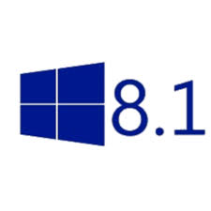
Positioning HON Solutions – 70e & 75e
Dolphin 70e Black
Dolphin 75e
Stable O/S
Purpose-built application environment
Require rugged device, but want a touchscreen user interface experience
Durability/ Serviceability (<5% ARR)
Entry-Level Touch Screen WWAN Device
Latest O/S
Multiple application environment
Require rugged device, but want a touchscreen user interface experience
Critical connectivity
High Performance Architecture (i.e. Galaxy S5)
WiFi only
Same Form Factor Meets High Performance Architecture

Slide 25
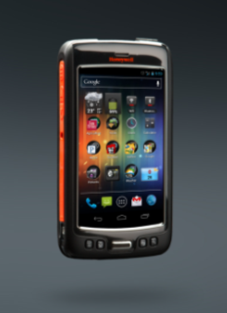
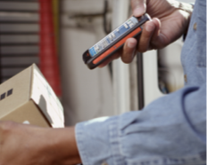
The Dolphin 75e Handheld Computer
The first Windows Embedded 8.1 Handheld device is here! Honeywell expands the Enterprise Hybrid Device platform with industry-leading processing power and the flexibility to support the Windows 8.1 O/S configuration to deliver the ultimate flexibility in mobile computing.
Program Summary
Key Product Differentiators across applications | Powerful, Versatile Platform: Industry-leading Qualcomm Snapdragon 800 processing power with 2.26GHz quad-core CPU enables advanced performance and power efficiencies with the flexibility to support WE8.1H Dedicated 1D/2D Scanning: Increases productivity and throughput with an integrated and easy-to-use imager that provides aggressive scanning of linear and 2D bar codes; when using a camera is not enough for enterprise. Field-Proven Ultra-Rugged Design: Lowers total cost of ownership and reduces downtime with an IP67 rated design for protection from dust and water and the ability to withstand multiple 1.2 m drops to concrete and 1,000 0.5 m tumbles. Crystal Clear Touch Screen Display: Capacitive touch technology and readability in various lighting conditions combine to provide an offering that is perfect for inside or outside use cases . Fast and Reliable Wireless Connectivity: Delivers full WLAN coverage for applications inside and outside of the four walls, the latest Bluetooth 4.0, and wide-band speech support. Extensive Software Options: Value-add software options include Diagnostic Information, RF Network Tools, Printing SDK, Scan-based provisioning and more.

Slide 26
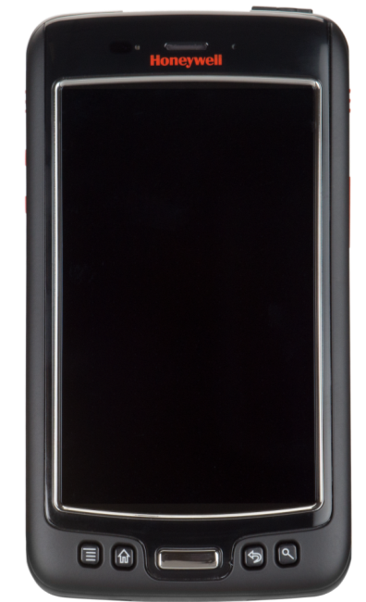
Solution Highlights
Mic & headphone combo jack
Dedicated imager – fast and ergonomic
Scan key
(programmable)
8mp camera (on the back side). Flash works as a light.
Volume keys
4.3” outdoor display with Gorilla glass. Two finger capacitive touch – a modern user experience
Scan key
(programmable)
Micro USB port
Proximity & light sensors. Accelerometer – ease of use
2.26GHZ quad core Qualcomm CPU,
2GB RAM, 16 flash – powerful
Speaker & dual array digital mics – a great communication experience
Dedicated scan key
(other keys can be programmed)

Slide 27
Dolphin 75e – Enterprise Hybrid Device
Introducing Dolphin 75e – the latest addition to the Enterprise Hybrid Portfolio!
Proven design (IP67 rated Dolphin 70e), with completely new Qualcomm Snapdragon 800 series 2.3 Ghz quad-core processor and architecture
New operating systems supported: Android 4.4 /Android 5.0 and Windows Embedded 8.1 Handheld / Windows 10 Upgradable from Microsoft.
Multiple new SW solutions: Industrial browser, Android launcher, Voice, etc.
Targeted use-cases Inventory, Stocking, Customer Engagement, Quality & Picking
WIFI only Applications

Slide 28
Dolphin 75e – Specifications
Display and input: | 4.3” sunlight viewable display, two finger capacitive touch, works with gloves or when wet, virtual keypad, stylus
Durability: | 4’ / 1.2m drop to concrete, IP67, scratch proof Gorilla glass
Talk time: | 6hrs (std.) & 12hrs (ext.). Same batteries as current Black but operation time could be a bit longer (new architecture)
Software: | Windows Embedded 8 Handheld Android 4.4
Data capture: | Same imager as in 70e Black, 8MP camera with much improved camera SW.
Connectivity: | 802.11a/b/g/n/ac, NFC, NO WWAN on 75e. Focus on Voip quality (roaming, audio quality…)
Performance: | 2.23 Ghz quad core , 2GB RAM, 8GB flash
Other: | Support for wireless display, improved sensors…
Dimensions & weight: | 134 mm x 73 mm x 18 mm, 204g (same as current Black)
Initial use-cases: | Inventory, Stocking, Customer Engagement, Quality & Picking

Slide 29
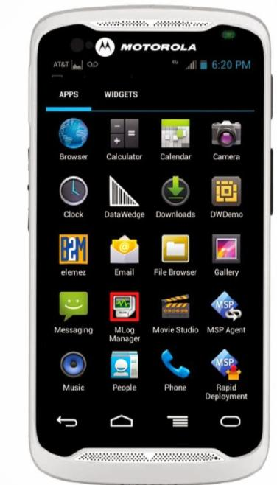
Form Factor – Side-by-Side
5.66” (143.9mm)
MC40 Total Height
5.4” (137mm)
TC55 Total Height
5.3” (134mm)
75e "Paris" Total Height
266.1g (9.38oz) with battery
220g (7.8 oz) with battery
204g (7.2 oz) with battery
Android 4.1
Android 4.1
Windows Embedded 8.1 Handheld & Android 4.4

Slide 30
Architecture – Side by Side
Honeywell invested in the Snapdragon 800 series quad-core Qualcomm processor architecture which is more complex than the Zebra dual-core Qualcomm processor, key benefits are:
Qualcomm study highlights that Honeywell architecture is 25 – 50% faster and has 25-30% more battery life than the Zebra architecture today (Snapdragon 600 dual-core processor in TC70 device).
“Make no mistake, MSM8974 is the new high-end, pushing Snapdragon 600 and S4 Pro parts further down into midrange category.”
Page 3
“One of the things Qualcomm promised would come with Snapdragon 800 (8974) (and by extension the process improvement with 28nm HPM) was lower power consumption, especially versus Snapdragon 600 (8064).”
Page 4

Slide 31
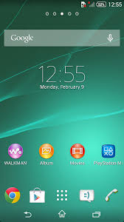
HSM Android Value Add Components
Scanner Settings Management
Data Wedging
Data Collection SDK
Enterprise Browser
Scanning and Printing SDKs
EZ Config / ScanNGo
Diagnostic Power Tools
Enterprise Launcher
Device Lockdown, Feature Lockdown, Application White-Listing
Enhancing Android for the Enterprise

Slide 32
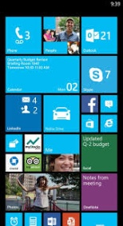
WE8.1H Enterprise Advantages
Released May 2014
Security Architecture Inherited from the Desktop
Secure Boot, Bitlocker Encryption, Application Sandboxing
Shared Kernel Delivers Consistent User Experience
Common Developer Tool Chain; Universal Apps
Full Windows Phone App Compatibility
Enterprise Assigned Access
Lockdown Experience, Multiple User / Role Support
Extra APIs to Enable Data Sharing by Enterprise Signed Apps
Remote Management and Provisioning
Open MDM Protocol
Controllable OS Update Rollout
WE8.1H – Now Enterprise Ready

Slide 33
Traditional “Spec” – Side by Side
 | TC55 | Zebra MC40 | Dolphin 75e | Zebra TC70
CPU | Qualcomm Snapdragon S4 1.5 GHz | OMAP4 - 800 GHz | QC Snapdragon 800 Quad-core 2.26 GHz | QC Snapdragon 600 – Dual-core 1.7 GHz
Storage | 1 GB / 8GB | 1GB / 8GB | 2GB/ 8GB | 1GB / 8GB
O/S | Android 4.1 | Android 4.1 | Android 4.4 WE8.1H | Android 4.4
Scanner | 1D/2D Barcode Scanner | SE41D/2D Scanner | 1D/2D Barcode Scanner | SE4750 – 1D/2D Scanner
Radio | 802.11 a/b/g/n BT 4.0 / WWAN LTE | 802.11 a/b/g/n BT 2.1 | 802.11 a/b/g/n/ac BT 4.0 / BTLE | 802.11 a/b/g/n BT 4.0 / BTLE
Battery | 2,940 mAh | 2,680 mAh | Standard 1670 mAh Extended 3340 mAh | 4,620 mAh
Accessories | N/A | MSR Reader | TBD | MSR Reader / Scan Handle
List Price | $1,400 | $1,500 | $1700 | $2,095
Online Avg. Reseller Price | $1,039 | $1,139 | TBD | $1,571

Slide 34
Value Based Drivers Side-by-Side
 | TC55 | Zebra MC40 | Dolphin 75e | Zebra TC70
Form Factor | Fully Touch – Light Rugged / Boot Recommended | Fully Touch – Heavy/Metal exterior adds unnecessary weight | Fully Touch – Light / Sleek design with a focus on Ergonomics | Fully Touch – Heavy/Rubber bumper exterior reduces Ergonomics
Architecture | Purpose Built - OMAP Standard Architecture | Purpose Built - OMAP Standard Architecture | High-end “Consumer-Like” architecture See QC Study | Mid-range “Consumer-Like” architecture See QC Study
O/S | Android 4.1 | Android 4.1 | Android 4.4 WE8.1H | Android 4.4
Use-case Performance (Battery + CPU + WLAN) | Standard AIDC battery-life | Standard AIDC battery-life | 25 – 30% improvement over QC 600 See QC Study | Improvement from adding mAh and significant weight
Accessories | Unique for TC55devices | Unique for MC40 devices | Fully Compatible with existing Dolphin 70e, including Common Quad battery Charger | Unique for TC70
List Price | $1,400 | $1,500 | $1700 | $2,095
Online Avg. Reseller Price | $1,039 | $1,139 | TBD | $1,571

Slide 35
Value Proposition for Dolphin 75e
Training improvements during on-boarding have a savings of $3,000 - $5,000 per employee hire, large retailers can save $15m in HR costs on-boarding their seasonal/new employees for for [INSERT WORKFLOW]
Performance & wireless connectivity improves mobile worker productivity by $8,000 – $10,000 additional revenue per employee per year, generating for for [INSERT WORKFLOW an additional $7.2m in upside using latest CPU & WLAN
Multi-application environments allow for more offerings on fewer devices with a potential savings of $200 - $300 per device, releasing $2.5m in CAPEX for [INSERT WORKFLOW] to re-invest in their other mobile workflows strategies

Slide 36
Managed Services
Honeywell is a Gartner Magic Quadrant Recognized Provider of Managed Mobility Services (MMS) and is the MMS Partner for many strategic HSM Projects
Device Deployment
Initial preparation, configuration and provisioning of mobile devices.
Helpdesk Support
Branded helpdesk designed to assist end-users with hardware, software, application and connectivity issues,
Device Depot
Management of spare pool, overnight device replacement, inoperable device collection, warranty management & recycling.
MDM Administration
Day-to-day administration of the MDM environment.
Honeywell has the capabilities to compliment end-users and your partners’ complete the deployment and helpdesk support needs

