Slide 1
Channel Marketing
Honeywell healthcare campaign
9/12/16
Partner Launch Kit

Slide 2
Campaign Timeline
Deposit payment due
Email #1 September 20th
2nd payment due September 20th
Launch telemarketing September 26th
Email #1 resend September 27th
Email #2 October 5th
Email #2 resend October 11th
Email #3 November 8th
Email #3 resend November 16th
Telemarketing wrap up November 17th
Telemarketing close out December 14th
Email #4 December 7th

Slide 3
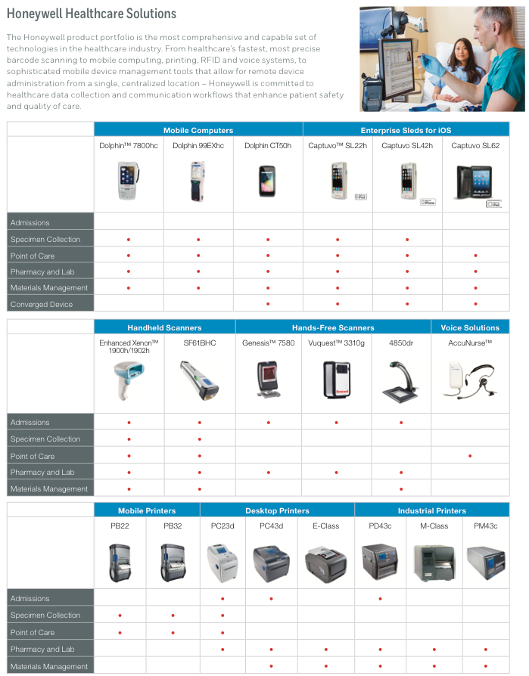
Featured Products
Honeywell Healthcare Solutions
Dolphin CT50h Mobile Computer
PB22 and PC23d Barcode Printers
Xenon Cordless Scanners
Workstation on Wheels

Slide 4
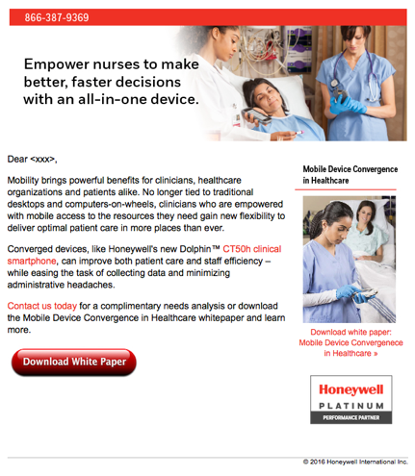
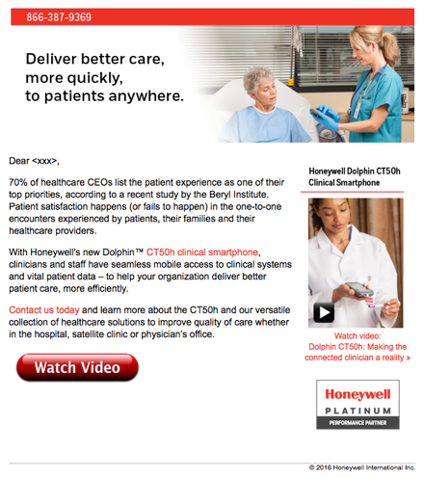
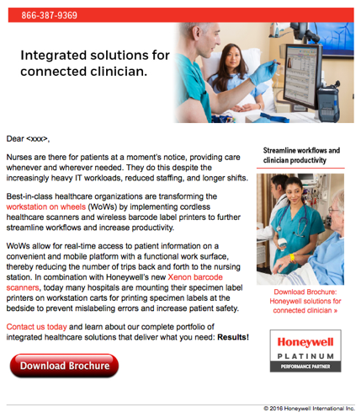
End-User Emails
Email #1
Mobile device convergence in healthcare
Email #2
Dolphin CT50h clinical smartphone
Email #3
Honeywell solutions for connected clinician

Slide 5
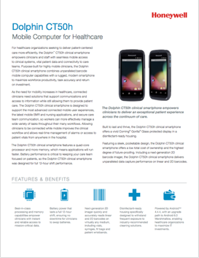
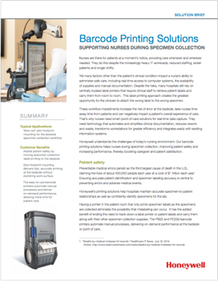
Customer Facing Collateral
Collateral co-branded with partner logo and contact information.
Innovation in Practice – healthcare brochure
A Nurse’s Perspective – application brief
Mobile Device Convergence in Healthcare – white paper
The Connected Clinician – white paper
Dolphin CT50 – data sheet
PB22 Series – data sheet
PC Series – data sheet
Enhanced Xenon 1902h – data sheet
Xenon Cordless Scanner – data sheet
Dolphin CT50h – accessory catalog
Barcode Printing Solutions – solution brief
Attention VPN Users
You may receive an error message when connecting to Dropbox. If you do, please take these steps to access Dropbox:
Log-out of VPN
Exit your browser
Relaunch your browser
Click on the Dropbox link
Co-branded assets can be downloaded from Dropbox link in your email

Slide 6
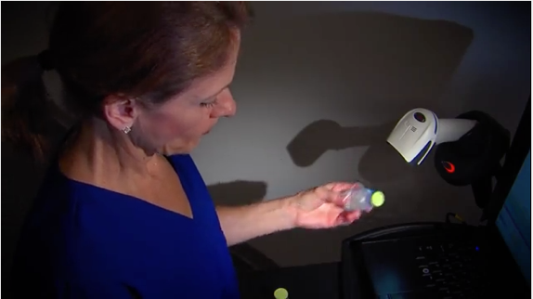
Customer Facing Video Files
Honeywell in Healthcare
https://youtu.be/8j7Khc1QFZg
Dolphin CT50h
https://youtu.be/6C9XLoeF_tM
Hands Free Meds Administration
https://youtu.be/Yrvth-zN8BM

Slide 7
Sales Tools
Dolphin CT50h Sales Playbook – pdf
Dolphin CT50h Partner Training – PowerPoint
Dolphin CT50h End-User Sales Presentation – PowerPoint
Attention VPN Users
You may receive an error message when connecting to Dropbox. If you do, please take these steps to access Dropbox:
Log-out of VPN
Exit your browser
Relaunch your browser
Click on the Dropbox link
Sales tools can be downloaded from Dropbox link in your email

Slide 8
Lead Definitions
Phone Appointment
Prospect has agreed to a phone appointment with a sales rep. Prospects should be contacted by sales professional and nurtured until they are ready to purchase.
A Lead
Leads with a project, budget and a timeline OR a prospect requests a sales rep to contact them with specific information and may not have shared budget or timeline. Prospects should be contacted by sales professional and nurtured until they are ready to purchase.
B Lead
Leads with a project, may or may not have a budget or defined timeline. Prospects should be contacted by sales professional and nurtured until they are ready to purchase.
C Lead
Leads with revenue potential in the future. They are interested in receiving information and communication in the next 30 to 90 days. Prospects should be contacted by telesales and nurtured until they transition to an A or B lead.
D Lead
Email click-through, individuals who downloaded a whitepaper or prospects who requested specific information sent to them.
Prospects should be contacted by telesales and nurtured until they transition to an A or B lead.
Phone, A and B Leads will be sent immediately. C and D Leads will be distributed at the close.

Slide 9
Partner Action Items
HPC will send you leads after we launch telemarketing
You will receive an email with the leads attached in a .xlsx format
Please review the spreadsheet – specifically the following columns:
Column O – lead status (categorized by agents)
Column P – call date (when the call was made)
Column Q – agent notes (actions and required next steps)
Follow-up with the prospects with the information requested.
For phone appointments, send the prospects a calendar request for the appointment along with the information they requested before the call.
Problems or concerns with a lead?
Contact HPC within 2 days to review, refresh or receive a new lead.
480-349-9263
Questions or Comments about the leads? call HPC: 480-349-9263

Slide 10
Contact Information
Product and Solution Support
Doug Brown
Honeywell Healthcare Industry Expert
Doug.Brown@Honeywell.com
Esther Han
Honeywell Channel Marketing Manager
Esther.Han@Honeywell.com
Campaign Execution Support
Walter Mikaelian
Honeywell Partner Concierge Lead
Walter@PartnerConcierge.com
602-692-1361
Ben Chaney
Honeywell Partner Concierge Program Manager
Ben@PartnerConcierge.com
623-386-7171

Slide 11
Thank you for your continued support

