Slide 1
SR31T Introduction
Julie Onephandara - June 30, 2013

Slide 2
Content
SR31T Line Up
  Product Line Positioning
  Product Overview & Value Proposition
  Model Number Configurator
  SR31T Family
Target Markets & Applications
Launch Schedule
  Availability
  Transition Plan
  SR30 vs SR31T
Pricing & Competition
Marketing Collaterals

Slide 3
SR31T Line Up

Slide 4
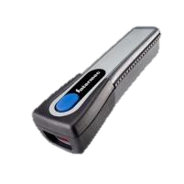
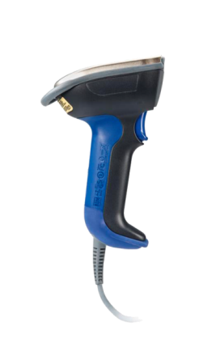
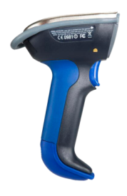
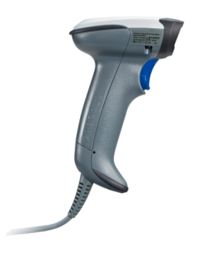
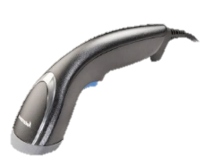
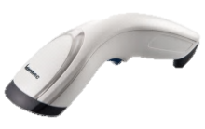
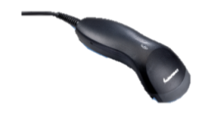
Product Line Positioning
Current
Industrial
Light
Industrial
Price
SF51
General Duty
SR61B
SR61T
SR30
Value Scanner
SG20 Family
SG10T Tethered
Ruggedness

Slide 5
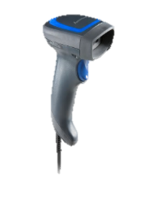
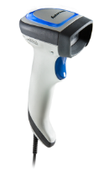
Product Line Positioning
New
Industrial
Price
General Duty
SF51
SR61B
SR61T
Value Scanner
Includes
1D & 2D models
Healthcare model
Wide range of acccessories
SR31T Family
SG20 Family
SG10T Tethered
Ruggedness

Slide 6



Redefining General Duty
  Class leading scanning performance with class leading motion tolerance
  Enhanced and leading drop (1.83m/6ft), IP (IP53) rating & tumble test (Over 2,000) for general duty
  Oversized LED indicator & Vibrator
  Accessories include cables, stands, holders
  5 years warranty

Slide 7
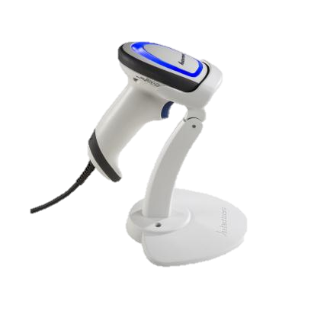
SR31T Model Number Configurator
SR31T xx-x xx xxx
Revision
001 = Standard Initial Revision
00x = Revision level
Accessories
U = USB cable
A= Adjustable Stand
Casing
S = Standard Dark
H= Healthcare
Scan Engine
HP = High Performance Laser 2D (EA30)
2D = High Performance LED 2D (EA31)
1D = Linear Imager (EV series)
2D
- H
UA
SR31T
001
Type
T = Tethered

Slide 8


SR31T Family
12 scanner models
Engine | Picture | Part Number | Description
1D (EV14+) |  | SR31T1D-S001 | SR31T1D (EV14+) LINEAR IMAGER
 |  | SR31T1D-SU001 | SR31T1D W/ USB CABLE
 |  | SR31T1D-SUA001 | SR31T1D W/ USB CABLE AND ADJ STAND
2D (EA31) |  | SR31T2D-S001 | SR31T2D (EA31) 2D IMAGER, LED
 |  | SR31T2D-SU001 | SR31T2D W/USB CABLE
 |  | SR31T2D-SUA001 | SR31T2D W/USB CABLE AND ADJ STAND
HP (EA30) |  | SR31THP-S001 | SR31THP (EA30) HP, 2D IMAGER, LASER
 |  | SR31THP-SU001 | SR31THP W/USB CABLE
 |  | SR31THP-SUA001 | SR31THP W/ USB CABLE AND ADJ STAND
HC (EA31) |  | SR31T2D-H001 | HC SR31T2D (EA31) 2D IMAGER, LED
 |  | SR31T2D-HU001 | HC SR31T2D W/ USB CABLE
 |  | SR31T2D-HUA001 | HC SR31T2D W/ USB CABLE AND ADJ STAND
Scanner Only
Channel Friendly Kit

Slide 9
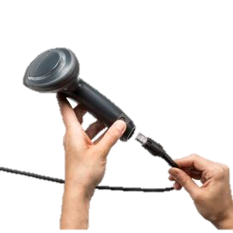
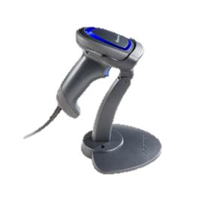
SR31T Family
Accessories available at launch
Accessories | Part Number | Description
Cables | SR31-CAB-K001 | KBW Cable, Str, PS2, Y Connection, 6.5ft
 | SR31-CAB-R001 | RS232 Cable, Str, 9 pin fem w/ PSU,6.5ft
 | SR31-CAB-U001 | USB Cable, Straight, 6.5ft
 | SR31-CAB-U002 | PWD USB Cable, Straight, w/ PSU, 6.5ft
Stands | SR31-STA-0001 | SR31 Adjustable Stand Dark
 | SR31-FLX-0001 | SR31 Gooseneck Stand Dark
 | SR31-STA-H001 | SR31 Adjustable Stand HC White
Same discount structure for cables and accessories
→ Enables easy partner Mix n’ Match kitting.

Slide 10
Target Markets & Applications

Slide 11
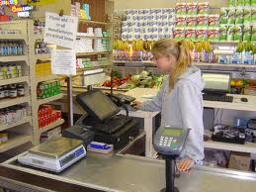

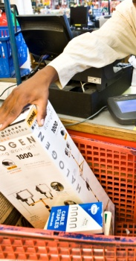
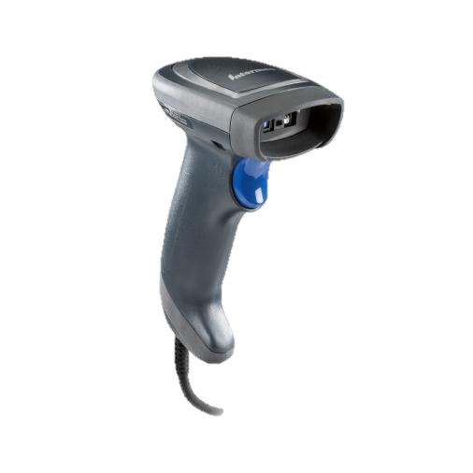
Target Markets: In Store Retail
Target App: POS Counter top Scanning
  Department / Mass Merchants
  Mall Specialty shops (Abercrombie, Gap)
  Liquor Stores / Gift Shops / Florists
  Secondary Scanner at POS (Grocery, DIY, Warehouse clubs)
  Drug / Pharmacy (CVS, Boots, Walgreens)
  CEP retail counters (FedEx Store, UPS store, USPS)
  Library Desk (Book check out/in)
Purchase Decision
  IT and or Store Operations
  Influenced by end user tests
Needs
  Durable and Reliable
  Affordable
  High Performance
  Hands free stand auto trigger

Slide 12
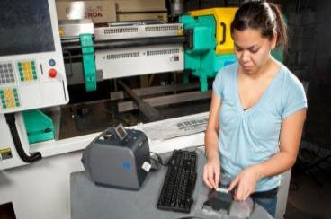


Target Markets: Manufacturing
Primary Target Applications
  Assembly Line, Work-in-Process flow
  Shipping / Receiving dock door
  Tool crib asset tracking
Purchasing Decision
    Economic Buyer – Operations Manager
    Influencer – IT Director
    End User – Assembly & Back room personnel
Needs
  Speed and Accuracy
  Durable & Reliability
  1D & 2D capability
  Adapted operator’s feedback to noisy environment
  (Adjustable vibrator & beeper)

Slide 13
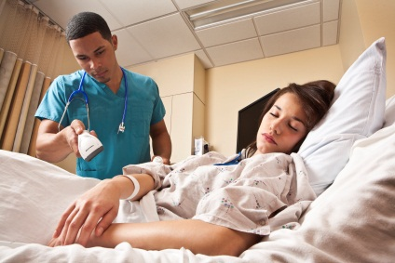
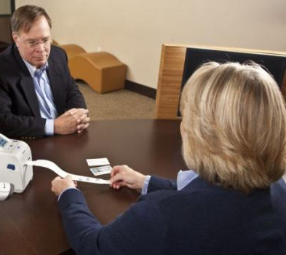
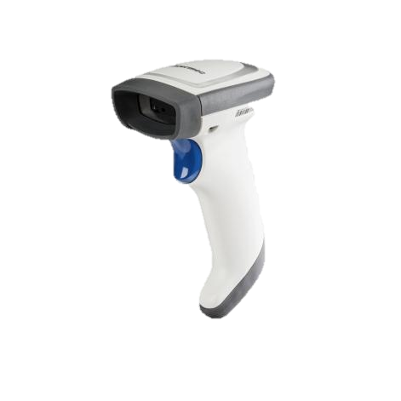
Target Markets: Healthcare
Target applications
  Meds dispensing
  Admissions
  Asset tracking
  Pharmacy
  Specimen tracking
Purchasing Decision
  Economic Buyer – Department IT (Business Ops, Laboratory, Pharmacy)
  Influencer – ISV and software application provider
  End User – Admissions staff, Nurses, Pharmacist
Needs
  Ensure 5 rights of patient safety
  Disinfectant Resistant Housing
  Omni-directional 2D reader
  Durable and Reliable
  Silent mode (No beep, No LED)

Slide 14
Launch Schedule

Slide 15
Availability Schedule
Timing | Event
June 18 | Public announcement; public site goes live Preliminary PP & Pre-recorded WebEx sales training
Mid July | BDU’s Distribution
End July - Beg August | Production start
Beg August | Q3 Honeywell Price Guide
End Aug | Distributors stocked Co-brandable materials on IN Partner Concierge
Sept | Awareness and Demand generation activities begin

Slide 16
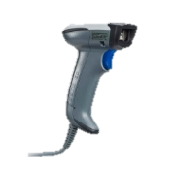
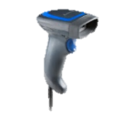
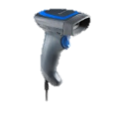
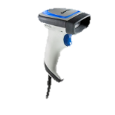
Transition Plan
 | SR30 | SR31
1D | SR30AV (EV12) | SR31T1D (EV14+)
2D | SR30AA (EA15) | SR31T2D (EA31) SR31THP (EA30)
HC |  | SR31T2D-H (EA31)
Objectives :
Must not stall or delay existing run rate for the SR30 line
→ 1 year transition period from SR31T product availability
October : First EOB notice

Slide 17
SR30 vs SR31T
 | SR30 | SR31
1D Scan Engine Reading Range | EV12 5 - 84 cm (2 - 33.1 in) | EV14+ 3.5 – 86 cm (1.4 – 33.4 in)
2D Scan Engine Motion Tolerance Reading Range Aimer | EA15 Below 10 in/s 0 – 83 cm (0 – 32.4 in) LED | EA31 400 in/s 3 – 116 cm ( 1.2 – 45.7 in) LED | EA30 500in/s 3 – 124 cm ( 1.2 – 48.8 in) Laser
Healthcare version | None | Yes
Image Capture | USB 1.1 | USB 2.0 Full Speed
Drop Specs | 26 drops from 1,5m (5 ft) | 26 drops from 1,83m (6 ft)
IP Rating | IP30 | IP53
Storage temperature | -20°C to +70°C (-4°F to +158°F) | -20° C to 60° C (-4° F to 140° F)
User interface | Beep | Beep, LED, Vibrator

Slide 18
Pricing & Competition

Slide 19


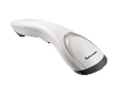

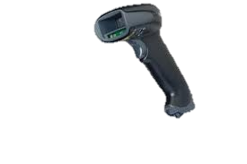
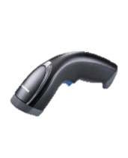
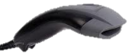
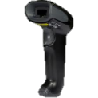
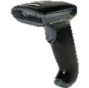
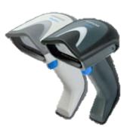

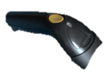
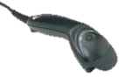
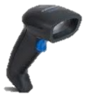

Competitive Positioning
General Duty Category
SR31T
Performance
Motorola 2208 & 4208
HON
Xenon
Value Scanners
SG20 Family
DataLogic
Gryphon
SG10
Price

Slide 20
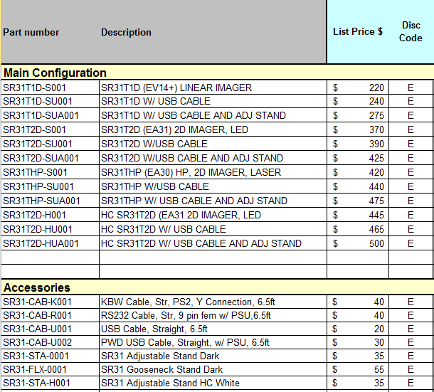
$ US Pricing
Strategy :
Be in line vs. key competition
Mix n’ Match Policy
  $ 20 for the USB kit
  $ 55 for the USB + Adj Stand kit
2D segment
  Apply $50 premium between 2D and HP version

Slide 21
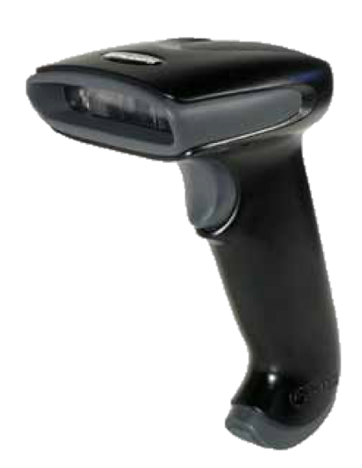
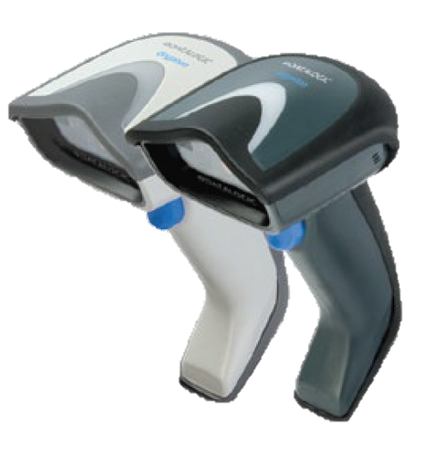
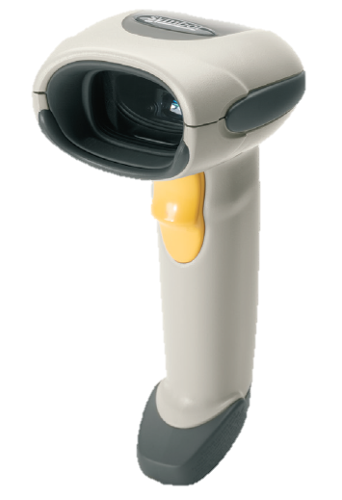
1D Competitive landscape (US)
 | Hyperion 1300G | SR31T1D-S001 | GD4130-BK | LS4208
Engine |  | EV14+
Scan pattern | Single line | 617nm Highly Visible LED | Dual LED Array 630 - 670 nm | 650 nm laser diode
Motion tolerance | 20 in/s |  |  | 200 in/s
Scan rate | Up to 270 scans/s max | 200 scans/s max | 325 scans/s max | 200 scans/s max
Print contrast | 20% minimum reflectance difference | down to 25% | 15% | 25% minimum reflectance difference
Reading distance (DOF)
Code 39 - 5 mils | 2.0˝ - 8˝ (6”) 5 - 20 cm (15 cm) | 1.38” – 9.45” (8.07”) 3.5 – 24 cm (20.5 cm) | 2.3” - 7.0” (4.7”) 6.0 - 18.0 cm (12cm) | 1.5” - 5.5” (4.0”) 3.81 - 13.97 cm (10.16 cm)
Code 39 - 10 mils | 1.0˝ - 15˝ (14”) 3 - 38 cm (35 cm) | 1.38” – 12.2”(10.83”) 3.5 – 31.0 cm (27.5 cm) | 0.8” - 17.7”(16.9”) 2.0 - 45.0 cm (43.0 cm) | 0.0” - 14.0” (14.0”) 0.00 - 35.56 cm (35.56 cm)
100% UPC – 13 mil | 0.5˝ - 18˝ (17.5”) 1 - 46 cm (45 cm) | 1.26” – 12.40” (11.14”) 3.2 – 31.5 cm (28.3 cm) | 1.2” - 23.4” 3.0 - 60.0 cm (57.0 cm) | 0.0 - 19.0” ( 19.0”) 0.00 - 48.25 cm (48.25 cm)
Operating temperature | 0° to 50° C +32°F to +122°F | 0° to 50° C +32°F to +122°F | 0 to 55°C +32°F to +131°F | 0° to 50° C +32°F to +122°F
Storage temperature | -40° to 60° - 40°F to +140F | -20° to 70° - 4°F to +158°F | -20° to 70° - 4°F to +158°F | -40° to 70° - 40°F to +158°F
Humidity | 0-95% non condensing | 5-95% non condensing | 0-90% | 5-95% non condensing
Drop | 50 drops to 1,5m concrete | 26 drops to 1,83m concrete | 18 drops to 1,8m concrete | Multiple drops to 1,8m concrete
Tumble test |  | Over 2000
Environmental sealing | IP41 | IP53 | IP52 | IP43
Light levels | 0-70 000 lux | 0-100 000 lux | 0-100 000 lux | 4844-86111 lux
Scanner | $190 | $220 | $226 | $265
USB Kit | $209 | $240 | $239 | $292
USB + Stand kit |  | $275

Slide 22
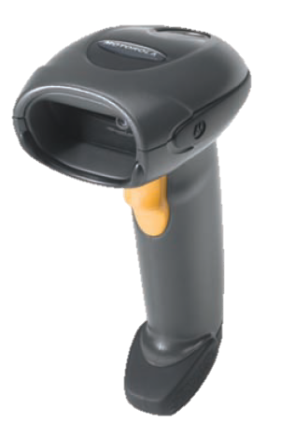

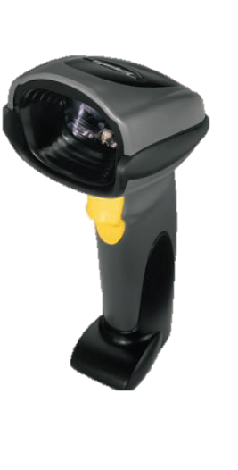
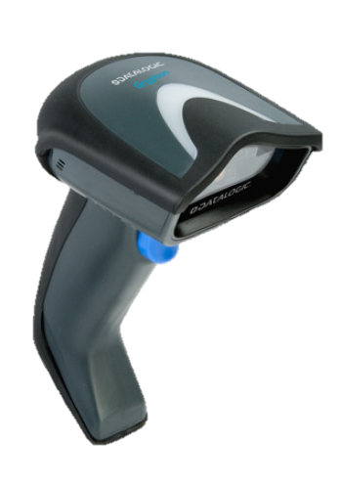

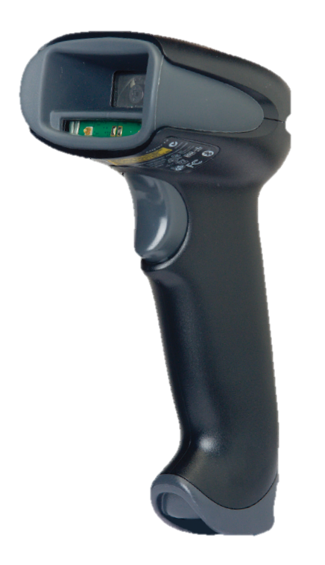
2D Competitive Landscape (US)
 | DS4208 | SR31T2D-S001 | DS6707 -SR | GD4430 | SR31THP-S001 | Xenon 1900 SR
Engine |  | EA31 |  |  | EA30
Scan pattern | Aiming pattern: 617 nm LED Illumination: 625 nm LEDs | LED | Aiming: 650 nm laser diode Illumination: 630 nm LED | LEDs | Laser | LED
Motion tolerance | Up to 25 inch /s | Up to 400’’ or 10.16m/s | 5 in. (12.7 cm) /s |  | Up to 500’’ or 12.7m/s | 240 in/s
Print contrast | 25% mininum | Down to 25% | 25% minimum | 25% minimum | Down to 25% | 20% mininum
Reading distance (DOF)
Code 39 – 5 mil | 0.2” - 6.86” (6.84”) 0.5 - 17.3cm (16.8 cm) | 1.18”– 9.06” (7.87”) 3 – 23 cm (20 cm) | 1.1 ”- 6.5 ” (5.4”) 2.8-16.5 cm (13.7 cm) | 1.6” -7.5”(5.9”) 4.0 - 19cm (15 cm) | 1.18''– 10.24”(9.06”) 3 – 26 cm (23 cm) | 1.1˝ - 5.3˝(4.2˝) 2.79 -13.46 cm (10.67 cm)
100% UPC – 13 mil | 0.3 ” - 15.2 ”(14.9”) 0.8 - 38.6 cm (37.8 cm) | 1.57” – 15.75” (14.17”) 4 – 40 cm (36 cm) | 0.5 ”- 9.7 ”(9.2”) 1.3 - 24.6 cm (23.3 cm) | 0.6” - 15.7” (15.1”) 1.5 - 40cm (38.5 cm) | 1.57 – 18.11” (16.54”) 4 – 46 cm (42 cm) | 0.4 – 17.3'' (16.9˝) 1.02 – 43.94 cm (42.92 cm)
Datamatrix – 10 mil | 0.4 ” - 7.2 ” (6.8” ) 1.0 - 18.3 cm (17.3 cm) | 1.57” – 7.09” (5.51”) 4 – 18 cm (14 cm) | 1.1” - 7.5 ” (6.4”) 2.8 - 19.1 cm (16.3 cm) | 0.8” - 6.3” (5.5 ”) 2.0 - 16cm (14 cm) | 1.97” – 8.27” (6.3”) 5 – 21 cm (16 cm) | 0.5˝ - 7.5˝ (7.0˝) 1.27 - 19.05 cm (17.78 cm)
Operating temperature | 0° to 40° C +32°F to +104°F | 0° to 50° C +32°F to +122°F | 0° to 50° C +32°F to +122°F | 0° to 55° C +32°F to +131°F | 0° to 50° C +32°F to +104°F | 0° to 50° C +32°F to +104°F
Storage temperature | -40° to 70° - 40°F to +158°F | -20° to 70° - 4°F to +158°F | -40° to 70° - 40°F to +158°F | -20° to 70° - 4°F to +158°F | -20° to 70° - 4°F to +158°F | -40° to 70° - 40°F to +158°F
Drop | Withstands multiple 6 ft. (1.83 m) drops to concrete | 26 drops to 1,83m concrete | Withstands multiple 6 ft. (1.83 m) drops to concrete | 18 drops to 1,83m concrete | 26 drops to 1,83m concrete | 50 drops to 1,8 m concrete
Tumble test |  | Over 2000 |  |  | Over 2000
Environmental sealing | IP43 | IP53 | IP41 | IP52 | IP53 | IP43
Light levels | 1600 - 86 000 lux | 0-100 000 lux | Immune to normal artificial indoor and natural outdoor (direct sunlight) lighting. | 0-100 000 lux | 0-100 000 lux | 0-100 000 lux
Scanner | $308 | $370 | $389 | $406 | $420 | $449
USB Kit | $338 | $390 | $416 | $423 | $440 | $467
USB + Stand kit |  | $425 |  | $438 | $475 | $582

Slide 23
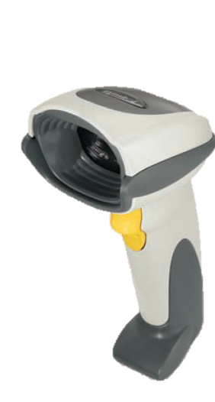
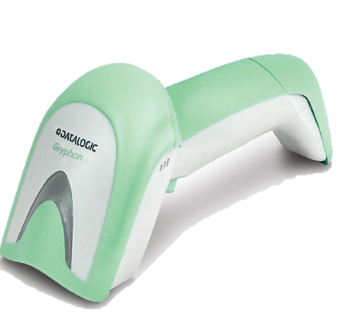
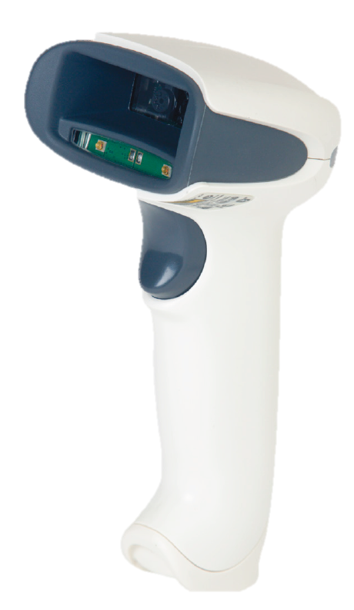
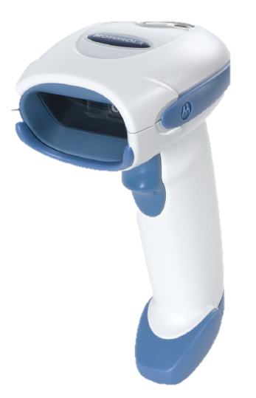
HC Competitive Landscape (US)
 | DS4208 | DS6707 -SR | SR31T2D-H001 | GD4430 | Xenon 1900 HD
Scan pattern | Aiming pattern: 617 nm LED Illumination: 625 nm LEDs | Aiming: 650 nm laser diode Illumination: 630 nm LED | LED | LEDs | LED
Motion tolerance | Up to 25 inch /s | 5 in. (12.7 cm)/s | Up to 400’’ or 10.16m/s |  | 240 in/s
Print contrast | 25% mininum | 25% minimum | Down to 25% | 25% minimum | 20% mininum
Reading distance
Code 39 – 5 mil | 0.2” - 6.86” (6.84”) 0.5 - 17.3 cm (16.8 cm) | 1.1 ”- 6.5 ” (5.4”) 2.8 - 16.5 cm (13.7 cm) | 0.79”– 7.87” (7.08”) 2 – 20 cm (18 cm) | 1.6” -7.5”(5.9”) 4.0 - 19cm (15 cm) | 0˝ - 4.1˝(4.1˝) 0 - 10.41 cm (10.41 cm)
100% UPC – 13 mil | 0.3 ” - 15.2 ”(14.9”) 0.8 - 38.6 cm (37.8 cm) | 0.5 ”- 9.7 ”(9.2”) 1.3 - 24.6 cm (23.3 cm) | 1.18” – 14.96” (13.78”) 3 – 38 cm (35 cm) | 0.6” - 15.7” (15.1”) 1.5 - 40cm (38.5 cm) | 0.4 – 6.6'' (6.2˝) 1.02 – 16.76 cm (15.74 cm)
Datamatrix – 10 mil | 0.4 ” - 7.2 ” (6.8” ) 1.0 - 18.3 cm (17.3 cm) | 1.1” - 7.5 ” (6.4”) 2.8 - 19.1 cm (16.3 cm) | 1.18” – 6.69” (5.51”) 3 – 17 cm (14 cm) | 0.8” - 6.3” (5.5 ”) 2.0 - 16cm (14 cm) | 0˝ - 5˝ (5˝) 0 - 12.7 cm (12.7 cm)
Operating temperature | 0° to 40° C +32°F to +104°F | 0° to 50° C +32°F to +122°F | 0° to 50° C +32°F to +122°F | 0° to 55° C +32°F to +131°F | 0° to 50° C +32°F to +122°F
Storage temperature | -40° to 70° - 40°F to +158°F | -40° to 70° - 40°F to +158°F | -20° to 70° - 4°F to +158°F | -20° to 70° - 4°F to +158°F | -40° to 70°
Humidity | 5-95% non condensing | 5-95% non condensing | 5-95% non condensing | 5-90% non condensing | 5-95% non condensing
Drop | Withstands multiple 6 ft. (1.83 m) drops to concrete | Withstands multiple 6 ft. (1.83 m) drops to concrete | 26 drops to 1,83m concrete | 18 drops to 1,5 m concrete | 50 drops to 1,8 m concrete
Tumble Test |  |  | Over 2000
Environmental sealing | IP43 | IP41 | IP53 | IP52 | IP41
Light levels | 1600 - 86 000 lux | Immune to normal artificial indoor and natural outdoor (direct sunlight) lighting. | 0-100 000 lux | 0-100 000 lux | 0-100 000 lux
Scanner | $348 | $439 | $445 | $447 | $485
USB Kit | $378 |  | $465 | $464 | $504
USB + Stand kit |  |  | $500

Slide 24
Marketing Collaterals

Slide 25
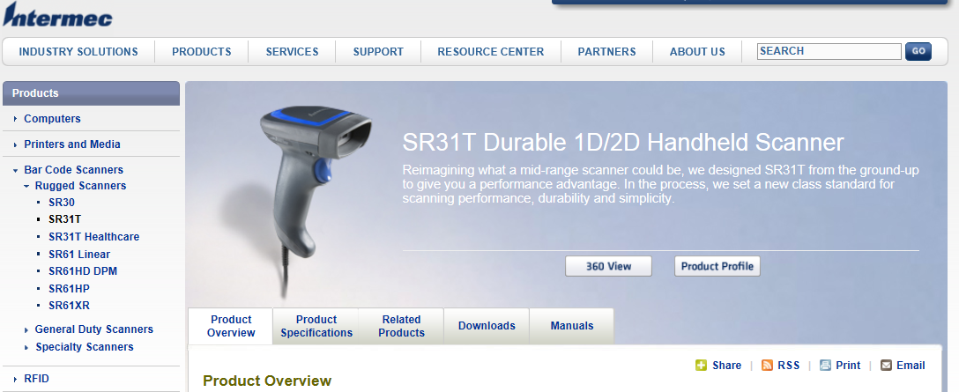
Where to find more info?
Rugged Scanner section on Insider
Look at the resources tab for each product to find more support material :
Available now : Preliminary Product Profile, Sales PPT, Pre-recorded Webex Training
Available in September : Final Product profile, FAQ, Migration Guide, Competitive Info, Accessory Guide
Approved Disinfectant, Product Videos, Updated Product Matrix

Slide 26
SR31T Summary
Durable General Duty Scanner
Available in 1D, 2D, HP and HC
User’s interface : Oversized LED, Beeper & Vibrator
Better Drop, IP rating and Tumble test specs
Wide range of accessories
Target markets : In-Store Retail, Manufacturing,
Healthcare
Competitive list prices

