Slide 1
Introducing the Dolphin™ CT50 Mobile Computer
Presented by:
Steven Ortley, Global Product Management
Jessica Cavalier, Global Marketing Communications

Slide 2
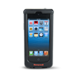
Handheld Mobile Computer Portfolio
BYOD
Durable
Rugged
Ultra Rugged
SL22/42
Sled
D60s
Scanphone
D70e/D75e
Hybrid
DCT50
“Fully Touch”
CN51
EDA
CN70
EDA
CN70e
EDA
99EX
PDT
“Consumer”
Apple® iPhone®
“Entry Level”
Pocketable
Device Consolidation
“Hybrid”
Pocketable & Usability
“Versatile”
Compact & Lightweight
Best Imaging Technologies
Larger Display with Keypad
“No Compromise”
Heavy Industrial Use
Best Imaging Technologies
Most Durable Displays
Multiple Keypad Options
Real-Time Connectivity & Data Capture.
Anytime. Anywhere.

Slide 3
Positioning HON Touchscreens
Dolphin 70e Black
Dolphin 75e
Dolphin CT50
Stable O/S
Purpose-built application environment
Require rugged device, but want a touchscreen user interface experience
Durability/ Serviceability (<5% ARR)
Entry-Level Touch Screen WWAN Device
Latest O/S
Multiple application environment
Require rugged device, but want a touchscreen user interface experience
Critical connectivity
High Performance Architecture (i.e. Galaxy S5)
WiFi only
Latest O/S
Multiple application environment
Require rugged device, but want a touchscreen user interface experience
Ruggedization upgrade
High Performance Architecture (i.e. Galaxy S5)
LTE enabled
Next Gen Scan Performance
Comprehensive Accessory Ecosystem

Slide 4
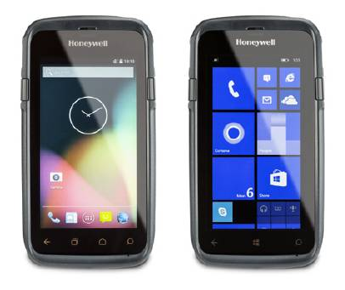
Dolphin CT50 Handheld Computer
Why
For organizations who want the ability to increase training, efficiency and accuracy of new policies while outside of the office
For organizations that want the ability to be connected to their ERP/centralized systems at speeds that increase productivity
For organizations that want the ability to rapidly deploy multiple applications into their workforce with ease to increase productivity
How
Mobile workers want a form-factor that they are accustomed to using in their personal lives, touch-screens
Organizations need to have consistent connection at speeds 4x faster than today, LTE/4G
Developers need O/S frameworks that support a rapid-prototyping mentality for SW development, Android 5.0 and Windows 8.1 (Win10)
What
Honeywell’s upcoming solution targets in-field training, LTE connectivity and easy SW deployment and it happens to be the Dolphin CT50
When
WLAN Globally // WWAN in EMEA, L. America & APAC
WWAN N. America – Q4 – 2015 – Carrier Certification
Use Cases
Specialty / On-Demand Delivery
Remote/Field Technician
Metering/Auditing
Service Contracts/Sales
Material/ Asset Tracking

Slide 5
Dolphin CT50 Value Proposition
For organizations who engage with customers in the field that want to increase training efficiency and accuracy and need to toggle between multiple applications to increase productivity and better engage customers,
- The CT50 is a truly connected device that combines smart phone ergonomics with an enterprise reliability focused design and industry-leading performance capabilities across the latest O/S platforms to enhance productivity and deliver a reduced TCO for the enterprise.
Unlike competitors which offer reduced performance capabilities, a less ergonomic form factor, and limitations in choice of O/S configuration,
- The CT50 is an easy-to-use mobile solution that empowers organizations to run 4+ applications simultaneously to address customer needs with the flexibility to select from multiple operating systems.

Slide 6
Dolphin CT50 User Personas
Customer
Has legacy automation > Wants to upgrade to a new platform
Thinking about smartphones > not happy with reliability, durability battery life, accessories, ‘locked-in’ O/S
Seeking latest device with expanded application flexibility – future-proof for next 5-8 years
Desire to re-engineer system to account for new operating systems and technologoies
Desire a high-performance scanner for over 1,000 scans per day
They differentiate from their competitors by how well they drive costs out and delight customers.
Needs and Concerns
VP of Ops – Driving accuracy and productivity; Lower TCO and Fast ROI
C-Level – Reduce total operating costs and enable business growth
IT Manager – Ease of deployment; integration with current systems; support and training
Fleet Manager Manager – Workforce performance (productivity, training, safety, ergonomics)
End-user – Easy-to-Use, is it “like my smartphone” (productivity, training, performance)
Myths, Fears and Beliefs
Believes smartphone technologies are a better alternative: “I need something that is connected and fast”
They view themselves as best practice operations already
They’ll have to fight for the capital investment, especially when their organization perceives that current solution isn’t broken
Want to lower the capital requirement by leveraging heavily subsidized consumer devices (by carriers)

Slide 7
Who benefits from Dolphin CT50 …
End-users who are highly mobile, in scan intensive workflows who interact with general consumers within their workflow
Desire a light weight, economic design, yet high performance solution
Need a mobile solution that is easy to adopt/minimize training time for seasonal employees
Is an attractive, sleek form factor ideal for use in consumer-facing workflows
IT managers that need to control costs and maintain flexibility in their mobile IT solutions
Need IT solutions that enables them to grow and adjust as business conditions change
Need tools that integrate easily with existing systems and reduce time to deploy and maintain
Strong enough solution to replace legacy PCs (the first AIDC handheld device)
Business managers that want to improve and expand their service offering to increase profitability
Need tools to help organizations migrate from ‘connected worker’ to ‘directed worker’ to improve productivity, efficiency and capability

Slide 8
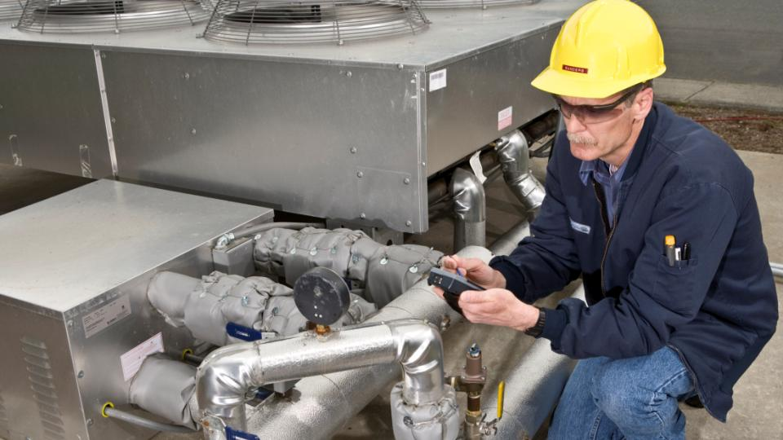
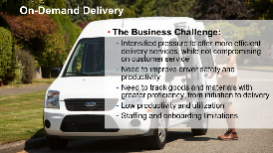
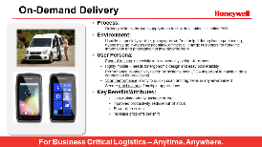
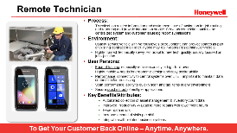
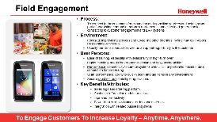
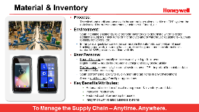
Who is your Audience – Use Case
On-Demand Delivery
Proof of Delivery
Navigation Assistance
Document Entry
Arrange displays
Price checking/ markdown
Returns management
Key Business Advantages
Increased volumes
Customer service
Faster response time to requests
Improved productivity
Remote Technician
Work-list Management
Information Distribution
Inventory maintenance
Spare/broken parts ordering
Asset protection
Key Business Advantages
Manage contract cost
Faster response time to customers
Improved cost control
Fewer data errors
Field Engagement
Price/ inventory checks
Loyalty apps
Item locator/ ordering
Clienteling
Electronic couponing
Cross channel fulfillment
Key Business Advantages
Increased sales
Better customer service
Faster response
Material & Inventory
Multi-use case environment
Barcode scanning
Inventory management
Quality/ audit
General purpose devices required
Documentation
Records maintenance
Key Business Advantages
Eliminates manual entry
Multiple apps
Optimized tasks
Audit & Metering
Inspection
Quality control
Supplier performance
Records maintenance
Product testing
Documentation
Process improvement
Compliance
Key Business Advantages
Cost-effective regulator compliance
Improved productivity
Fewer data errors

Slide 9
Dolphin CT50 – Technical details*
Display and input: | 4.7” optically bonded (for all-light readability) Touch device w/o keyboard Gloved hand usage
Durability: | 5ft/1.5m drop, 1000 1m tumble, IP67
Talk time: | Support up to 12hr duty cycle
Software: | Windows Embedded 8.1 Handheld – Upgradable to Win10 Android 4.4 – Upgradeable to Android M
Data capture: | 8MP Auto Focus w/ Flash (rear) High-performance 2D with laser aimer
Connectivity: | LTE/GSM, CDMA, 802.11 a/b/g/n/ac BT Low Energy 4.0, NFC, Dual-SIM
Performance: | Qualcomm 2.26 GHz Quad-core, 2GB RAM + 16GB Flash
Other: | Peripherals including docking systems and vehicle cradles for target environments, Smart battery monitoring & long-battery life
Target Segments | On-Demand Delivery, Remote Technician, Field Engagement, Audit & Metering, Materials Inventory
*Specifications subject to change
Pictures are not final / not Honeywell property

Slide 10
Dolphin CT50 Handheld Computer
As Honeywell’s first LTE touch-only device, the ultra-slim Dolphin™ CT50 integrates industry-leading processing power and best-in-class imager from Honeywell for customers who seek high productivity in various mobile environments.
Program Summary
Key Product Differentiators | Ultra-Slim and Rugged Design: Pocketable and lightweight design, combined with the reliability and longevity of an IP67 rating, maximizes end user experience and investment. Unparalleled Scanning Performance: Next generation 2D imager delivers best-in-class data capture performance on linear and 2D barcodes. To complement the performance, ergonomic scan trigger keys have been developed for CT50. Powerful, Versatile Platform: Industry-leading Qualcomm Snapdragon 800 processing power with 2.3GHz quad-core CPU enables advanced performance and power efficiencies with the flexibility to support both WE8H and Android O/S configurations. Peripherals Designed to Enhance Workflow: Specialized for target DEs to empower mobile workers and maximize workflow efficiency. Large Touch Screen Display: Large 4.7” brilliant all-light readable multi-touch display that is perfect for inside or outside use cases. Extensive Software Options: Value-add software options include Industrial browser, Device management, Signature capturing, Launcher, PoD, Navigation, Package tracking, and more.

Slide 11
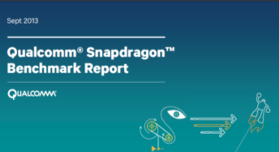
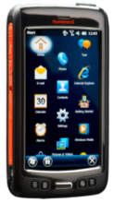
Honeywell Architecture – DCT50 & D75e
Honeywell invested in the Snapdragon 800 series quad-core Qualcomm processor architecture which is more complex than dual-core Qualcomm processor, key benefits are:
Qualcomm study highlights that Honeywell architecture is 25 – 50% faster and has 25-30% more battery life than the Next Best Alternative.
“Make no mistake, MSM8974 is the new high-end, pushing Snapdragon 600 and S4 Pro parts further down into midrange category.”
Page 3
“One of the things Qualcomm promised would come with Snapdragon 800 (8974) (and by extension the process improvement with 28nm HPM) was lower power consumption, especially versus Snapdragon 600 (8064).”
Page 4

Slide 12
What Does that Mean for AIDC Landscape?
TC55 ✗ vs. D75e✓
D75e is 76% better from overall Performance
D75e is 2.7x faster from a multi-core Performance
D75e has 2.2x better memory performance
Geekbench Results: https://browser.primatelabs.com/geekbench3/compare/2695782?baseline=2937005
MC40✗ vs. D75e✓
D75e is 3.8x better from overall Performance
D75e is 6x faster from a multi-core Performance
D75e has 7.8x better memory Performance
Geekbench Results: https://browser.primatelabs.com/geekbench3/compare/2695849?baseline=2937005
TC70 ✗ vs. D75e✓
D75e is 33% better from overall Performance
D75e is 2x faster from a multi-core Performance
D75e has 53% better memory performance
Geekbench Results: https://browser.primatelabs.com/geekbench3/compare/2937399?baseline=2937005
Source: All Test & Scoring Performed Via Geekbench Process of Independently Uploading a Test Results File - All Devices Tested Used Android 4.4 – KitKat Operating System
Notes:
Motorola Solutions TC700H vs Honeywell D75E
Motorola Solutions TC700HHoneywell D75EGeekbench 3 Score666892Geekbench 3 Multicore Score12402657System Information
Motorola Solutions TC700HHoneywell D75EOperating SystemAndroid 4.4.2Android 4.4.4ModelMotorola Solutions TC700HHoneywell D75EProcessorQualcomm QCT @ 1.73 GHz 1 processor, 2 coresQualcomm Qualcomm @ 2.27 GHz 1 processor, 4 coresProcessor IDARM implementer 81 architecture 7 variant 2 part 77 revision 0ARM implementer 81 architecture 7 variant 2 part 111 revision 1L1 Instruction Cache0 KB0 KBL1 Data Cache0 KB0 KBL2 Cache0 KB0 KBL3 Cache0 KB0 KBMotherboardMSM8960HSM8X74BIOSMemory832 MB1868 MBInteger Performance
Motorola Solutions TC700HHoneywell D75EInteger687882Integer Multicore13412882AES6684AES Multicore130314Twofish10401483Twofish Multicore21055414SHA112471561SHA1 Multicore24576270SHA213251739SHA2 Multicore26297061BZip2 Compress710911BZip2 Compress Multicore13293318BZip2 Decompress7771012BZip2 Decompress Multicore15473729JPEG Compress8451135JPEG Compress Multicore17104118JPEG Decompress707843JPEG Decompress Multicore14582196PNG Compress721896PNG Compress Multicore14093248PNG Decompress10071276PNG Decompress Multicore19683809Sobel585748Sobel Multicore11422587Lua632797Lua Multicore10991251Dijkstra771967Dijkstra Multicore14522814Floating Point Performance
Motorola Solutions TC700HHoneywell D75EFloating Point611786Floating Point Multicore12232970BlackScholes607843BlackScholes Multicore12343164Mandelbrot551709Mandelbrot Multicore10902832Sharpen Filter681910Sharpen Filter Multicore13853522Blur Filter7941056Blur Filter Multicore16093760SGEMM675841SGEMM Multicore12482753DGEMM384452DGEMM Multicore7411900SFFT765918SFFT Multicore15633590DFFT404537DFFT Multicore8851938N-Body587762N-Body Multicore11802894Ray Trace8651111Ray Trace Multicore16654287Memory Performance
Motorola Solutions TC700HHoneywell D75EMemory7361126Memory Multicore10741582Stream Copy14791612Stream Copy Multicore14722061Stream Scale700958Stream Scale Multicore11701541Stream Add453955Stream Add Multicore7911302Stream Triad6271092Stream Triad Multicore9781516
COMPARE
Remove Baseline
Motorola Solutions TC700H Benchmark Chart
SHARE
Tweet
Copyright 2004-2014 Primate Labs Inc. π Contact Primate Labs Built with Bootstrap from Twitter

Slide 13
CT50’s New N66xx Slim Imager Engine

Slide 14
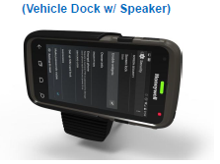
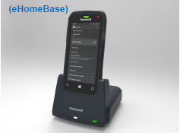
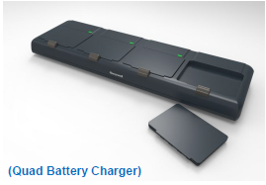
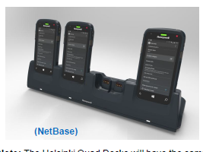
CT50 Accessories – Available at Launch

Slide 15
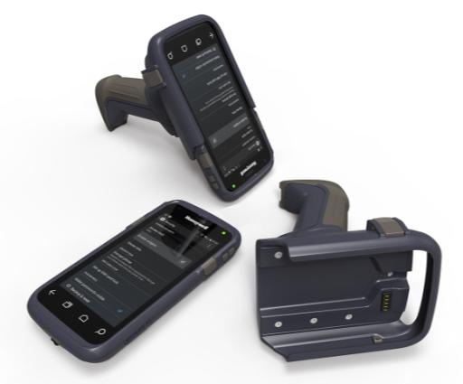
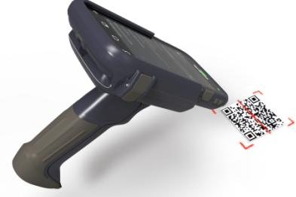
Dolphin CT50: Scan Handle

Slide 16
CT50 Value Added Solutions
HSM Value Add Feature | Android | WE8.1H
Speech to Text | Yes | Yes
Custom Scanner Settings | Yes | No
Programmatic Radio On/Off Controls | Yes | No
Device Controls: Notification LED, Vibrator | Yes | No
802.11 CCX v4 Support | Yes | No
RF Network Tools | Yes | Yes
Diagnostic Information (SysInfo / Device Health) | Yes | Yes
Printing SDK | Yes | Yes
Driver License Parsing SDK | Yes | Yes
Enterprise Launcher | Yes | No*
Scan-based Provisioning | Yes | Yes
Push-to-Talk | 3rd Party (Zello) | 3rd Party (Zello)
* Enterprise Assigned Access provides similar functionality

Slide 17
CT50 Value Added Solutions - Continued
Feature | Description | Android | WE8H
Device Health | Quick access to critical device health information Support for alerts | Yes | Yes
Virtual keypad | Keyboard Keyboard creator (in the cloud) | Yes | Native WE8H
Industrial HTML5 Browser | Locked down configurable browser Decode and Printing APIs/extensions | Yes | Yes
Document capture | SDK / Application | Yes | Yes
Total Freedom | Easy DL Easy BP | Yes | Yes
Launcher | User based access control and device settings | Yes | Native WE8H
Advanced provisioning | Cross platform Device GUI Support for local provisioning from barcode or file (ScanNGo/EZConfig/DeviceConfig) License Support | Yes | Yes
Indoor location positioning | Demo application SDK | Yes | Yes
New Data Collection Architecture (DCS) | Support for standard MS POS API (WE8H) with extension Integrated Scan out of the box Wedge Future support for other data input device (i.e. MSR, RFID, External scanner) | Yes | Native WE8H POS / Profiles

Slide 18
HSM Android Value Add Components
Scanner Settings Management
Data Wedging
Data Collection SDK
Enterprise Browser
Scanning and Printing SDKs
EZ Config / ScanNGo
Diagnostic Power Tools
Enterprise Launcher
Device Lockdown, Feature Lockdown, Application White-Listing
Enhancing Android for the Enterprise

Slide 19
WE8.1H Enterprise Advantages
Released May 2014
Security Architecture Inherited from the Desktop
Secure Boot, Bitlocker Encryption, Application Sandboxing
Shared Kernel Delivers Consistent User Experience
Common Developer Tool Chain; Universal Apps
Full Windows Phone App Compatibility
Enterprise Assigned Access
Lockdown Experience, Multiple User / Role Support
Extra APIs to Enable Data Sharing by Enterprise Signed Apps
Remote Management and Provisioning
Open MDM Protocol
Controllable OS Update Rollout
WE8.1H – Now Enterprise Ready

Slide 20
Launch Strategy

Slide 21
What to Expect from Honeywell
 | July | Aug | Sept | Oct | Nov | Dec
Product
Marketing/PR
Events
Distys Stocking Orders;
Pricing/
Skus Loaded
WLAN
EU WWAN Production Begins
WWAN Verizon Production Begins
WWAN AT&T
Production Begins
Pistol Grip Availability
DCT50
Press Announce
DCT50
Product
Announce/ Marketing Collateral Available
Change Your Perspective Campaign Materials Available
Verizon certification announce
AT&T certification announce
DCT50 Demand Gen Campaigns- T&L/ Field/ DSD
Sept. 16-18
End User Edge Conference
Phoenix
Sept. 29-Oct. 1
Post Expo
Paris
Oct. 19-21
Parcel Forum
Chicago
Oct. 19-21
World Mail Express
Manila
Sept. 23-25
Enterprise Mobility Exchange, UK
Regional Disty/ Partner Road Shows

Slide 22
Additional Resources
Available for download on HSM Partner Performance Portal (early Aug):
Product Collateral
Data sheet
Accessory guide
Feature Overview Video
Media Kit
Customer-Facing Sales Presentation
Training presentations/ recorded webinars
Battle card
White Papers/ Application Briefs
Mobile Operating System O/S
Things to Consider When Using Smartphones for Data Capture
Enterprise Advantages of VoIP
Other
Honeywell Repair Services Brochure
Available for download on HSM Partner Concierge (early Aug):
Change Your Perspectives campaign (T&L focus)
Print ad
Web banner ads
Trade show banner
E-blast
Campaign landing page
White paper

