Slide 1
Introducing the Dolphin™ CT50
Mobile Computer
Presented by:

Slide 2
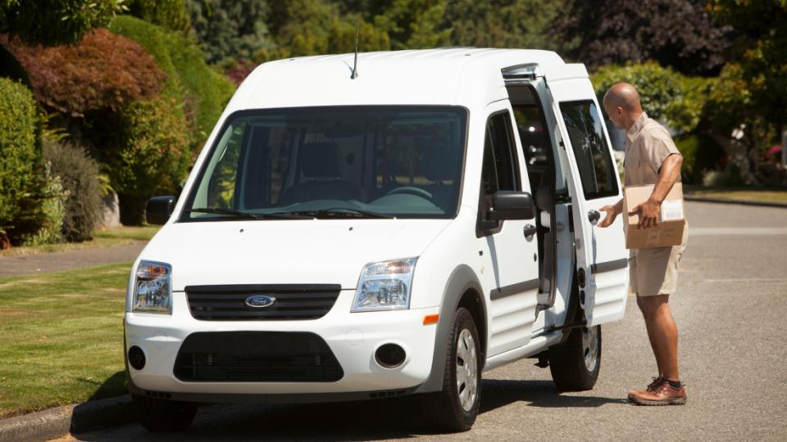
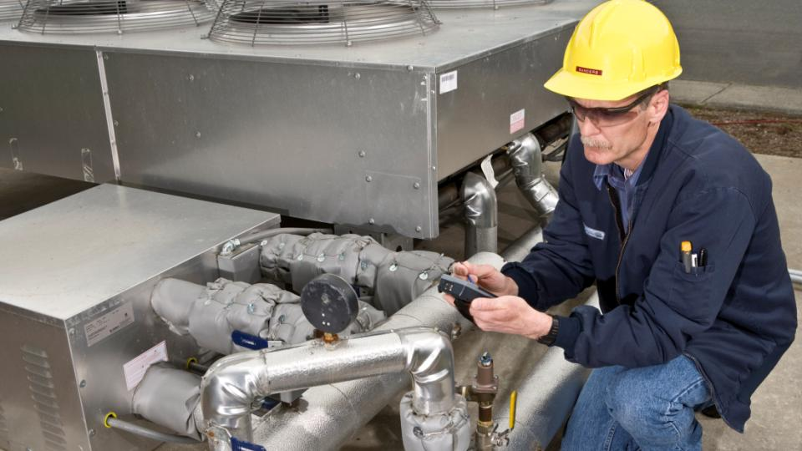

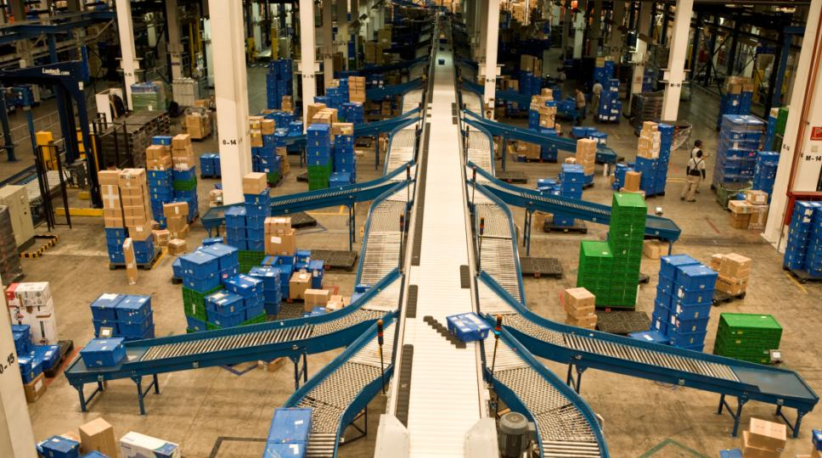
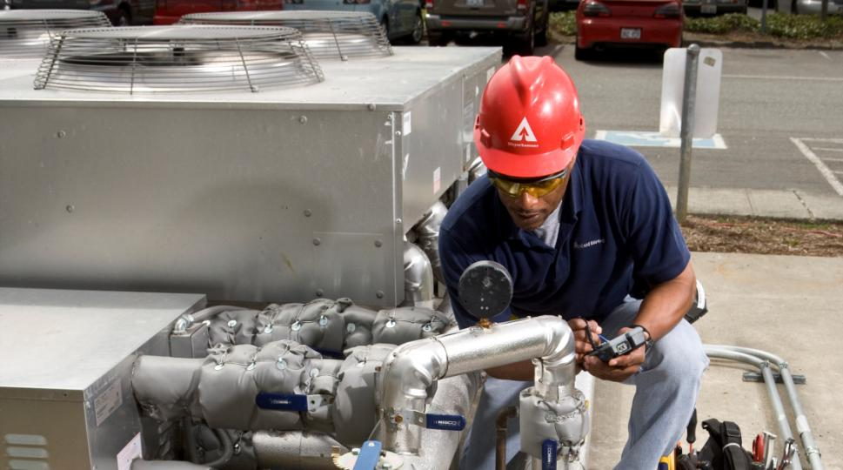
Who is your Audience? – Use Case
On-Demand Delivery
Proof of Delivery
Navigation Assistance
Document Entry
Arrange displays
Price checking/ markdown
Returns management
Key Business Advantages
Increased volumes
Customer service
Faster response time to requests
Improved productivity
Remote Technician
Work-list Management
Information Distribution
Inventory maintenance
Spare/broken parts ordering
Asset protection
Key Business Advantages
Manage contract cost
Faster response time to customers
Improved cost control
Fewer data errors
Field Engagement
Price/ inventory checks
Loyalty apps
Item locator/ ordering
Clienteling
Electronic couponing
Cross channel fulfillment
Key Business Advantages
Increased sales
Better customer service
Faster response
Material & Inventory
Multi-use case environment
Barcode scanning
Inventory management
Quality/ audit
General purpose devices required
Documentation
Records maintenance
Key Business Advantages
Eliminates manual entry
Multiple apps
Optimized tasks
Audit & Metering
Inspection
Quality control
Supplier performance
Records maintenance
Product testing
Documentation
Process improvement
Compliance
Key Business Advantages
Cost-effective regulator compliance
Improved productivity
Fewer data errors

Slide 3


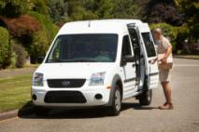
Who benefits from Dolphin CT50 …
End-users who are highly mobile, in scan intensive workflows who interact with general consumers within their workflow
  Desire a light weight, economic design, yet high performance solution
  Need a mobile solution that is easy to adopt/minimize training time for seasonal employees
  Is an attractive, sleek form factor ideal for use in consumer-facing workflows
IT managers that need to control costs and maintain flexibility in their mobile IT solutions
  Need IT solutions that enables them to grow and adjust as business conditions change
  Need tools that integrate easily with existing systems and reduce time to deploy and maintain
  Strong enough solution to replace legacy PCs (the first AIDC handheld device)
Business managers that want to improve and expand their service offering to increase profitability
  Need tools to help organizations migrate from ‘connected worker’ to ‘directed worker’ to improve productivity, efficiency and capability

Slide 4
Dolphin CT50 User Personas
Customer
  Has legacy automation > Wants to upgrade to a new platform
  Thinking about smartphones > not happy with reliability, durability battery life, accessories, ‘locked-in’ O/S
  Seeking latest device with expanded application flexibility – future-proof for next 5-8 years
  Desire to re-engineer system to account for new operating systems and technologoies
  Desire a high-performance scanner for over 1,000 scans per day
  They differentiate from their competitors by how well they drive costs out and delight customers.
Needs and Concerns
  VP of Ops – Driving accuracy and productivity; Lower TCO and Fast ROI
  C-Level – Reduce total operating costs and enable business growth
  IT Manager – Ease of deployment; integration with current systems; support and training
  Fleet Manager Manager – Workforce performance (productivity, training, safety, ergonomics)
  End-user – Easy-to-Use, is it “like my smartphone” (productivity, training, performance)
Myths, Fears and Beliefs
  Believes smartphone technologies are a better alternative: “I need something that is connected and fast”
  They view themselves as best practice operations already
  They’ll have to fight for the capital investment, especially when their organization perceives that current solution isn’t broken
  Want to lower the capital requirement by leveraging heavily subsidized consumer devices (by carriers)

Slide 5
Positioning HON Touchscreens
Dolphin 70e Black
Dolphin 75e
Dolphin CT50
Stable O/S
Purpose-built application environment
Require rugged device, but want a touchscreen user interface experience
Durability/ Serviceability (<5% ARR)
Entry-Level Touch Screen WWAN Device
Latest O/S
Multiple application environment
Require rugged device, but want a touchscreen user interface experience
Critical connectivity
High Performance Architecture (i.e. Galaxy S5)
WiFi only
Latest O/S
Multiple application environment
Require rugged device, but want a touchscreen user interface experience
Ruggedization upgrade
High Performance Architecture (i.e. Galaxy S5)
LTE enabled
Next Gen Scan Performance
Comprehensive Accessory Ecosystem

Slide 6
Mobility Overview
Standard in all decks

Slide 7
Who We Are Working To Become
Delivering Power to the Edge to become the
Workflow Performance Company

Slide 8

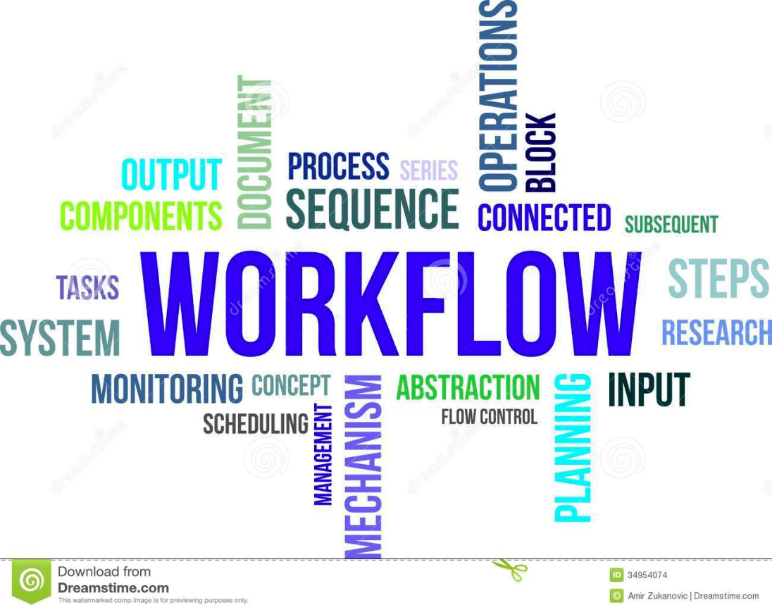
Workflow
The Sequence of Processes to Accomplish a Desired Outcome

Slide 9

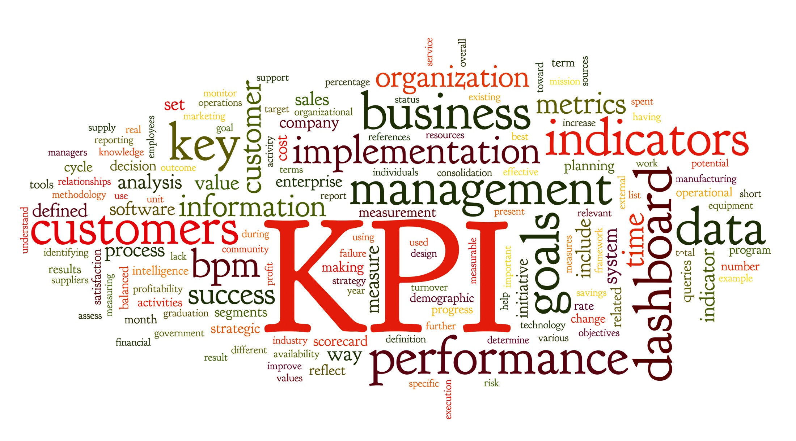
Performance
How Effective or Successful Something or Someone is

Slide 10
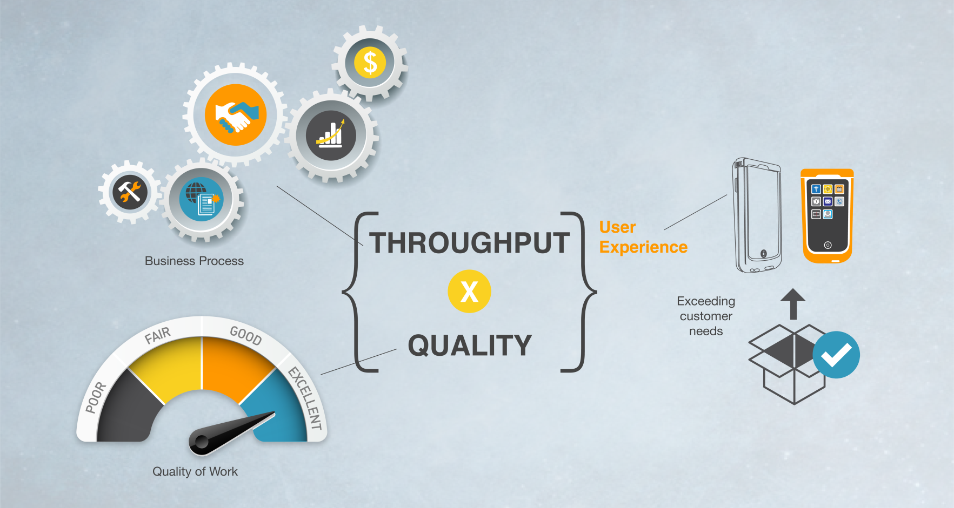
Workflow Performance
Accomplishing a Desired Outcome as Efficiently as Possible

Slide 11
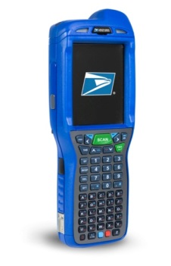





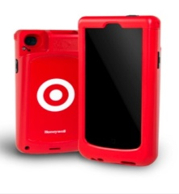
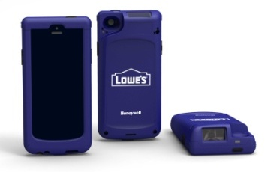







Notable Wins in Mobility
LATIN AMERICA:
Sab Miller, CN70, $10M
ENTERPRISE MOBILE: USPS, Lifecycle Services, $10M
NORTH AMERICA:
FedEx Freight, CN70, $12M
EMEIA: Sainsbury, CN3, $2.5M
$250M +
  Dolphin 99EX + Peripherals $65M
  Remote Mastermind $2M
  Service $2M
  Enterprise Mobile $10M
75k units delivered; 200k more coming
Delighting the customer every day
LATIN AMERICA: EPM Colombia, D99EX & D7800, $6M
APAC:
TNT, CN51
$1.3M
$30M+
50,000+ Units
Multiple Use Cases
Customized Exterior Sleds
NORTH AMERICA:
Publix, CK3X, $6.5M
NORTH AMERICA:
Michael’s Stores, D7800, $10M
EMEIA: Swiss Post, CN51, $13M
EMEIA: Schenker AB Sweden, Dolphin 70e
Black, $3M

Slide 12






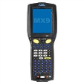









Honeywell mobility architecture strategy
Hardware
Architecture
Option 1
Option 2
Vehicle Mounts
Customer Facing Handhelds
Task-Based Handhelds

Slide 13











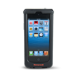



Handheld Mobile Computer Portfolio
BYOD
Durable
Rugged
Ultra Rugged
SL22/42
Sled
D60s
Scanphone
D70e/D75e
Hybrid
DCT50
“Fully Touch”
CN51
EDA
CN70
EDA
CN70e
EDA
99EX
PDT
“Consumer”
Apple® iPhone®
“Entry Level”
Pocketable
Device Consolidation
“Hybrid”
Pocketable & Usability
“Versatile”
Compact & Lightweight
Best Imaging Technologies
Larger Display with Keypad
“No Compromise”
Heavy Industrial Use
Best Imaging Technologies
Most Durable Displays
Multiple Keypad Options
Real-Time Connectivity & Data Capture.
Anytime. Anywhere.

Slide 14
Use Case Selector
Select the 2-pager that aligns with the target

Slide 15
On-Demand Delivery
The Business Challenge:
  Intensified pressure to offer more efficient delivery services, while not compromising on customer service
  Need to improve driver safety and productivity
  Need to track goods and materials with greater proficiency, from initiation to delivery
  Low productivity and utilization
  Staffing and onboarding limitations

Slide 16

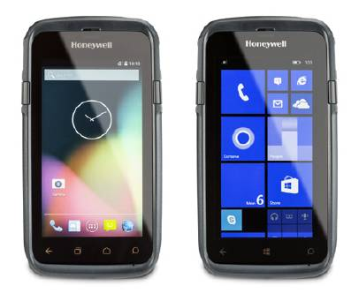
On-Demand Delivery
Process:
  Delivery of items through supply chain to final destination, including PoD
Environment:
  Usually in specialty vehicle, going up-down from height during loading/unloading, hybrid may go in-doors Residential/Commercial, charge customers for real-time information and prioritization of inventory/delivery
User Persona:
  Ease of training, especially with seasonality or high-turn-over
  Highly mobile – needs for ergonomic design and easy pocketability
  Performance connectivity to central systems over LTE – important to maintain data connection for processing
  Scan performance, ability to quickly scan and tag items in any environment
  Secure rapid roll-out of multiple applications
Key Benefits/Attributes:
  Just-in-time/priority package deliver
  Improved productivity, reduce out-of-stock
  Fewer data errors
  Increase drop-offs per shift
Productivity Multiplier Is Achievable with This Refresh

Slide 17
Remote Technician
The Business Challenge:
  Lack of revenue growth at the point of service
  High cost of field service resources
  Long travel miles reducing employee efficiency and productivity
  Low productivity and utilization
  New workforce sourcing and onboarding
  Intensified pressure in providing superior service as a differentiator

Slide 18

Remote Technician
Process:
  To collect job related information and assignment, use of navigation for job routing and reporting and provide information on-site. Serve as connection back to the centralized system and customer issue log report submissions
Environment:
  Usually service vehicle with various levels of equipment, can provide spares as part of existing contract or bill later, hybrid may go in-doors Residential/Commercial
  Highly trained, technically savvy, will adapt to new tech quickly, usually focused on jobs-per-day
User Persona:
  Ease of training, especially with seasonality or high-turn-over
  Highly mobile – needs for ergonomic design and easy pocketability
  Performance connectivity to central systems over LTE – important to maintain data connection for processing
  Scan performance, ability to quickly scan and tag items in any environment
  Secure rapid roll-out of multiple applications
Key Benefits/Attributes:
  Automated collection of asset management & inventory count data
  Improved Productivity -> Lead to more repairs with fewer work hours
  Fewer data errors
  Increase amount of visits per shift
  Integration with related business systems
Link Just-in-Time Inventory to the Field

Slide 19
Field Engagement
The Business Challenge:
  Intensified pressure to offer more efficient delivery services, while not compromising on customer service
  Growing competition and price pressure from other suppliers/ private labels
  Escalating costs to manage/maintain vehicle fleet
  Need to reduce overall transaction costs
  New workforce sourcing and onboarding
  Peak seasons put strain on customer service

Slide 20

Field Engagement
Process:
  To connect to the customers for expanding and up-selling services and solutions as part of an existing contract or net-new agreement; connect to lead generation to contracting to customer engagement and ERP systems
Environment:
  Focused on providing services and up-selling other offerings, hybrid may go in-doors Residential/Commercial
  Usually performs a service as well as an up-sell opportunity to the customer
User Persona:
  Ease of training, especially with seasonality or high-turn-over
  Highly mobile – needs for ergonomic design and easy pocketability
  Performance connectivity to central systems over LTE – important to maintain data connection for processing
  Scan performance, ability to quickly scan and tag items in any environment
  Secure rapid roll-out of multiple applications
Key Benefits/Attributes:
  Sales logs and ordering platform
  Customer information update process
  Improved productivity
  Fewer data errors -> Names, orders and materials
  Integration with related business systems
Customer Focused Ease-of-Use Designed From the Beginning

Slide 21
Material & Inventory
The Business Challenge:
  Higher throughputs stretch ability to meet customer expectations
  High workforce turnover erodes productivity and accuracy
  Increased prevalence of omni-channel fulfillment demand
  Need to reduce overall transaction costs
  Need to track goods and materials with greater proficiency

Slide 22

Material & Inventory
Process:
  To collect and audit various assets throughout operations; tied to an ERP system the data is used for order management, customer fulfillment, etc.
Environment:
  Scan incoming shipments, take periodic inventories to determine when to order additional supplies, track items on the shelves and/or warehouse equipment - such as forklifts, conveyors, etc.
  In the yard a quick barcode scan can enable the automatic completion of asset tracking paperwork, ensuring that accurate costing and condition information is captured. WIFI provides real-time visibility
User Persona:
  Ease of training, especially with seasonality or high-turn-over
  Highly mobile – needs for ergonomic design and easy pocketability
  Performance connectivity to central systems over LTE – important to maintain data connection for processing
  Scan performance, ability to quickly scan and tag items in any environment
  Secure rapid roll-out of multiple applications
Key Benefits/Attributes:
  Automated collection of asset management & inventory count data
  Improved Productivity
  Reduced cost of ownership for assets
  Integration with related business systems
Ability to Stay Connected in a WWAN + WLAN Data Environment

Slide 23
Audit & Metering
The Business Challenge:
  Increased need to rely on customer and asset data to effectively provision customer care and asset management
  Poor data integrity hinders ability to effectively serve customers and operations
  Intensified regulatory demands and need to prepare for future regulations
  Impact of poor quality can have devastating effects on a firm’s reputation

Slide 24

Audit & Metering
Process:
  Operations and workflow visibility; usually with a check-list and work order
Environment:
  Energy industry– Perform quick barcode scan to track inventory levels, provide customer billing, or improve process and perform work-orders
  Perform activities in hazardous environment (NI Certification)
User Persona:
  Ease of training, especially with seasonality or high-turn-over
  Highly mobile – needs for ergonomic design and easy pocketability
  Performance connectivity to central systems over LTE – important to maintain data connection for processing
  Scan performance, ability to quickly scan and tag items in any environment
  Secure rapid roll-out of multiple applications
Key Benefits/Attributes:
  Multi-application Environment (Native and Web-based)
  Improved productivity – multiple applications for single user
  Fewer data errors -> Eliminate any remaining manual entry
  Customer centered/connected workflows

Slide 25

The Business Challenge:
  Brick & mortar business model under assault by online shopping
  Need to innovate and improve customer experience to stay relevant
  Need to reduce overall transaction costs
  Staffing/ seasonal employee limitations
  Rising worker turnover
  Peak seasons put strain on customer service

Slide 26

Voice Automation
Process:
  To enable workflows that increase productivity by completing various work-lists or customers orders via voice automation
Environment:
  Voice – users will engage a work-list while wearing a headset for sound, the device will communicate the task to the worker and the user will speak the task / asset / or location back to the system for processing and decision making. Full work list completed by 2-way communication.
User Persona:
  Ease of training, specifically with Android OS and fully touch solution
  Highly mobile – needs for ergonomic design and easy pocketability
  Performance to paper-process process, current purpose built mobile terminal/PDA or legacy PCs
  Secure rapid roll-out of multiple applications
Key Benefits/Attributes:
  Automated collection of materials as part of a work-list or order
  Fewer data errors -> Eliminating shrinkage or mistakes
  Integration with related voice automated workflows/systems

Slide 27
The Dolphin CT50
Anytime, Anywhere Connectivity
Standard in all decks

Slide 28
Dolphin CT50 Handheld Computer
Why
  For organizations who want the ability to increase training, efficiency and accuracy of new policies while outside of the office
  For organizations that want the ability to be connected to their ERP/centralized systems at speeds that increase productivity
  For organizations that want the ability to rapidly deploy multiple applications into their workforce with ease to increase productivity
How
  Mobile workers want a form-factor that they are accustomed to using in their personal lives, touch-screens
  Organizations need to have consistent connection at speeds 4x faster than today, LTE/4G
  Developers need O/S frameworks that support a rapid-prototyping mentality for SW development, Android 5.0 and Windows 8.1 (Win10)
What
  Honeywell’s upcoming solution targets in-field training, LTE connectivity and easy SW deployment and it happens to be the Dolphin CT50
  When
  WLAN Globally // WWAN in EMEA, L. America & APAC
  WWAN N. America – Q4 – 2015 – Carrier Certification
Use Cases
  Specialty / On-Demand Delivery
  Remote/Field Technician
  Metering/Auditing
  Service Contracts/Sales
  Material/ Asset Tracking

Slide 29

Dolphin CT50 Value Proposition
For organizations who engage with customers in the field that want to increase training efficiency and accuracy and need to toggle between multiple applications to increase productivity and better engage customers,
- The CT50 is a truly connected device that combines smart phone ergonomics with an enterprise reliability focused design and industry-leading performance capabilities across the latest O/S platforms to enhance productivity and deliver a reduced TCO for the enterprise.
Unlike competitors which offer reduced performance capabilities, a less ergonomic form factor, and limitations in choice of O/S configuration,
- The CT50 is an easy-to-use mobile solution that empowers organizations to run 4+ applications simultaneously to address customer needs with the flexibility to select from multiple operating systems.

Slide 30
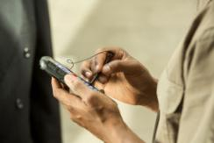


Who benefits from Dolphin CT50 …
End-users who are highly mobile, in scan intensive workflows who interact with general consumers within their workflow
  Desire a light weight, economic design, yet high performance solution
  Need a mobile solution that is easy to adopt/minimize training time for seasonal employees
  Is an attractive, sleek form factor ideal for use in consumer-facing workflows
IT managers that need to control costs and maintain flexibility in their mobile IT solutions
  Need IT solutions that enables them to grow and adjust as business conditions change
  Need tools that integrate easily with existing systems and reduce time to deploy and maintain
  Strong enough solution to replace legacy PCs (the first AIDC handheld device)
Business managers that want to improve and expand their service offering to increase profitability
  Need tools to help organizations migrate from ‘connected worker’ to ‘directed worker’ to improve productivity, efficiency and capability

Slide 31
Dolphin CT50 – Technical details*
Display and input: | 4.7” optically bonded (for all-light readability) Touch device w/o keyboard Gloved hand usage
Durability: | 5ft/1.5m drop, 1000 1m tumble, IP67
Talk time: | Support up to 12hr duty cycle
Software: | Windows Embedded 8.1 Handheld – Upgradable to Win10 Android 4.4 – Upgradeable to Android M
Data capture: | 8MP Auto Focus w/ Flash (rear) High-performance 2D with laser aimer
Connectivity: | LTE/GSM, CDMA, 802.11 a/b/g/n/ac BT Low Energy 4.0, NFC, Dual-SIM
Performance: | Qualcomm 2.26 GHz Quad-core, 2GB RAM + 16GB Flash
Other: | Peripherals including docking systems and vehicle cradles for target environments, Smart battery monitoring & long-battery life
Target Segments | On-Demand Delivery, Remote Technician, Field Engagement, Audit & Metering, Materials Inventory
*Specifications subject to change
Pictures are not final / not Honeywell property

Slide 32

Dolphin CT50 Handheld Computer
As Honeywell’s first LTE touch-only device, the ultra-slim Dolphin™ CT50 integrates industry-leading processing power and best-in-class imager from Honeywell for customers who seek high productivity in various mobile environments.
Program Summary
Key Product Differentiators | Ultra-Slim and Rugged Design: Pocketable and lightweight design, combined with the reliability and longevity of an IP67 rating, maximizes end user experience and investment. Unparalleled Scanning Performance: Next generation 2D imager delivers best-in-class data capture performance on linear and 2D barcodes. To complement the performance, ergonomic scan trigger keys have been developed for CT50. Powerful, Versatile Platform: Industry-leading Qualcomm Snapdragon 800 processing power with 2.3GHz quad-core CPU enables advanced performance and power efficiencies with the flexibility to support both WE8H and Android O/S configurations. Peripherals Designed to Enhance Workflow: Specialized for target DEs to empower mobile workers and maximize workflow efficiency. Large Touch Screen Display: Large 4.7” brilliant all-light readable multi-touch display that is perfect for inside or outside use cases. Extensive Software Options: Value-add software options include Industrial browser, Device management, Signature capturing, Launcher, PoD, Navigation, Package tracking, and more.

Slide 33
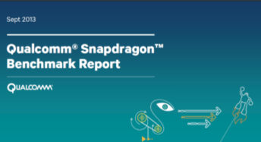
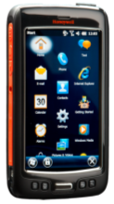


Honeywell Architecture – DCT50 & D75e
Honeywell invested in the Snapdragon 800 series quad-core Qualcomm processor architecture which is more complex than dual-core Qualcomm processor, key benefits are:
  Qualcomm study highlights that Honeywell architecture is 25 – 50% faster and has 25-30% more battery life than the Next Best Alternative.
“Make no mistake, MSM8974 is the new high-end, pushing Snapdragon 600 and S4 Pro parts further down into midrange category.”
Page 3
“One of the things Qualcomm promised would come with Snapdragon 800 (8974) (and by extension the process improvement with 28nm HPM) was lower power consumption, especially versus Snapdragon 600 (8064).”
Page 4

Slide 34
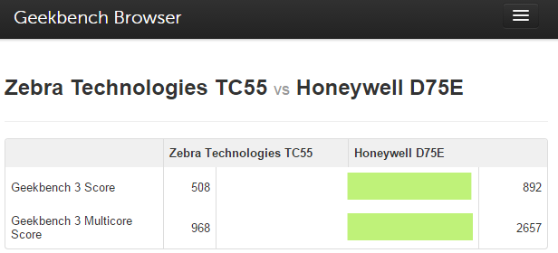
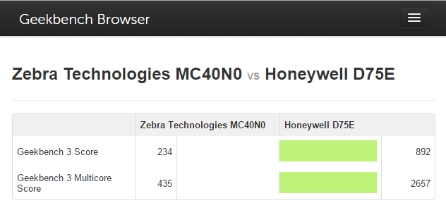
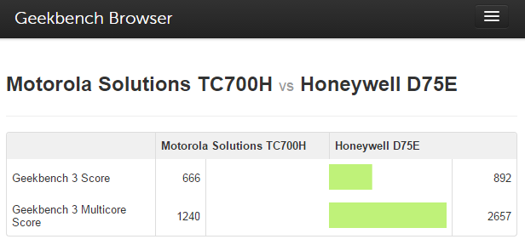
What Does that Mean for AIDC Landscape?
TC55 ✗ vs. D75e✓
D75e is 76% better from overall Performance
D75e is 2.7x faster from a multi-core Performance
D75e has 2.2x better memory performance
Geekbench Results: https://browser.primatelabs.com/geekbench3/compare/2695782?baseline=2937005
MC40✗ vs. D75e✓
D75e is 3.8x better from overall Performance
D75e is 6x faster from a multi-core Performance
D75e has 7.8x better memory Performance
Geekbench Results: https://browser.primatelabs.com/geekbench3/compare/2695849?baseline=2937005
TC70 ✗ vs. D75e✓
D75e is 33% better from overall Performance
D75e is 2x faster from a multi-core Performance
D75e has 53% better memory performance
Geekbench Results: https://browser.primatelabs.com/geekbench3/compare/2937399?baseline=2937005
Source: All Test & Scoring Performed Via Geekbench Process of Independently Uploading a Test Results File - All Devices Tested Used Android 4.4 – KitKat Operating System
Notes:
Motorola Solutions TC700H vs Honeywell D75E
Motorola Solutions TC700HHoneywell D75EGeekbench 3 Score666892Geekbench 3 Multicore Score12402657System Information
Motorola Solutions TC700HHoneywell D75EOperating SystemAndroid 4.4.2Android 4.4.4ModelMotorola Solutions TC700HHoneywell D75EProcessorQualcomm QCT @ 1.73 GHz
1 processor, 2 coresQualcomm Qualcomm @ 2.27 GHz
1 processor, 4 coresProcessor IDARM implementer 81 architecture 7 variant 2 part 77 revision 0ARM implementer 81 architecture 7 variant 2 part 111 revision 1L1 Instruction Cache0 KB0 KBL1 Data Cache0 KB0 KBL2 Cache0 KB0 KBL3 Cache0 KB0 KBMotherboardMSM8960HSM8X74BIOSMemory832 MB1868 MBInteger Performance
Motorola Solutions TC700HHoneywell D75EInteger687882Integer Multicore13412882AES6684AES Multicore130314Twofish10401483Twofish Multicore21055414SHA112471561SHA1 Multicore24576270SHA213251739SHA2 Multicore26297061BZip2 Compress710911BZip2 Compress Multicore13293318BZip2 Decompress7771012BZip2 Decompress Multicore15473729JPEG Compress8451135JPEG Compress Multicore17104118JPEG Decompress707843JPEG Decompress Multicore14582196PNG Compress721896PNG Compress Multicore14093248PNG Decompress10071276PNG Decompress Multicore19683809Sobel585748Sobel Multicore11422587Lua632797Lua Multicore10991251Dijkstra771967Dijkstra Multicore14522814Floating Point Performance
Motorola Solutions TC700HHoneywell D75EFloating Point611786Floating Point Multicore12232970BlackScholes607843BlackScholes Multicore12343164Mandelbrot551709Mandelbrot Multicore10902832Sharpen Filter681910Sharpen Filter Multicore13853522Blur Filter7941056Blur Filter Multicore16093760SGEMM675841SGEMM Multicore12482753DGEMM384452DGEMM Multicore7411900SFFT765918SFFT Multicore15633590DFFT404537DFFT Multicore8851938N-Body587762N-Body Multicore11802894Ray Trace8651111Ray Trace Multicore16654287Memory Performance
Motorola Solutions TC700HHoneywell D75EMemory7361126Memory Multicore10741582Stream Copy14791612Stream Copy Multicore14722061Stream Scale700958Stream Scale Multicore11701541Stream Add453955Stream Add Multicore7911302Stream Triad6271092Stream Triad Multicore9781516
COMPARE
Remove Baseline
Motorola Solutions TC700H Benchmark Chart
SHARE
Tweet
Copyright 2004-2014 Primate Labs Inc. π
Contact Primate Labs
Built with Bootstrap from Twitter

Slide 35
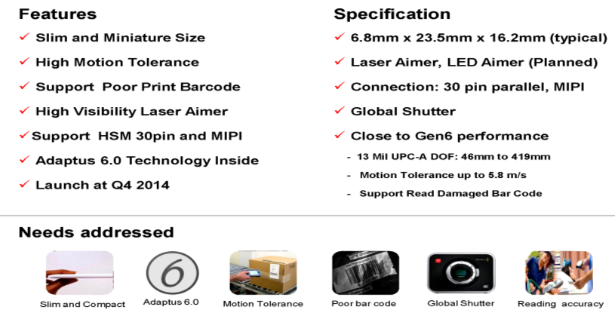
CT50’s New N66xx Slim Imager Engine

Slide 36
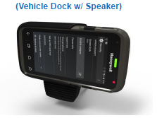
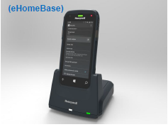
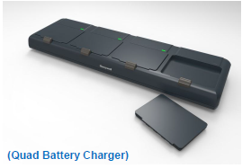
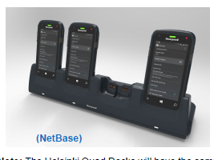
CT50 Accessories – Available at Launch

Slide 37
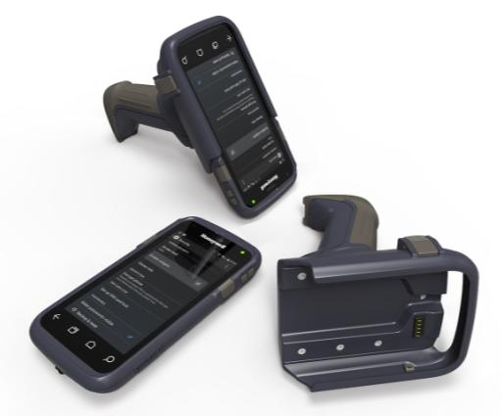
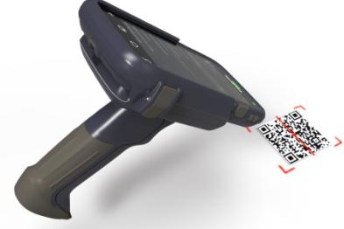
Dolphin CT50: Scan Handle

Slide 38
CT50 Value Added Solutions
HSM Value Add Feature | Android | WE8.1H
Speech to Text | Yes | Yes
Custom Scanner Settings | Yes | No
Programmatic Radio On/Off Controls | Yes | No
Device Controls: Notification LED, Vibrator | Yes | No
802.11 CCX v4 Support | Yes | No
RF Network Tools | Yes | Yes
Diagnostic Information (SysInfo / Device Health) | Yes | Yes
Printing SDK | Yes | Yes
Driver License Parsing SDK | Yes | Yes
Enterprise Launcher | Yes | No*
Scan-based Provisioning | Yes | Yes
Push-to-Talk | 3rd Party (Zello) | 3rd Party (Zello)
* Enterprise Assigned Access provides similar functionality

Slide 39
CT50 Value Added Solutions - Continued
Feature | Description | Android | WE8H
Device Health | Quick access to critical device health information Support for alerts | Yes | Yes
Virtual keypad | Keyboard Keyboard creator (in the cloud) | Yes | Native WE8H
Industrial HTML5 Browser | Locked down configurable browser Decode and Printing APIs/extensions | Yes | Yes
Document capture | SDK / Application | Yes | Yes
Total Freedom | Easy DL Easy BP | Yes | Yes
Launcher | User based access control and device settings | Yes | Native WE8H
Advanced provisioning | Cross platform Device GUI Support for local provisioning from barcode or file (ScanNGo/EZConfig/DeviceConfig) License Support | Yes | Yes
Indoor location positioning | Demo application SDK | Yes | Yes
New Data Collection Architecture (DCS) | Support for standard MS POS API (WE8H) with extension Integrated Scan out of the box Wedge Future support for other data input device (i.e. MSR, RFID, External scanner) | Yes | Native WE8H POS / Profiles

Slide 40
HSM Android Value Add Components
Scanner Settings Management
  Data Wedging
  Data Collection SDK
Enterprise Browser
  Scanning and Printing SDKs
EZ Config / ScanNGo
Diagnostic Power Tools
Enterprise Launcher
  Device Lockdown, Feature Lockdown,
  Application White-Listing
Enhancing Android for the Enterprise

Slide 41
WE8.1H Enterprise Advantages
Released May 2014
Security Architecture Inherited from the Desktop
  Secure Boot, Bitlocker Encryption, Application Sandboxing
Shared Kernel Delivers Consistent User Experience
  Common Developer Tool Chain; Universal Apps
  Full Windows Phone App Compatibility
Enterprise Assigned Access
  Lockdown Experience, Multiple User / Role Support
  Extra APIs to Enable Data Sharing by Enterprise Signed Apps
Remote Management and Provisioning
  Open MDM Protocol
  Controllable OS Update Rollout
WE8.1H – Now Enterprise Ready

Slide 42
Managed Services
Honeywell is a Gartner Magic Quadrant Recognized Provider of Managed Mobility Services (MMS) and is the MMS Partner for many strategic HSM Projects
Device Deployment
Initial preparation, configuration and provisioning of mobile devices.
Helpdesk Support
Branded helpdesk designed to assist end-users with hardware, software, application and connectivity issues,
Device Depot
Management of spare pool, overnight device replacement, inoperable device collection, warranty management & recycling.
MDM Administration
Day-to-day administration of the MDM environment.
Honeywell has the capabilities to compliment end-users and your partners’ complete the deployment and helpdesk support needs

