Slide 1
Doug Brown
Dolphin® CT50h – Mobile Computer
February 23,2016
Channel Partner Training

Slide 2

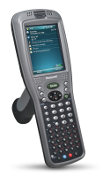

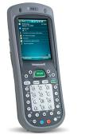
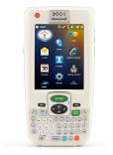

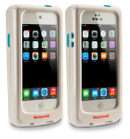
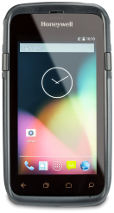
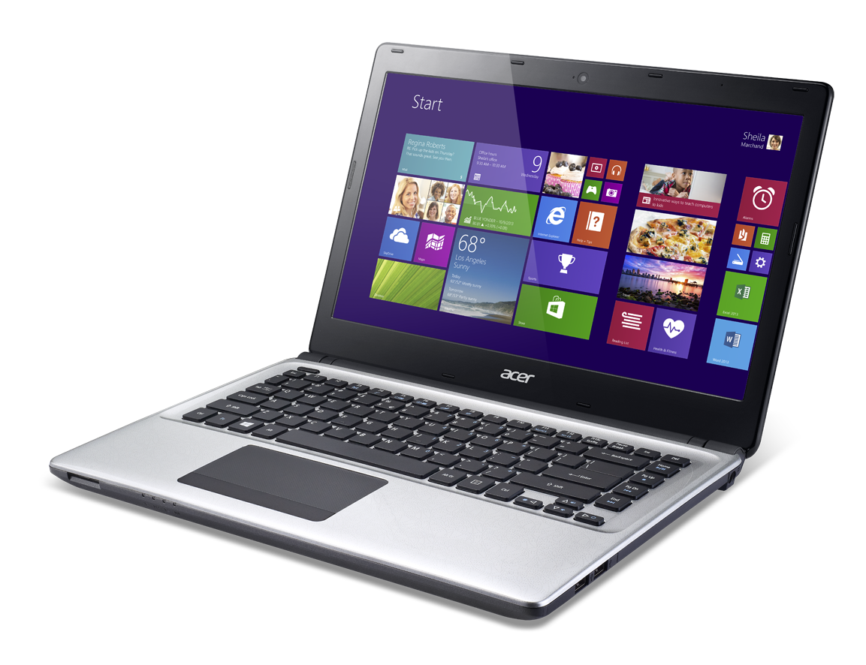
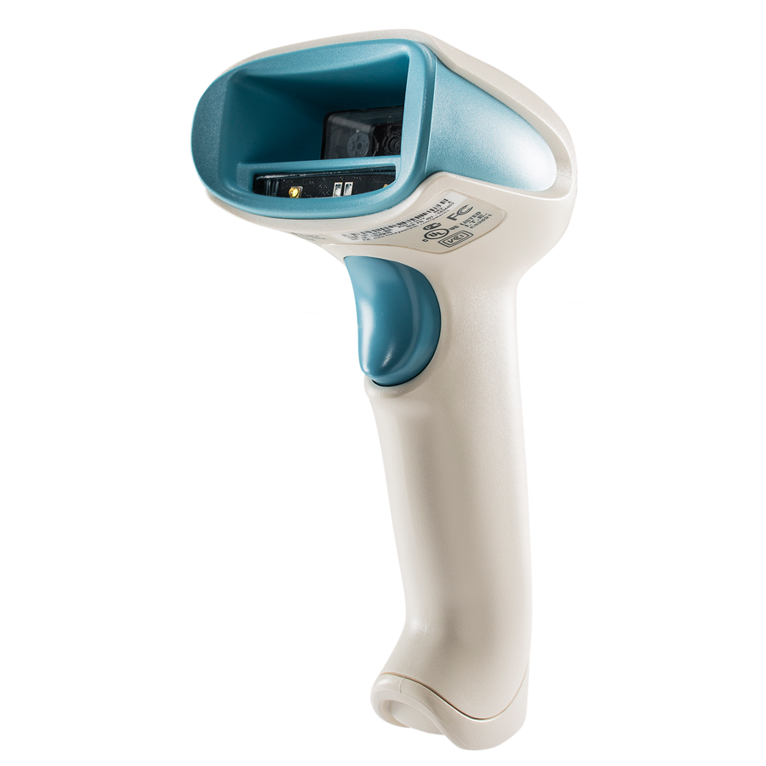
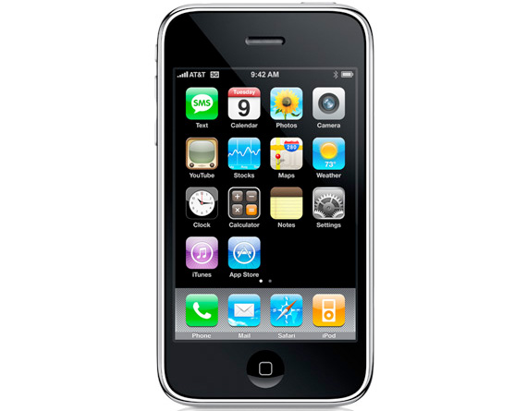
Honeywell Healthcare Mobility Portfolio Progresses
CT50h IS A TRUE CONVERGED DEVICE
Converging Voice, EMR Data, Barcode, and Smartphone computing
CT50h
Full-touch Smartphone
Dolphin 9950
Dolphin 7600
Dolphin 97hc
Dolphin 9900hc
Dolphin 7800hc
Dolphin 99EXhc
Captuvo SL 22/42 hc
iOS Sleds

Slide 3
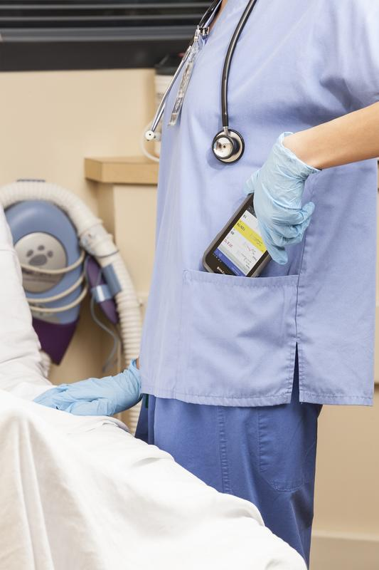
Healthcare Trends Diving Smartphones
Healthcare Analytics
The electronic medical record will be used for clinical decision support and to find the best processes
  Honeywell technology is an integral part of data collection and process efficiencies
Alarm Fatigue – Government Mandate to address in 2016
Clinicians are faced with a overwhelming number of alarms and alerts from the medical devices attached to patients
  Honeywell provides the tools to manage clinical alarms and alerts in a more human friendly way
Care Team Collaboration
Hospitals are replacing old VOIP systems with smartphones
  Honeywell nursing Smartphone's will be at the core of care team communication and information sharing

Slide 4

Clinical Smartphone Priorities
WORKFLOW / APPLICATION PRIORITIES
VOIP voice calls, Secure Texting, Alarm management, Nurse Call,
Meds Administration, Specimen Collection, Medical Device monitoring
HOSPITAL SMARTPHONE PRIORITIES
Operating System – Will the OS get me to future applications?
Memory – Is there enough memory for all the Apps I want to run?
Display – Will the display show the heavy graphical medical App screens?
Battery – The battery has to last a full shift or you are wasting my staffs time.
Wireless – Will the radio support my new WiFi backbone?
Durability – Will this product last through all the cleaning, drops, and tumbles and stay reliable?

Slide 5
Connected Clinicians – The New Reality for Healthcare Providers
Connected to
the Care Plan
Doctors Order
Connected to
the Patient
Nurse Call
Connected to
Alarms
Mobile Alarm Management
Connected to
Patient Data
EMR Data Access
Connected to
Nursing Tools
Smartphone
Nursing Apps
The Mobile Connected Clinician
Connected to
the Patient’s Status
Medical Device Integration
Connected to
Assets
Equipment Locator
Connected to
the Care Team
Communication
Connected to
Support
IT Access

Slide 6
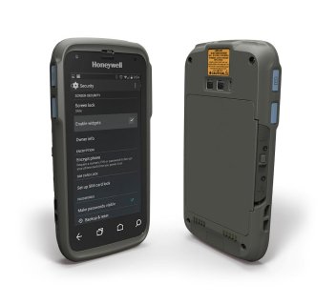
Introducing: Dolphin CT50h Clinical Smartphone
FEATURES
Best-in-class processing capabilities means applications respond quickly and minimize user wait times. | Larger display screen improves accuracy when reading and makes data entry easier and more accurate (larger virtual keyboard). | Easily replaceable battery that powers the device for the entire shift. | Extensive durability testing will help to keep nurses productive and enable long device life-cycle. | Converged design that replaces multiple individual devices (scanner, pager, VoIP phone…) improved clinician efficiency and saves hospitals money. | Enterprise grade WiFi connectivity developed in-house from years of experience, tested in hospitals across the nation, backed by onsite support. | Increases productivity and throughput with an integrated and easy-to-use imager that provides first-time scanning performance on linear and 2D barcodes. | Disinfectant ready housings have gone through extensive testing can be cleaned with harsh disinfectants after each patient visit.
A Single Converged Solution that Simplifies Clinician Workflows

Slide 7

Dolphin CT50h Specs at a Glance
Disinfectant ready plastics
4.66" backlit color LCD
with 720p HD resolution
2.3 GHz Quad Core processor from Qualcomm
2GB RAM, DDR3 @ 800MHz
with 16GB NAND Flash
802.11 a/b/g/n/ac/r, NFC, BT 4.0
Li-Ion, 3.6V, 4040mAh with integrated fuel gauge = 12+ hour performance
Android 4.4.4 KitKat with plans to release Android 6.0
4ft drop to concrete, 500 1M tumbles and IP54 rating
Honeywell slim engine powerful 1D 2D barcode scanner
8.0MP color camera with
auto focus
Ergonomically positioned
scan buttons
CT50 vs CT50h
CT50h only runs Android
CT50h does NOT support a WWAN radio
CT50h has disinfectant ready plastics including spare battery
CT50 has higher drop and tumble specs
CT50 is IP67 versus CT50h being IP54
Slightly different side button designs
CT50h Has All the Features You Would Expect in 2016

Slide 8
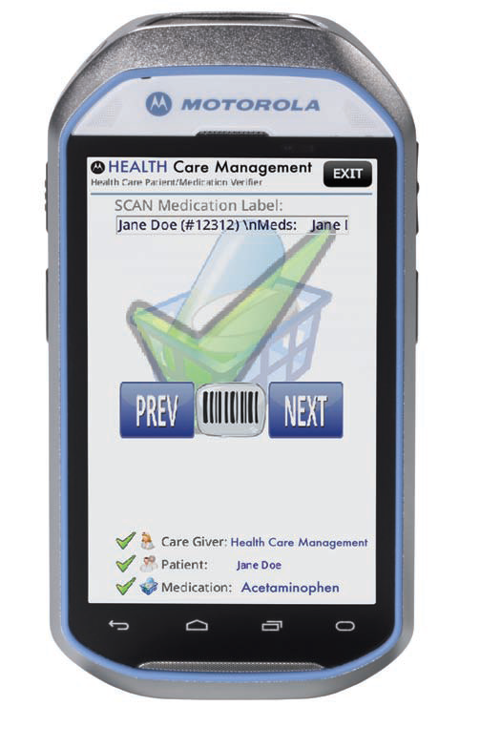
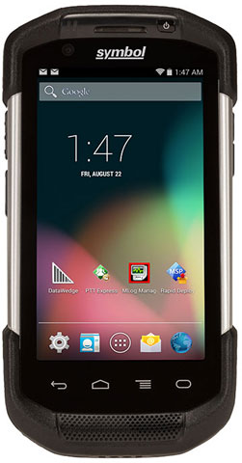
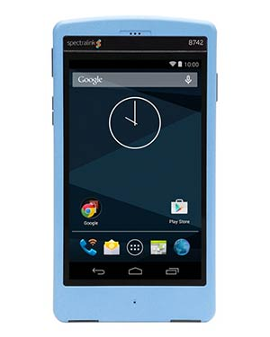
Dolphin CT50h Versus the Competition
Dolphin CT50h
Quad Core CPU – 3X faster
2G Ram/16G Flash – 2X memory
12+ hour battery – Full Shift
4.7” display 1280x720 720P HD 3/16
Android 4.4.4 to Android 6.0 future
List Price $2,149
Motorola MC40HC
Dual Core CPU – 3X slower
1G Ram/8G Flash – ½ the memory
8 – 10 hour battery – partial shift
4.3” display 800x480 – poor graphics 3/13
Limited to Android 4.4
List Price $1,770
Spectralink Pivot
Dual Core CPU – 3X slower
1G Ram/8G Flash – ½ the memory
8 – 10 hour battery – partial shift
4.3” display 800x480 – poor graphics 7/15
Limited to Android 4.4
List Price $1,450
Motorola TC70
Dual Core CPU
1G Ram/8G Flash
Higher ruggedness specs
Equivalent display 10/14
Limited to Android 4.4
List Price $2,095

Slide 9
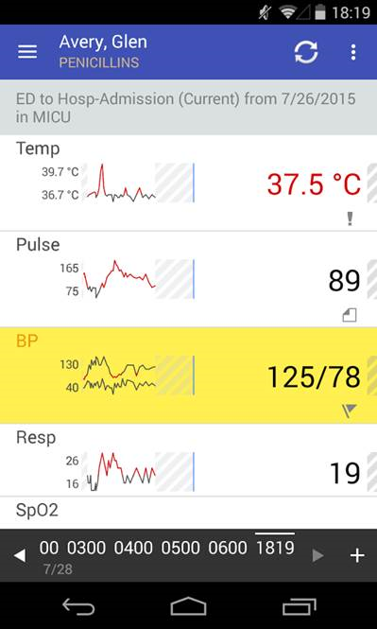
The REAL Reason the CT50h WINS
CPU Speed
Apps will run faster both in the foreground and in the background and it should be easy for Hospitals to test this
Double the Memory
More memory also helps Apps run faster and it allows more Apps to be loaded on the phone and in the background
12+ Hour Battery
Saves nurses time to not have to swap batteries during their shift. But it also saves money….after 500 recharges the battery is dead, so a Motorola unit will require more replacement batteries each year.
Display Size and Resolution
Size makes it nicer to use and see, but resolution is more important than you realize. Clinical Apps are sending hi-res graphics to the nurses phones that a low-res VGA display can’t handle.
Android Roadmap
Hospitals on average are expected to run 10 Apps on Clinical Smartphones. Many of the Apps are still in development and will only run on Android 5 and Android 6 OS’s. Buying an OLD Smartphone that the OS is locked is a bad investment.
Price
The CT50h has the most value for a long term deployment

Slide 10
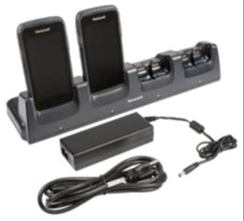
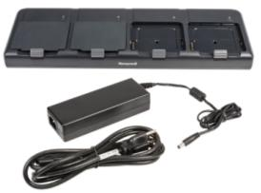
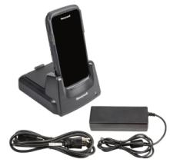
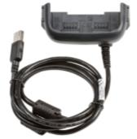
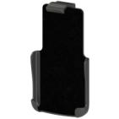
Pricing, SKU’s, and Accessories
CT50L0N-CS13SFH – List $2,149 - Android 4.4.4 KitKat/GMS, 802.11 a/b/g/n/ac, 1D/2D Imager (N6600), 2.26 GHz Quad-core, 2GB/16GB Memory, 8MP Camera, BT 4.0, NFC, Battery 4,040 mAh, U.S. FCC, Healthcare
CT50L0N-CS13SEH – List $2,149 - Android 4.4.4 KitKat/GMS, 802.11 a/b/g/n/ac, 1D/2D Imager (N6600), 2.26 GHz Quad-core, 2GB/16GB Memory, 8MP Camera, BT 4.0, NFC, Battery 4,040 mAh, EU, Healthcare Version
Accessories
318-055-002 – List $95 – CT50h Replacement battery (note this is disinfectant ready plastics)
New Belt Clip accessory still in development
All existing CT50 accessories are available but not always used in a hospital
QUAD BATTERY CHARGER
CT50-QBC-1
CHARGE BASE
CT50-CB-1
eHOMEBASE
CT50-EB-1
BELT CLIP
CT50-BC
(future)
USB ADAPTER
CT50-USB

Slide 11
ISV Certification Status
ISV | TYPE | Solution | Status
EPIC | EMR/ISV only | Rover | Complete
Cerner | EMR/Reseller | CareAware Connect | In Process
Voalte | Voice/Reseller | Voalte Platform | In Process press release @ HIMSS
Cisco | Voice/ISV only | Jabber | Complete
Allscripts | EMR/Reseller | Sunrise Mobile Care | In process
Extensions | Alarm/ISV only | Engage | In Process
Sunquest | LAB/ISV only | Collection Manager | In process
Vocera | Voice/ISV only | Vocera Connect | Needs Opportunity
Iatric | LAB/ISV only | Mobilab | Needs Opportunity

Slide 12
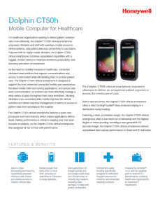




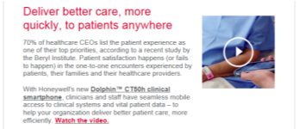
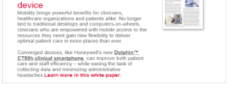
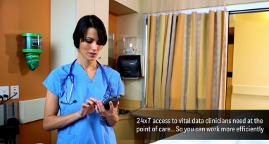
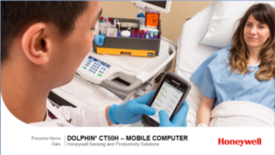

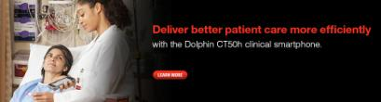
Launch Materials Reinforce Value, Applications & More
Data Sheet
Accessory Guide
Solutions Brochure
Launch Eblasts
Feature Overview Video
Sales Presentations/ Playbook
Digital Banner Ads
Sales Kit Available for Download on Performance Partner Portal!

Slide 13
What to Expect from Honeywell
 | Q1 2016 |  |  | Q2 2016
Product
Marketing/PR
Events
App Certification with CT50 Units
Dolphin CT50H
BDU Units Available
Disty Stocking Orders;
Pricing/
Skus Loaded
Production Begins
Telesales/ Appt Setting Campaign
Disty/ Partner Webinar Events
Healthcare Demand-Gen Program
Inside Marketing Campaign targeting IDNs
Dolphin CT50H Press Release
HIMMS
2/29-3/4
ANIA
4/21-4/23
Generating Demand for S&PS Solutions

Slide 14
Doug.brown@Honeywell.com

