Slide 1
Presenter Name
Dolphin® CT50h – Mobile Computer
Date
Honeywell Sensing and Productivity Solutions

Slide 2
Connected Clinicians – The New Reality for Healthcare Providers
CLINICIAN MOBILITY
WoW’s and PC’s will not go away anytime soon, but the demand for greater productivity by clinicians
is driving Clinical Mobile computers into the hands of nurses. Analytics driven by more data will be required.
MEANINGFUL COMMUNICATION
The top priority is on demand clinician communication tailored
to the needs of a hospital and patient privacy. Secure texting, VOIP calls, and video conference will dominate.
PATIENT SAFETY
Positive Patient ID, medication ID and specimen labeling are just the beginning. Mobile vitals and alarm management are ready to deploy.
PATIENT SATISFACTION
The model has changed and only positive outcomes and patient satisfaction will be funded.
The future of nursing is upon us.

Slide 3
Connected Clinicians – The New Reality for Healthcare Providers
Connected to
the Care Plan
Doctors Order
Connected to
the Patient
Nurse Call
Connected to
Alarms
Mobile Alarm Management
Connected to
Patient Data
EMR Data Access
Connected to
Nursing Tools
Smartphone
Nursing Apps
The Mobile Connected Clinician
Connected to
the Patient’s Status
Medical Device Integration
Connected to
Assets
Equipment Locator
Connected to
the Care Team
Communication
Connected to
Support
IT Access

Slide 4

Clinical Smartphone Considerations
WORKFLOW / APPLICATION PRIORITIES
VOIP voice calls, Secure Texting, Alarm management, Nurse Call,
Meds Administration, Specimen Collection, Medical Device monitoring
SMARTPHONE PRIORITIES
Operating System – The CT50h launches with Android 4.4 and will soon be available with Android 6.0
Memory – Double the memory of other devices in its class to run more apps faster
Display – The larger display and higher resolutions improves readable and touchscreen use with graphical applications
Battery – CT50h was designed with a 12+ hour shift in mind
Wireless – A new radio architecture and advanced antenna design means fast roaming and greater coverage
Durability – Designed to survive drops, tumbles, disinfectants, splashes and still look great and perform flawlessly

Slide 5
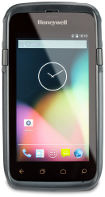
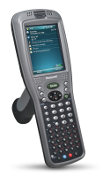
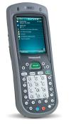


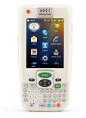

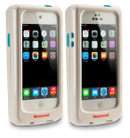
Honeywell Healthcare Mobility Portfolio Progresses
CT50H IS A TRUE CONVERGED DEVICE
Converging Voice, EMR Data, Barcode, and Smartphone computing
CT50h
Full-touch Smartphone
Dolphin 9950
Dolphin 7600
Dolphin 97hc
Dolphin 9900hc
Dolphin 7800hc
Dolphin 99EXhc
Captuvo SL 22/42 hc
iOS Sleds

Slide 6
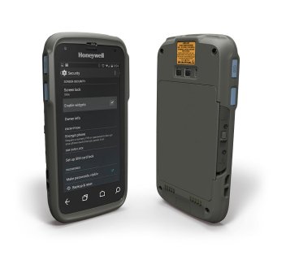
Introducing: Dolphin CT50h Clinical Smartphone
FEATURES
Best-in-class processing capabilities means applications respond quickly and minimize user wait times. | Larger display screen improves accuracy when reading and makes data entry easier and more accurate (larger virtual keyboard). | Easily replaceable battery that powers the device for the entire shift. | Extensive durability testing will help to keep nurses productive and enable long device life-cycle. | Converged design that replaces multiple individual devices (scanner, pager, VoIP phone…) improved clinician efficiency and saves hospitals money. | Enterprise grade WiFi connectivity developed in-house from years of experience, tested in hospitals across the nation, backed by onsite support. | Increases productivity and throughput with an integrated and easy-to-use imager that provides first-time scanning performance on linear and 2D barcodes. | Disinfectant ready housings have gone through extensive testing can be cleaned with harsh disinfectants after each patient visit.
A Single Converged Solution that Simplifies Clinician Workflows

Slide 7

Dolphin CT50h Specs at a Glance
4.66" backlit color LCD
with 720p HD resolution
2.3 GHz Quad Core processor from Qualcomm
2GB RAM, DDR3 @ 800MHz
with 16GB NAND Flash
802.11 a/b/g/n/ac/r, NFC, BT 4.0
Li-Ion, 3.6V, 3950mAh with integrated fuel gauge = 12+ hour performance
Android 4.4.4 KitKat with plans to release Android 6.0
4ft drop to concrete, 500 tumbles and IP54 rating
Honeywell slim engine powerful 1D 2D barcode scanner
8.0MP color camera with
auto focus
Ergonomically positioned
scan buttons
CT50h Provides a Platform for Future Android Upgrades

Slide 8
CT50h Specification Information
SPECIFICATION | DOLPHIN CT50H | VALUE
PROCESSOR | 2.26 GHz Qualcomm Snapdragon 801 quad-core | Runs applications faster without device battery drain Runs data-intensive apps with no latency More efficient running rich multi-media graphics
MEMORY | 2GB RAM / 16GB Flash | Performs faster with quicker read and write to memory
BATTERY | 3950 mAH Li-Ion | Battery power that lasts a full 12 hour shift Less battery swaps minimizes clinician downtime
O/S | Android 4.4.4 KitKat | Highest level of future-proofing protection
RADIO | IEEE 802.11 a/b/g/n/ac WiFi certified | Ensures access to real-time patient data Reliably keeps staff connected Protects sensitive patient information
DURABILITY | Multiple 4ft drop to concrete; Exceeds 500 1.0m tumbles; IP54 | Tested to survive drops, bumps, spills and sanitizing common to hospital environments Protects device uptime and increases utilization for stronger ROI
DISPLAY | 4.66" TFT Color LCD with Backlight, 720p HD, >400NIT | Larger screen improves clinician accuracy and eases data entry
BARCODE SCANNING | Best in class1D and 2D Imager with Laser aimer | Next-generation 2D imager delivers best-in-class data capture performance on linear and 2D barcodes

Slide 9
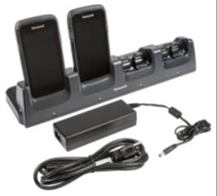
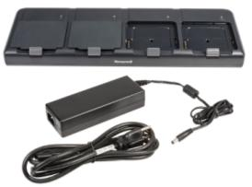
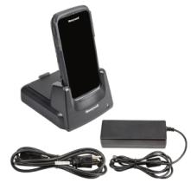
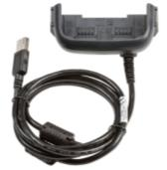
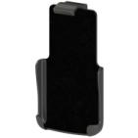
CT50h Accessories – Available at Launch
QUAD BATTERY CHARGER
CT50-QBC-1
CHARGE BASE
CT50-CB-1
eHOMEBASE
CT50-EB-1
BELT CLIP
CT50-BC
(future)
USB ADAPTER
CT50-USB
NA Part Numbers

Slide 10
Honeywell Dolphin CT50h Clinical Smartphone
COMPATIBLE
Relax knowing the CT50h will support many versions of Android, applications, and Wifi
FAST
Enjoy the fact your clinicians will notice how fast their apps are running
ACCEPTED
Be confident your clinicians will quickly love the BIG display and the freedom of mobility
LONG LASTING
Rest in the knowledge that Honeywell stands behind its durability promises
There is a Peace of Mind You Will Have Partnering With Honeywell

