Slide 1

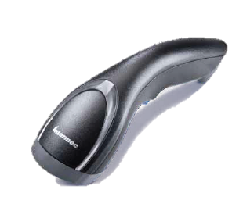

SG20 Introduction
February 2012

Slide 2
Content
Data Capture Product Line up
Messaging
Product Overview
  Configurations, Kits, Accessories, Agency certifications
Target Markets / Applications
Pricing / Availability
Competitive Overview
Migration Guidance

Slide 3
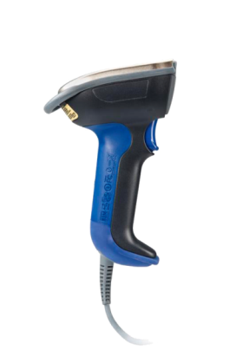
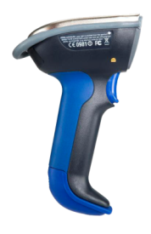
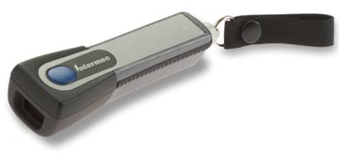
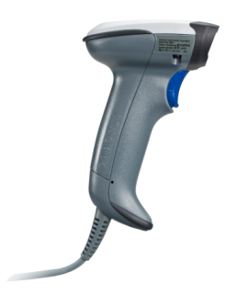
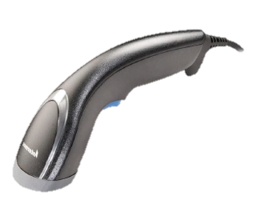
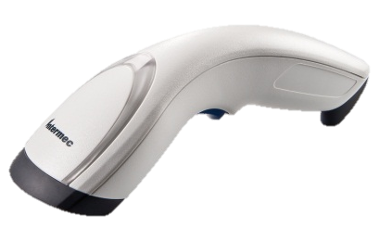
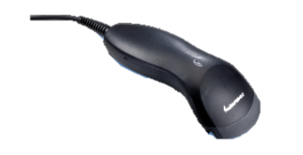
Intermec Scanner Range
Industrial
Building a competitive product range
Light
Industrial
SF51
SR61B
SR61 T
General Duty
SR30
Value Scanner
SG20 Family includes
1D & 2D models
Corded & Cordless
2D Healthcare models in corded & cordless
Broad suite of accessories
SG10T Tethered
SG20 Family
Launch 2/13/12

Slide 4
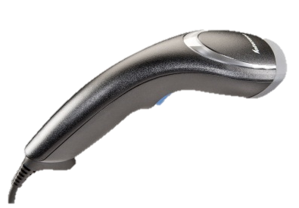
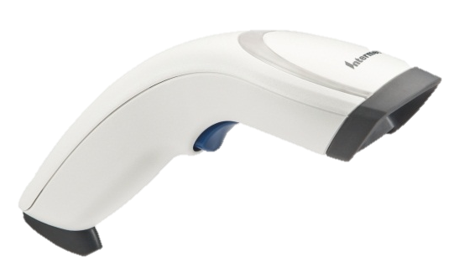
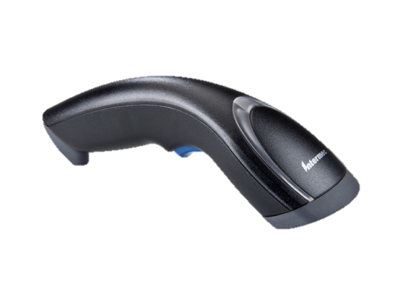
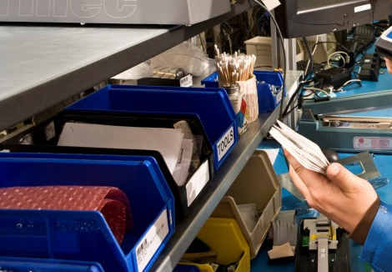


What is the SG20?
Performance Choice Affordable
SG20T/B1D
SG20T/BHP
SG20THPHC
SG20BHPHC
SG20T/B1D
SG20T/BHP
WH / DC / Mfg back office countertop
Healthcare
Retail In store

Slide 5
Messaging Pillars
Performance
  HP scanner is second to none in snappiness
  Fastest 2D scanner in the market – EA30 technology
Choice
  1D or 2D, Corded or Cordless, Standard or Healthcare
  One look and feel, many options
Affordability
  Each Scanner and Kit is priced to beat mainstream competition
  Best price performance relationship of any 2D reader

Slide 6

Performance
SG20HP the fastest 2D HH imager available

Slide 7
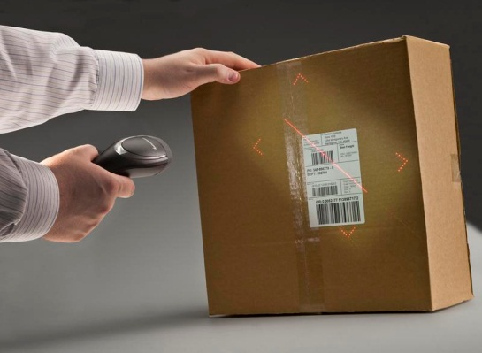
Choice
Linear 1D (EV performance) or High Performance 2D (EA30)
Cabled or Bluetooth Cordless
Standard Black or Healthcare Disinfectant White
Choice of available holders and Stands
Always the same look and feel!

Slide 8
Affordability
Each Scanner model and kit is price below the competition.
Making the SG20 extremely affordable in the General duty class.
Plus the SG20 is the only scanner that can boast time-to-read superiority.

Slide 9
Value Proposition
For Information Technology, Operations Directors and Vice Presidents who desire to improve the operator experience and profitability, the SG20 is a family of affordable handheld imagers that provides 50 times more motion tolerance to minimize the time and effort to read a bar code. Unlike leading incumbent solutions, the SG20 has industry leading motion tolerance which substantially improves first time read rates to increase operator efficiency.

Slide 10
Positioning Statement
The SG20 family of affordable bar code readers offers class leading imaging performance with a choice of linear or 2D, corded or cordless for the enterprise that is looking to improve their bar code data capture experience and increase profitability by improving data collection efficiency.

Slide 11
Product Overview
SG20 Family (General Duty Scanner) – 6 scanner models
  Tethered & Cordless
Key characteristics
  Leading 2D imager performance leveraged off EA30 technology providing the fastest 2D HHS scanner on the market
  Unique styling that sets it apart from traditional gun shaped HH’s
  Highly visible multi-color LED user feedback
  Attractive category leading pricing
  Reading from LCD screen (mobile couponing)
  2D image and video capture (2D models)
  USB trickle recharge for BT models
  5 yr warranty corded scanner; 3 yrs on cordless scanner

Slide 12

SG20 Model Number Configurator
SG20x xx – xxx
001 = std initial revision
00x = revision level
SG20T1D-001
SG20THP-001
SG20THPHC-001
SG20B1D-001
SG20BHP-001
SG20BHPHC-001
HP: High Performance 2D (EA30)
HC: Healthcare
1D: Linear Imager (EV Series)
T = tethered corded
B = Bluetooth cordless

Slide 13
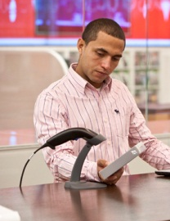
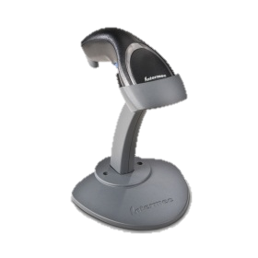
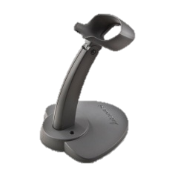
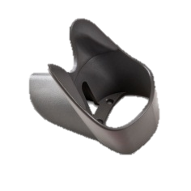
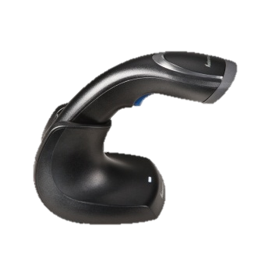

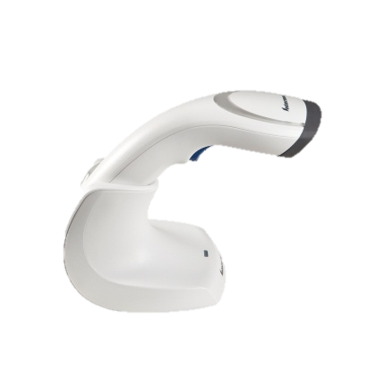
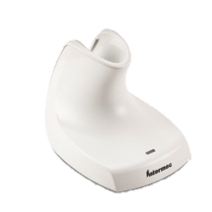
Product Overview
Accessories
  Adjustable Scan Stand
    Desktop/Wall holder
      BT Communication / charge base
        Healthcare aligned charge base

Slide 14
Easy order kits
Channel friendly kit / accessory pricing.
Same discount structure for cables and accessories - enables easy mix-n-match kitting.

Slide 15


DOF Charts
SG201D
SG20HP / SG20HPHC

Slide 16
Certifications
  Additional certifications will be supplied through CRISP

Slide 17
Target Markets and Applications

Slide 18
Target Markets (VDC 2011 Global Barcode Industry Business Planning)
Target markets ($m)
    In Store Retail, Light manufacturing, Back Office W/D, Office and Healthcare Patient apps
Market size, opportunity ($m)
    Gen Purpose Scanners account >75% mkt)
Target decision makers / influencers
    IT / Operations Directors and VP’s in target markets
    VAR / ISV’s are key influencers in the HHS purchase decisions

Slide 19

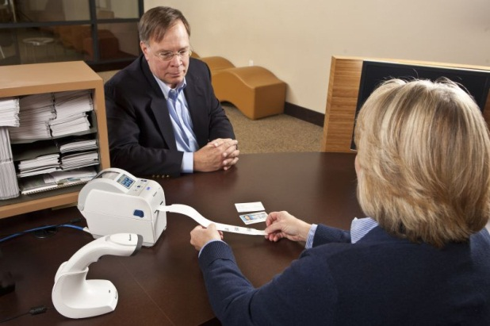
Healthcare Applications
Target applications
  Bedside care
  Meds dispensing
  Admissions
  Asset tracking
  Pharmacy
  Specimen tracking
Purchasing Decision
  Economic Buyer – Department IT (Business Ops, Laboratory, Pharmacy)
  Influencer – ISV and software application provider
  End User – Admissions staff, Nurses, Pharmacist
Needs
  Ensure 5 rights of patient safety
  Disinfectant Resistant Housing
  Omni-directional 2D reader
  Corded and / or Cordless

Slide 20

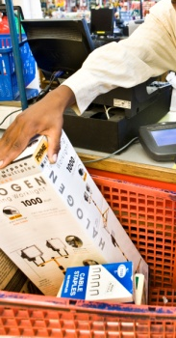

In Store Retail Applications
Retail POS Counter top Scanning
  Tier 2/3 regional / local stores
  Mall Specialty shops (Abercrombie, Gap)
  Liquor Stores / Gift Shops / Florists
  Secondary Scanner at POS (Grocery, DIY, Warehouse clubs)
  Drug / Pharmacy (CVS, Boots)
  Grocery specialty depts (Sushi, HBA, Deli)
  CEP retail counters (FedEx Store, UPS store, USPS)
  Library Desk (Book check out/in)
Purchase Decision
  IT and or Store Operations
  Influenced by end user tests
Needs
  Affordable
  Choice of corded or cordless
  High Performance

Slide 21
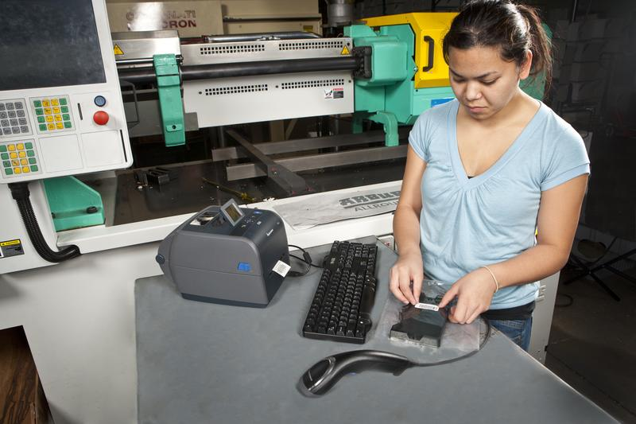
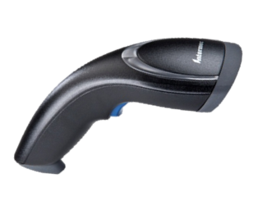
Manufacturing
Primary Target Applications
  Assembly Line Work in Process flow
  Shipping / Receiving dock door
  Tool crib asset tracking
Purchasing Decision
    Economic Buyer – Operations Manager
    Influencer – IT Director
    End User – Assembly & Back room personnel
Needs
  Speed and Accuracy
  Reliability
  1D & 2D capability
  Cordless

Slide 22
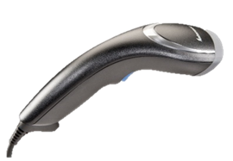
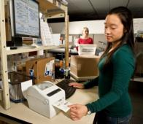
CEP / T&L Applications
Primary Target Applications
  Company owned or franchised retail stores (FedEx Kinkos)
  Shipping Receiving departments at CEP customer location
Purchasing Decision
  Economic Buyer – Purchasing or IT
  Influencer - IT or Marketing
  End User – Business customers or store personnel
Needs
  Reliable
  Easy to use
  Affordable
  Image Capture

Slide 23
Pricing
Will be in Discount Category “E”

Slide 24
Availability - launch is Feb 13, 2012
Insider is live now for partners
Public website live on Feb 13th
Global distribution supply chain will be stocked and ready to fulfill SG20 order demand at launch
All scanner configurations and accessories available at launch.
  One exception - Adjustable desktop scan stand available at the end of Feb / early March

Slide 25
Competition

Slide 26









Mainstream Competitive Scanners
Motorola LS2208 (corded 1D laser)
Motorola LS4278 (cordless 1D laser)
Motorola DS670x (Corded 2D imager)
Motorola DS6878 (cordless 2D Imager)
Honeywell 3800g, 3820g Linear Imager (corded and cordless)
Honeywell Voyager 9520 (1D laser corded and cordless)
Honeywell Xenon 1900, 4800g 2D Imager (corded and cordless)
Notes:
Gun form factor dominant in the GP scanner space – our research indicated most preferred countertop ergonomic was SP1800 like shape.
Form factor changes between corded and cordless

Slide 27
Competitive Overview
Re-establish Intermec as a full range supplier after several years of absence in the General Duty Scanner space.

Slide 28
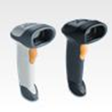
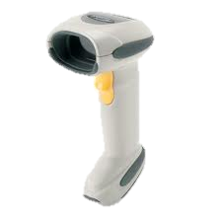
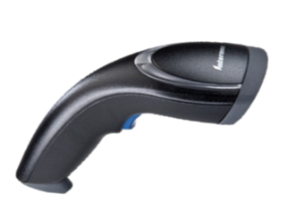


SG201D vs. Motorola LS2208/LS4278
Features | Intermec SG201D | Motorola LS2208/4278
Reliable Imager Technology | Linear imager | Laser
No moving parts
Large Multi-color LED
Unique Modern Style
Large Oversized LED
No external Battery

Slide 29
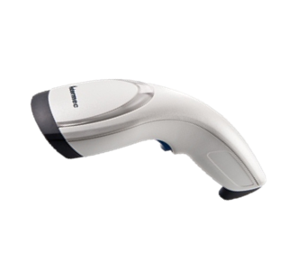
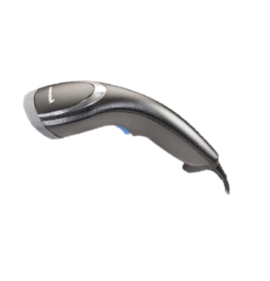
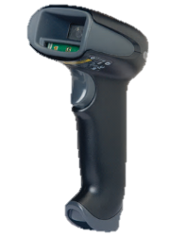
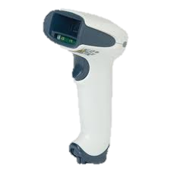


SG20HP vs. Honeywell 1900/1902g
Features | Intermec SG20HP | Honeywell 1900g
Extreme Motion Tolerance
High Visibility Aimer | Laser Framer
Fastest time to read
Unique Modern Style
VGA+ Imager
White Illumination (truest grayscale images)
Snappiest 2D reader available!

Slide 30
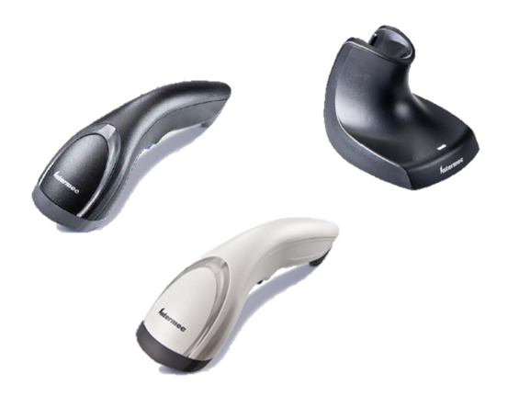
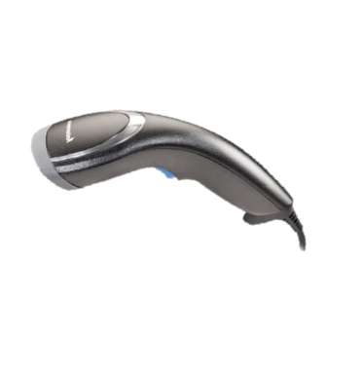
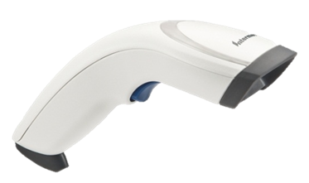
Competitive Migration Guide

Slide 31


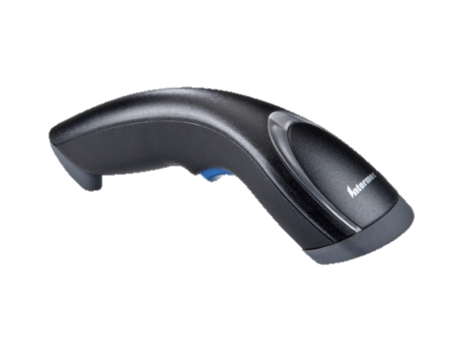

1D Competitive Migration Path
Linear Scanning
Motorola LS2208 scanner
Honeywell 1300g scanner
Honeywell / HHP 3800g scanner
Motorola LS4208 scanner
SG20T1D-001
Corded 1D scanning
Intermec Linear Imager reliability
5 yr warranty
SG20B1D-001
Motorola LS4278 scanner
Honeywell / HHP 3820g scanner
Cordless 1D scanning
Intermec Linear Imager reliability
3 yr warranty

Slide 32
2D Competitive Migration Path
2D Scanning
SG20THP-001
Motorola DS6708 scanner
Honeywell 1900g scanner
Corded 2D High Performance scanning
Intermec HP Imager speed
Fastest time to read of any imager
5 yr warranty
SG20BHP-001
Motorola DS6878 scanner
Honeywell 1902g scanner
Cordless 2D High Performance scanning
Intermec HP Imager speed
Fastest time to read of any imager
3 yr warranty

Slide 33

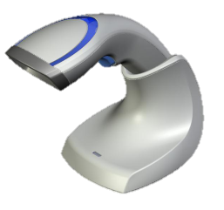
Healthcare Migration Path
Healthcare Scanning
SG20THPHC-001
Motorola DS6708 HC scanner
Honeywell 1900 HC scanner
Disinfectant Ready
Corded 2D High Performance scanning
Intermec HP Imager speed
Fastest time to read of any imager
5 yr warranty
SG20BHPHC-001
Motorola DS6878 HC scanner
Honeywell 1902 HC scanner
Disinfectant Ready
Cordless 2D High Performance scanning
Intermec HP Imager speed
Fastest time to read of any imager
3 yr warranty

Slide 34
ScanPlus 180X Migration Path
Linear Scanning
Intermec ScanPlus 1800SR
Intermec ScanPlus 1800VT
Intermec ScanPlus 1800ST
SG20T1D-001
Corded 1D scanning
Intermec Linear Imager reliability
5 yr warranty
SG20B1D-001
ScanPLus 1802VT
ScanPlus 1802SR
ScanPlus 1802ST
Cordless 1D scanning
Intermec Linear Imager reliability
3 yr warranty

Slide 35
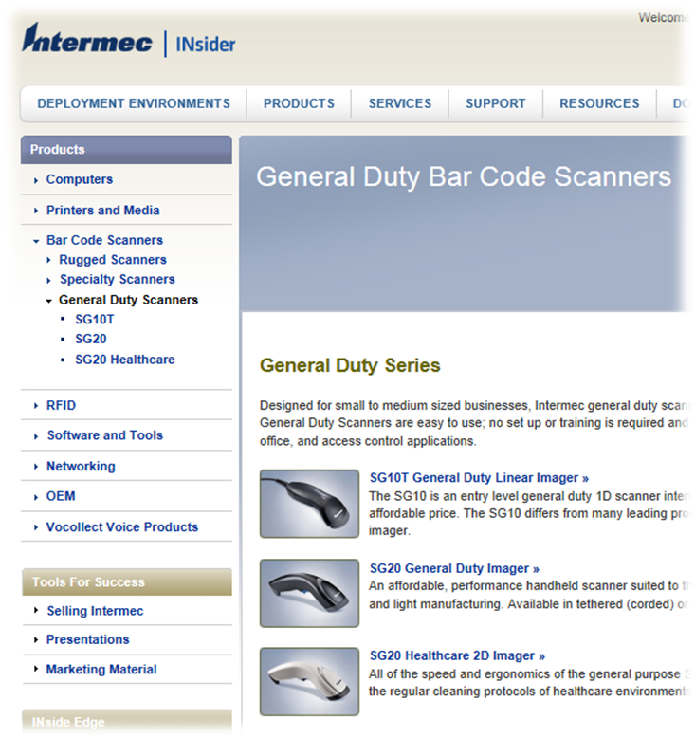
Where to find more info?
General Duty Scanner section on Insider
Look at the resources tab for each product to find more support material
  PPT
  Competitive Info
  Video
  FAQ’s
  Profile
  Scanner Selection Matrix
  Migration Guides

Slide 36

THANK YOU!
Visit the Solution Center to experience a hands on trail of the SG20.

Slide 37
Q&A

Slide 38
Appendix
Connectivity options

Slide 39
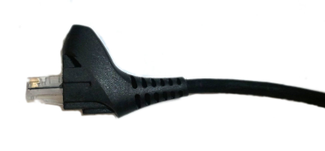
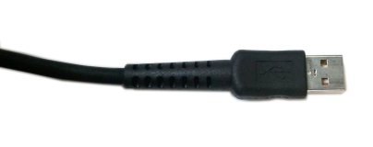
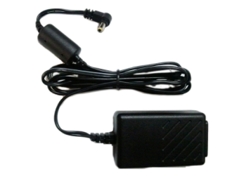
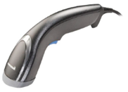
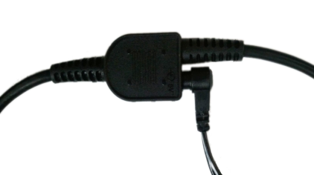
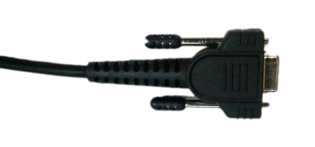
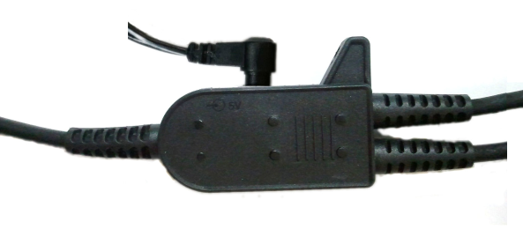
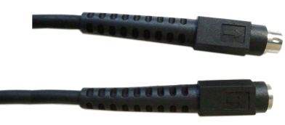
Connectivity: Corded to Host
USB
Type A
to PSU
PSU
Serial
Female DB9
to PSU
KBW PSU host dependent
PS/2
Keyboard
Mini-DIN

Slide 40
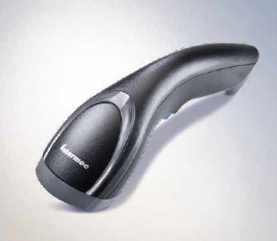



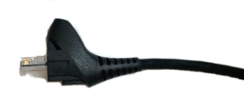
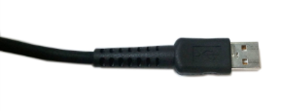







Connectivity: Cordless to Charge Base
Type B
Off-the-shelf USB
Type A
USB
Type A
to PSU
PSU
Serial
Female DB9
to PSU
PS/2
Keyboard
Mini-DIN

Slide 41








Connectivity: Cordless to Host
PC/tablet/printer with built-in Bluetooth
Intermec SD61 Bluetooth Hub
USB
Serial
Wand
PS/2
Custom
Intermec Bluetooth-to-Serial adapter
USB Bluetooth adapters

