Slide 1
SR31T Introduction
Julie Onephandara - June 30, 2013

Slide 2
Content
SR31T Line Up
Product Line Positioning
Product Overview & Value Proposition
Model Number Configurator
SR31T Family
Target Markets & Applications
Launch Schedule
Availability
Transition Plan
SR30 vs SR31T
Pricing & Competition
Marketing Collaterals

Slide 3
SR31T Line Up

Slide 4
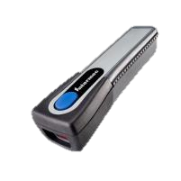
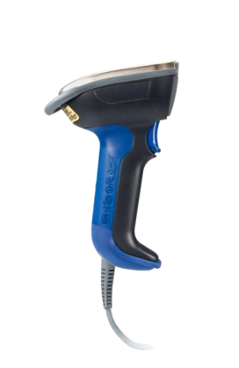
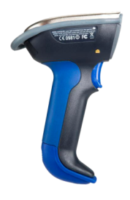
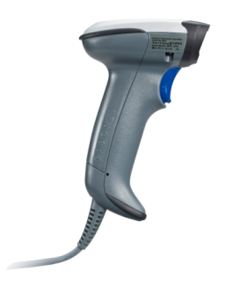
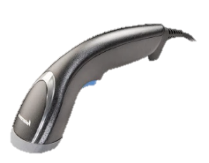
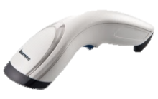
Product Line Positioning
Current
Industrial
Light
Industrial
Price
SF51
General Duty
SR61B
SR61T
SR30
Value Scanner
SG20 Family
SG10T Tethered
Ruggedness

Slide 5
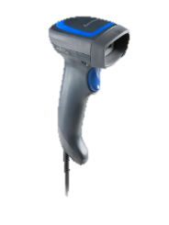
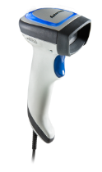
Product Line Positioning
New
Industrial
Price
General Duty
SF51
SR61B
SR61T
Value Scanner
Includes
1D & 2D models
Healthcare model
Wide range of acccessories
SR31T Family
SG20 Family
SG10T Tethered
Ruggedness

Slide 6
Redefining General Duty
Class leading scanning performance with class leading motion tolerance
Enhanced and leading drop (1.83m/6ft), IP (IP53) rating & tumble test (Over 2,000) for general duty
Oversized LED indicator & Vibrator
Accessories include cables, stands, holders
5 years warranty

Slide 7
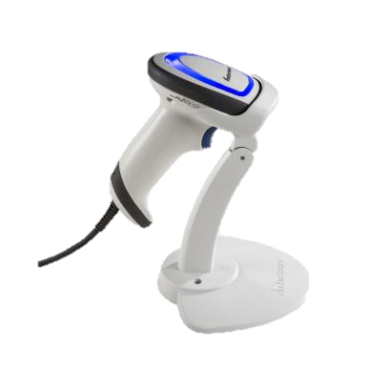
SR31T Model Number Configurator
SR31T xx-x xx xxx
Revision
001 = Standard Initial Revision
00x = Revision level
Accessories
U = USB cable
A= Adjustable Stand
Casing
S = Standard Dark
H= Healthcare
Scan Engine
HP = High Performance Laser 2D (EA30)
2D = High Performance LED 2D (EA31)
1D = Linear Imager (EV series)
2D
- H
UA
SR31T
001
Type
T = Tethered

Slide 8
SR31T Family
12 scanner models
Engine | Picture | Part Number | Description
1D (EV14+) |  | SR31T1D-S001 | SR31T1D (EV14+) LINEAR IMAGER
 |  | SR31T1D-SU001 | SR31T1D W/ USB CABLE
 |  | SR31T1D-SUA001 | SR31T1D W/ USB CABLE AND ADJ STAND
2D (EA31) |  | SR31T2D-S001 | SR31T2D (EA31) 2D IMAGER, LED
 |  | SR31T2D-SU001 | SR31T2D W/USB CABLE
 |  | SR31T2D-SUA001 | SR31T2D W/USB CABLE AND ADJ STAND
HP (EA30) |  | SR31THP-S001 | SR31THP (EA30) HP, 2D IMAGER, LASER
 |  | SR31THP-SU001 | SR31THP W/USB CABLE
 |  | SR31THP-SUA001 | SR31THP W/ USB CABLE AND ADJ STAND
HC (EA31) |  | SR31T2D-H001 | HC SR31T2D (EA31) 2D IMAGER, LED
 |  | SR31T2D-HU001 | HC SR31T2D W/ USB CABLE
 |  | SR31T2D-HUA001 | HC SR31T2D W/ USB CABLE AND ADJ STAND
Scanner Only
Channel Friendly Kit

Slide 9
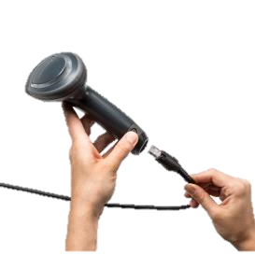
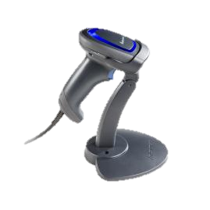
SR31T Family
Accessories available at launch
Accessories | Part Number | Description
Cables | SR31-CAB-K001 | KBW Cable, Str, PS2, Y Connection, 6.5ft
 | SR31-CAB-R001 | RS232 Cable, Str, 9 pin fem w/ PSU,6.5ft
 | SR31-CAB-U001 | USB Cable, Straight, 6.5ft
 | SR31-CAB-U002 | PWD USB Cable, Straight, w/ PSU, 6.5ft
Stands | SR31-STA-0001 | SR31 Adjustable Stand Dark
 | SR31-FLX-0001 | SR31 Gooseneck Stand Dark
 | SR31-STA-H001 | SR31 Adjustable Stand HC White
Same discount structure for cables and accessories
→ Enables easy partner Mix n’ Match kitting.

Slide 10
Target Markets & Applications

Slide 11
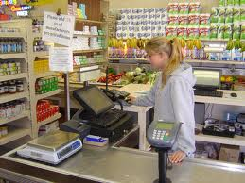
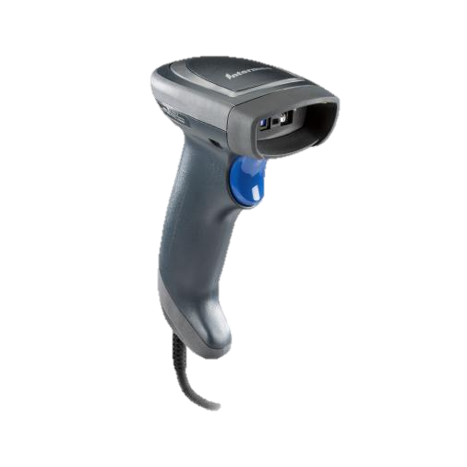
Target Markets: In Store Retail
Target App: POS Counter top Scanning
Department / Mass Merchants
Mall Specialty shops (Abercrombie, Gap)
Liquor Stores / Gift Shops / Florists
Secondary Scanner at POS (Grocery, DIY, Warehouse clubs)
Drug / Pharmacy (CVS, Boots, Walgreens)
CEP retail counters (FedEx Store, UPS store, USPS)
Library Desk (Book check out/in)
Purchase Decision
IT and or Store Operations
Influenced by end user tests
Needs
Durable and Reliable
Affordable
High Performance
Hands free stand auto trigger

Slide 12
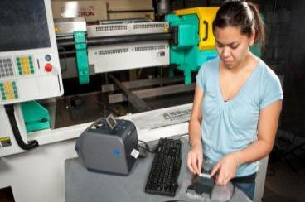
Target Markets: Manufacturing
Primary Target Applications
Assembly Line, Work-in-Process flow
Shipping / Receiving dock door
Tool crib asset tracking
Purchasing Decision
Economic Buyer – Operations Manager
Influencer – IT Director
End User – Assembly & Back room personnel
Needs
Speed and Accuracy
Durable & Reliability
1D & 2D capability
Adapted operator’s feedback to noisy environment
(Adjustable vibrator & beeper)

Slide 13
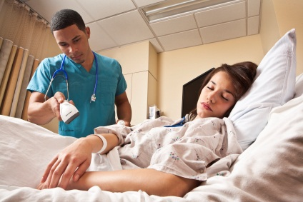
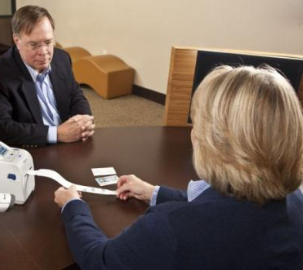
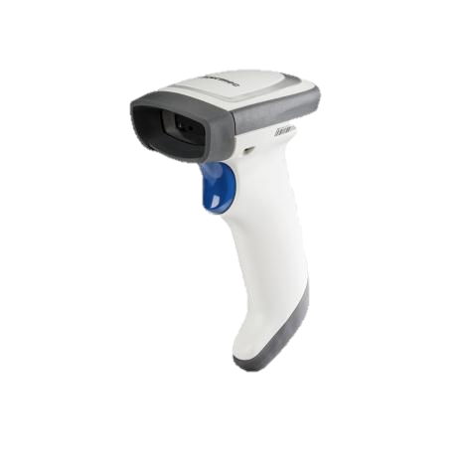
Target Markets: Healthcare
Target applications
Meds dispensing
Admissions
Asset tracking
Pharmacy
Specimen tracking
Purchasing Decision
Economic Buyer – Department IT (Business Ops, Laboratory, Pharmacy)
Influencer – ISV and software application provider
End User – Admissions staff, Nurses, Pharmacist
Needs
Ensure 5 rights of patient safety
Disinfectant Resistant Housing
Omni-directional 2D reader
Durable and Reliable
Silent mode (No beep, No LED)

Slide 14
Launch Schedule

Slide 15
Availability Schedule
Timing | Event
June 18 | Public announcement; public site goes live Preliminary PP & Pre-recorded WebEx sales training
Mid July | BDU’s Distribution
End July - Beg August | Production start
Beg August | Q3 Intermec Price Guide
End Aug | Distributors stocked Co-brandable materials on IN Partner Concierge
Sept | Awareness and Demand generation activities begin

Slide 16
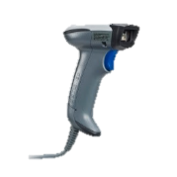
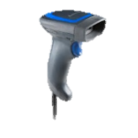
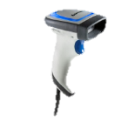
Transition Plan
 | SR30 | SR31
1D | SR30AV (EV12) | SR31T1D (EV14+)
2D | SR30AA (EA15) | SR31T2D (EA31) SR31THP (EA30)
HC |  | SR31T2D-H (EA31)
Objectives :
Must not stall or delay existing run rate for the SR30 line
→ 1 year transition period from SR31T product availability
October : First EOB notice

Slide 17
SR30 vs SR31T
 | SR30 | SR31
1D Scan Engine Reading Range | EV12 5 - 84 cm (2 - 33.1 in) | EV14+ 3.5 – 86 cm (1.4 – 33.4 in)
2D Scan Engine Motion Tolerance Reading Range Aimer | EA15 Below 10 in/s 0 – 83 cm (0 – 32.4 in) LED | EA31 400 in/s 3 – 116 cm ( 1.2 – 45.7 in) LED | EA30 500in/s 3 – 124 cm ( 1.2 – 48.8 in) Laser
Healthcare version | None | Yes
Image Capture | USB 1.1 | USB 2.0 Full Speed
Drop Specs | 26 drops from 1,5m (5 ft) | 26 drops from 1,83m (6 ft)
IP Rating | IP30 | IP53
Storage temperature | -20°C to +70°C (-4°F to +158°F) | -20° C to 60° C (-4° F to 140° F)
User interface | Beep | Beep, LED, Vibrator

Slide 18
Pricing & Competition

Slide 19
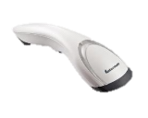
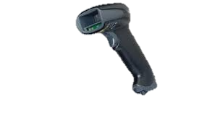
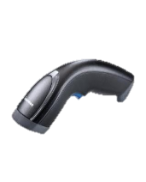
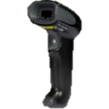
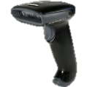
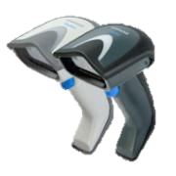
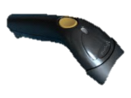
Competitive Positioning General Duty Category
SR31T
Performance
Motorola 2208 & 4208
HON
Xenon
Value Scanners
SG20 Family
DataLogic
Gryphon
SG10
Price

Slide 20
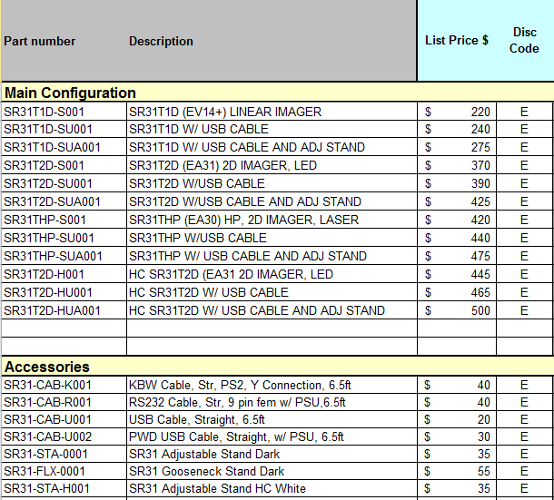
$ US Pricing
Strategy :
Be in line vs. key competition
Mix n’ Match Policy
$ 20 for the USB kit
$ 55 for the USB + Adj Stand kit
2D segment
Apply $50 premium between 2D and HP version

Slide 21
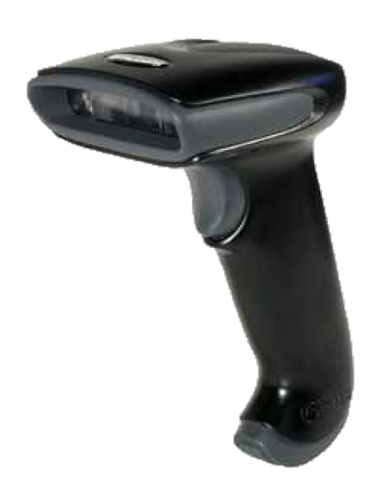
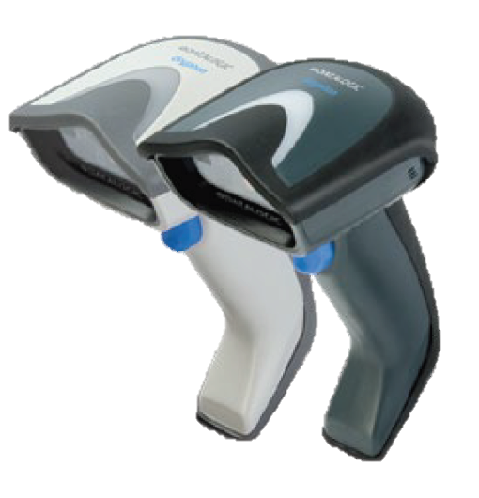
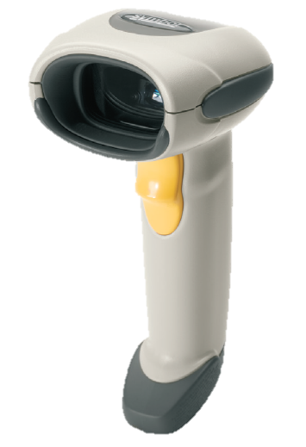
1D Competitive landscape (US)
 | Hyperion 1300G | SR31T1D-S001 | GD4130-BK | LS4208
Engine |  | EV14+
Scan pattern | Single line | 617nm Highly Visible LED | Dual LED Array 630 - 670 nm | 650 nm laser diode
Motion tolerance | 20 in/s |  |  | 200 in/s
Scan rate | Up to 270 scans/s max | 200 scans/s max | 325 scans/s max | 200 scans/s max
Print contrast | 20% minimum reflectance difference | down to 25% | 15% | 25% minimum reflectance difference
Reading distance (DOF)
Code 39 - 5 mils | 2.0˝ - 8˝ (6”) 5 - 20 cm (15 cm) | 1.38” – 9.45” (8.07”) 3.5 – 24 cm (20.5 cm) | 2.3” - 7.0” (4.7”) 6.0 - 18.0 cm (12cm) | 1.5” - 5.5” (4.0”) 3.81 - 13.97 cm (10.16 cm)
Code 39 - 10 mils | 1.0˝ - 15˝ (14”) 3 - 38 cm (35 cm) | 1.38” – 12.2”(10.83”) 3.5 – 31.0 cm (27.5 cm) | 0.8” - 17.7”(16.9”) 2.0 - 45.0 cm (43.0 cm) | 0.0” - 14.0” (14.0”) 0.00 - 35.56 cm (35.56 cm)
100% UPC – 13 mil | 0.5˝ - 18˝ (17.5”) 1 - 46 cm (45 cm) | 1.26” – 12.40” (11.14”) 3.2 – 31.5 cm (28.3 cm) | 1.2” - 23.4” 3.0 - 60.0 cm (57.0 cm) | 0.0 - 19.0” ( 19.0”) 0.00 - 48.25 cm (48.25 cm)
Operating temperature | 0° to 50° C +32°F to +122°F | 0° to 50° C +32°F to +122°F | 0 to 55°C +32°F to +131°F | 0° to 50° C +32°F to +122°F
Storage temperature | -40° to 60° - 40°F to +140F | -20° to 70° - 4°F to +158°F | -20° to 70° - 4°F to +158°F | -40° to 70° - 40°F to +158°F
Humidity | 0-95% non condensing | 5-95% non condensing | 0-90% | 5-95% non condensing
Drop | 50 drops to 1,5m concrete | 26 drops to 1,83m concrete | 18 drops to 1,8m concrete | Multiple drops to 1,8m concrete
Tumble test |  | Over 2000
Environmental sealing | IP41 | IP53 | IP52 | IP43
Light levels | 0-70 000 lux | 0-100 000 lux | 0-100 000 lux | 4844-86111 lux
Scanner | $190 | $220 | $226 | $265
USB Kit | $209 | $240 | $239 | $292
USB + Stand kit |  | $275

Slide 22
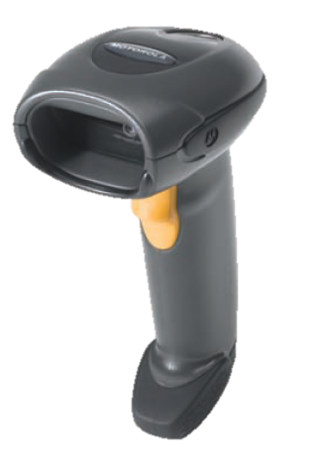
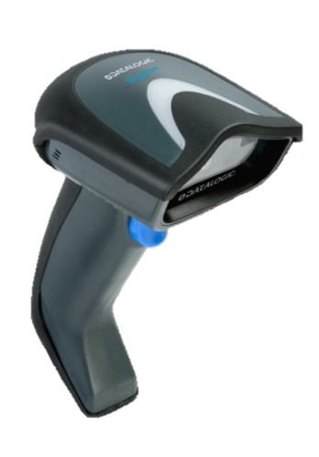
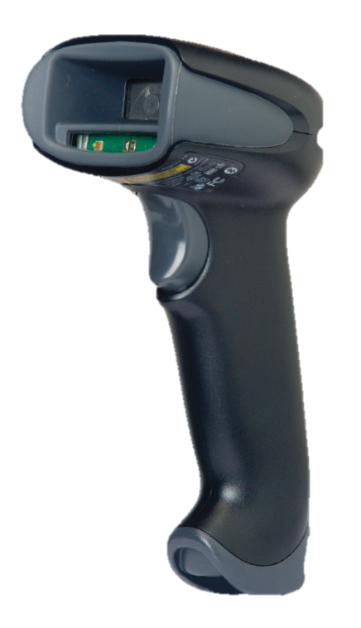
2D Competitive Landscape (US)
 | DS4208 | SR31T2D-S001 | DS6707 -SR | GD4430 | SR31THP-S001 | Xenon 1900 SR
Engine |  | EA31 |  |  | EA30
Scan pattern | Aiming pattern: 617 nm LED Illumination: 625 nm LEDs | LED | Aiming: 650 nm laser diode Illumination: 630 nm LED | LEDs | Laser | LED
Motion tolerance | Up to 25 inch /s | Up to 400’’ or 10.16m/s | 5 in. (12.7 cm) /s |  | Up to 500’’ or 12.7m/s | 240 in/s
Print contrast | 25% mininum | Down to 25% | 25% minimum | 25% minimum | Down to 25% | 20% mininum
Reading distance (DOF)
Code 39 – 5 mil | 0.2” - 6.86” (6.84”) 0.5 - 17.3cm (16.8 cm) | 1.18”– 9.06” (7.87”) 3 – 23 cm (20 cm) | 1.1 ”- 6.5 ” (5.4”) 2.8-16.5 cm (13.7 cm) | 1.6” -7.5”(5.9”) 4.0 - 19cm (15 cm) | 1.18''– 10.24”(9.06”) 3 – 26 cm (23 cm) | 1.1˝ - 5.3˝(4.2˝) 2.79 -13.46 cm (10.67 cm)
100% UPC – 13 mil | 0.3 ” - 15.2 ”(14.9”) 0.8 - 38.6 cm (37.8 cm) | 1.57” – 15.75” (14.17”) 4 – 40 cm (36 cm) | 0.5 ”- 9.7 ”(9.2”) 1.3 - 24.6 cm (23.3 cm) | 0.6” - 15.7” (15.1”) 1.5 - 40cm (38.5 cm) | 1.57 – 18.11” (16.54”) 4 – 46 cm (42 cm) | 0.4 – 17.3'' (16.9˝) 1.02 – 43.94 cm (42.92 cm)
Datamatrix – 10 mil | 0.4 ” - 7.2 ” (6.8” ) 1.0 - 18.3 cm (17.3 cm) | 1.57” – 7.09” (5.51”) 4 – 18 cm (14 cm) | 1.1” - 7.5 ” (6.4”) 2.8 - 19.1 cm (16.3 cm) | 0.8” - 6.3” (5.5 ”) 2.0 - 16cm (14 cm) | 1.97” – 8.27” (6.3”) 5 – 21 cm (16 cm) | 0.5˝ - 7.5˝ (7.0˝) 1.27 - 19.05 cm (17.78 cm)
Operating temperature | 0° to 40° C +32°F to +104°F | 0° to 50° C +32°F to +122°F | 0° to 50° C +32°F to +122°F | 0° to 55° C +32°F to +131°F | 0° to 50° C +32°F to +104°F | 0° to 50° C +32°F to +104°F
Storage temperature | -40° to 70° - 40°F to +158°F | -20° to 70° - 4°F to +158°F | -40° to 70° - 40°F to +158°F | -20° to 70° - 4°F to +158°F | -20° to 70° - 4°F to +158°F | -40° to 70° - 40°F to +158°F
Drop | Withstands multiple 6 ft. (1.83 m) drops to concrete | 26 drops to 1,83m concrete | Withstands multiple 6 ft. (1.83 m) drops to concrete | 18 drops to 1,83m concrete | 26 drops to 1,83m concrete | 50 drops to 1,8 m concrete
Tumble test |  | Over 2000 |  |  | Over 2000
Environmental sealing | IP43 | IP53 | IP41 | IP52 | IP53 | IP43
Light levels | 1600 - 86 000 lux | 0-100 000 lux | Immune to normal artificial indoor and natural outdoor (direct sunlight) lighting. | 0-100 000 lux | 0-100 000 lux | 0-100 000 lux
Scanner | $308 | $370 | $389 | $406 | $420 | $449
USB Kit | $338 | $390 | $416 | $423 | $440 | $467
USB + Stand kit |  | $425 |  | $438 | $475 | $582

Slide 23
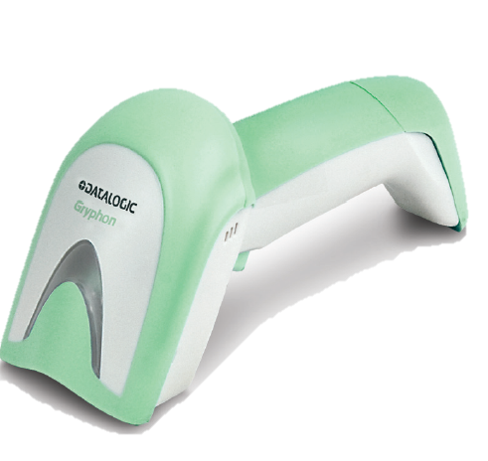
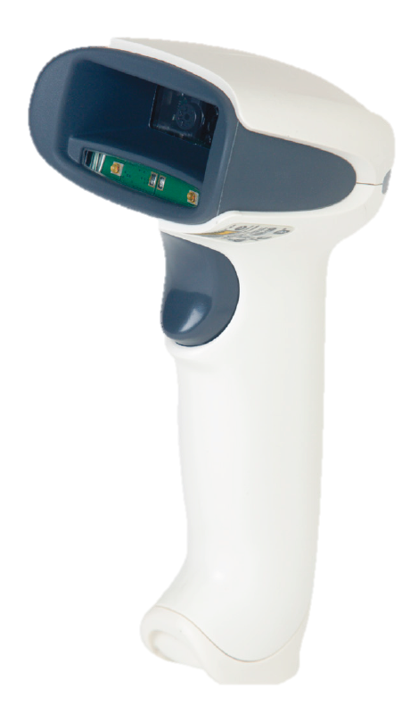
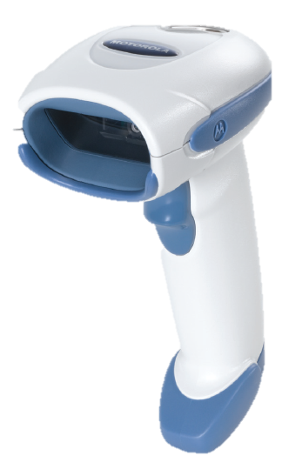
HC Competitive Landscape (US)
 | DS4208 | DS6707 -SR | SR31T2D-H001 | GD4430 | Xenon 1900 HD
Scan pattern | Aiming pattern: 617 nm LED Illumination: 625 nm LEDs | Aiming: 650 nm laser diode Illumination: 630 nm LED | LED | LEDs | LED
Motion tolerance | Up to 25 inch /s | 5 in. (12.7 cm)/s | Up to 400’’ or 10.16m/s |  | 240 in/s
Print contrast | 25% mininum | 25% minimum | Down to 25% | 25% minimum | 20% mininum
Reading distance
Code 39 – 5 mil | 0.2” - 6.86” (6.84”) 0.5 - 17.3 cm (16.8 cm) | 1.1 ”- 6.5 ” (5.4”) 2.8 - 16.5 cm (13.7 cm) | 0.79”– 7.87” (7.08”) 2 – 20 cm (18 cm) | 1.6” -7.5”(5.9”) 4.0 - 19cm (15 cm) | 0˝ - 4.1˝(4.1˝) 0 - 10.41 cm (10.41 cm)
100% UPC – 13 mil | 0.3 ” - 15.2 ”(14.9”) 0.8 - 38.6 cm (37.8 cm) | 0.5 ”- 9.7 ”(9.2”) 1.3 - 24.6 cm (23.3 cm) | 1.18” – 14.96” (13.78”) 3 – 38 cm (35 cm) | 0.6” - 15.7” (15.1”) 1.5 - 40cm (38.5 cm) | 0.4 – 6.6'' (6.2˝) 1.02 – 16.76 cm (15.74 cm)
Datamatrix – 10 mil | 0.4 ” - 7.2 ” (6.8” ) 1.0 - 18.3 cm (17.3 cm) | 1.1” - 7.5 ” (6.4”) 2.8 - 19.1 cm (16.3 cm) | 1.18” – 6.69” (5.51”) 3 – 17 cm (14 cm) | 0.8” - 6.3” (5.5 ”) 2.0 - 16cm (14 cm) | 0˝ - 5˝ (5˝) 0 - 12.7 cm (12.7 cm)
Operating temperature | 0° to 40° C +32°F to +104°F | 0° to 50° C +32°F to +122°F | 0° to 50° C +32°F to +122°F | 0° to 55° C +32°F to +131°F | 0° to 50° C +32°F to +122°F
Storage temperature | -40° to 70° - 40°F to +158°F | -40° to 70° - 40°F to +158°F | -20° to 70° - 4°F to +158°F | -20° to 70° - 4°F to +158°F | -40° to 70°
Humidity | 5-95% non condensing | 5-95% non condensing | 5-95% non condensing | 5-90% non condensing | 5-95% non condensing
Drop | Withstands multiple 6 ft. (1.83 m) drops to concrete | Withstands multiple 6 ft. (1.83 m) drops to concrete | 26 drops to 1,83m concrete | 18 drops to 1,5 m concrete | 50 drops to 1,8 m concrete
Tumble Test |  |  | Over 2000
Environmental sealing | IP43 | IP41 | IP53 | IP52 | IP41
Light levels | 1600 - 86 000 lux | Immune to normal artificial indoor and natural outdoor (direct sunlight) lighting. | 0-100 000 lux | 0-100 000 lux | 0-100 000 lux
Scanner | $348 | $439 | $445 | $447 | $485
USB Kit | $378 |  | $465 | $464 | $504
USB + Stand kit |  |  | $500

Slide 24
Marketing Collaterals

Slide 25
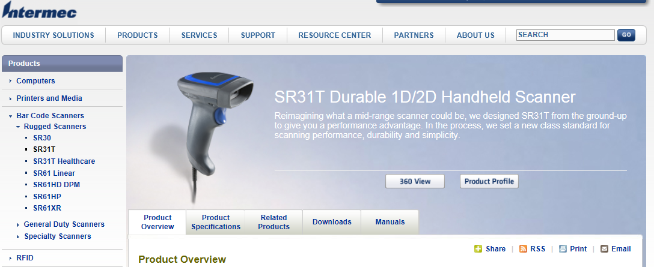
Where to find more info?
Rugged Scanner section on Insider
Look at the resources tab for each product to find more support material :
Available now : Preliminary Product Profile, Sales PPT, Pre-recorded Webex Training
Available in September : Final Product profile, FAQ, Migration Guide, Competitive Info, Accessory Guide
Approved Disinfectant, Product Videos, Updated Product Matrix

Slide 26
SR31T Summary
Durable General Duty Scanner
Available in 1D, 2D, HP and HC
User’s interface : Oversized LED, Beeper & Vibrator
Better Drop, IP rating and Tumble test specs
Wide range of accessories
Target markets : In-Store Retail, Manufacturing,
Healthcare
Competitive list prices

