Slide 1

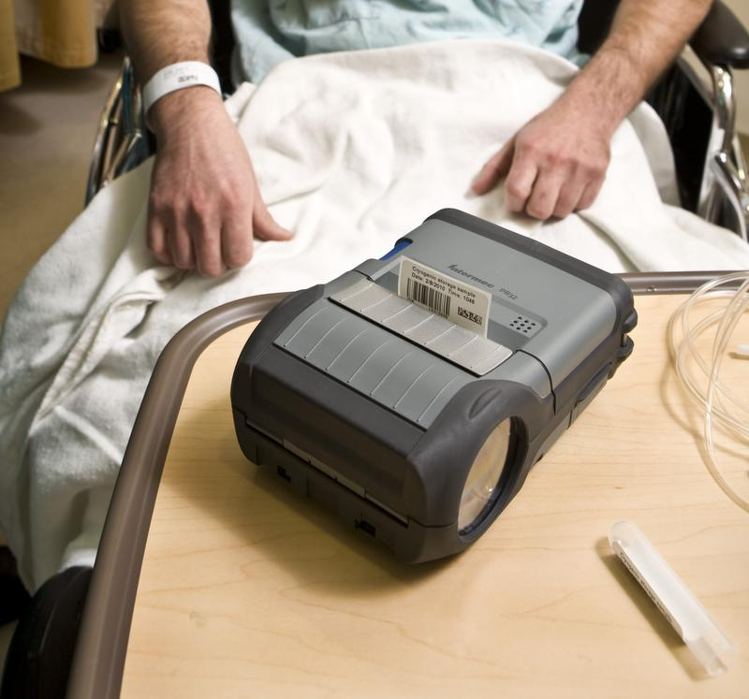


Intermec Bar Code Printing Solutions:
Solving Healthcare Challenges
Tom Roth | Printers & Media Division
August 9, 2010

Slide 2

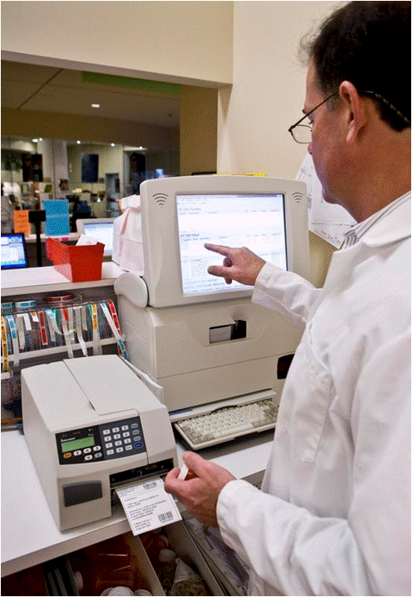

What You’ll Learn Today:
How large is the healthcare printer opportunity?
Who are the target customers?
What are their key challenges?
What are Intermec’s solutions by application and why Intermec is the smart choice?
What healthcare selling tools are available and where do I find them?

Slide 3
Printer Opportunity in Healthcare
Source: 2010 VDC Printer Report
CAGR (2009-2014): 6%
Notes:
The Americas region represents over 50% of total shipment revenues

Slide 4
Healthcare Target Customer Segments
General Medical and Surgical Hospitals (SIC: 8062)
Over 6,000 hospitals in the US*
$642 Billion in annual revenues*
52% of hospitals have more than 100 beds*
Need: Provide higher quality and faster service at lower costs
Medical Laboratories (SIC: 8071)
170,000 medical labs in the US*
$38 Billion in annual revenues*
58% of labs are in doctor’s offices*
Need: Move testing to the point of care for faster, more accurate diagnosis and treatment
Offices & Clinics of Medicine (SIC: 8011)
66,700 family & general physicians in the US (US Dept of labor)
23,000 licensed clinics in the US (General Actg Office)
20% of healthcare dollars go to administrative costs (Lewin-VHI consulting)
Need: Automation delivering cost, claims and patient recording efficiencies
*(2002-2010 US Statistical Abstract)

Slide 5
Healthcare Organizations are Under Unprecedented Pressure…
Increasing Patient Safety & Reducing Errors
Meeting FDA and HIPAA Requirements
Providing More Services With Constrained Budgets
Improving Efficiencies
Totals exceed 100% because labels could have multiple errors.
Source: College of American Pathologists Q-Probe Study
Source: College of American Pathologists Q-Probe Study
…Intermec’s solutions can help.

Slide 6

Intermec printers & media can help healthcare customers:
Confidently identify patients
Accurately bar code patient charts, medications & records
Ensure correct specimen to patient relationships
Identify & store specimens/samples, regardless of the environment
….and more.
U.S. Food and Drug Administration
“Hospitals could eliminate 50 percent of their medication administration errors by scanning bar codes at the point of care to positively identify patients, the medication they are about to receive and match the information to a physician order.”¹
¹“Bar Code Label Requirements for Human Drug Products and Biological Products; Final Rule” Department of Health and Human Services, Food and Drug Administration. Federal Register Notice, February 26, 2004 (Volume 69, Number 38) Page 9120. Viewable online at: www.fda.gov/OHRMS/DOCKETS/98fr/04-4249.htm.
Notes:
The FDA rule calls for the inclusion of linear bar codes on most prescription drugs and on certain over-the-counter drugs that are commonly used in hospitals and dispensed pursuant to an order. Each bar code for a drug will have to contain, at a minimum, the drug’s National Drug Code number. This information will be encoded within the bar code on the label of the product. In addition, the rule requires the use of machine-readable information on container labels of blood and blood components intended for transfusion. These labels, which are already used by most blood establishments, contain FDA-approved, machine-readable symbols identifying the collecting facility, the lot number relating to the donor, the product code, and the donor's blood group and type.
FDA information on medication errors can be found at: http://www.fda.gov/Drugs/DrugSafety/MedicationErrors/default.htm
HIPAA requirements are extensive with regards to protecting the privacy and security of health information. Entities must provide individuals with certain rights with respect to their health information. HIPAA Requirements for Covered Healthcare organizations can be found at: http://www.hhs.gov/ocr/privacy/hipaa/understanding/coveredentities/index.html
Intermec satisfies the FDA requirements by providing a bar code printer and media that results in a readable label for the appropriate drugs, containers and products

Slide 7
Intermec Printers: The Smart Choice for Healthcare
Complete Compelling Product Solutions Designed for Healthcare
Leading Healthcare Software Provider Certifications
Network Connectivity and Security Leadership
Best-in Class Services and Support
Proven Experience & Global Reach
Healthcare Optimized Media Options
From admissions and prescriptions to patient bedsides, Intermec bar code printing solutions are designed to meet Healthcare’s greatest challenges

Slide 8
Bar Code Printing Solutions for Healthcare
APPLICATION | PRINTER |  |  |  |  | MEDIA
 | Desktop PF8 / PC41 | Mobile PB22/32/50 | Commercial PD41/42 | Mid-Range PM4i PF2/4 | High Performance PX4i/PX6i
Certifications Achieved | Cerner (PC41) Meditech (PF8) | Cerner Meditech | Meditech | Cerner Meditech (PM4i) | Cerner (PX4i) Meditech
Patient Tracking/Administration (patient ID/wristbands) | X |  | X |  |  | X
Point of Care/Bedside (specimen, diet, in-home care) |  | X |  |  |  | X
Security & Records (patient, medical records) | X |  | X | X | X | X
Pharmacy Labeling (unit dose & prescription) | X |  |  | X | X | X
Laboratory (specimen, vial labeling) | X |  |  | X | X | X
Supply Inventory (materials, shipping/receiving) |  |  | X | X | X | X
Asset Tracking (High value equipment labeling) |  |  | X | X | X | X

Slide 9
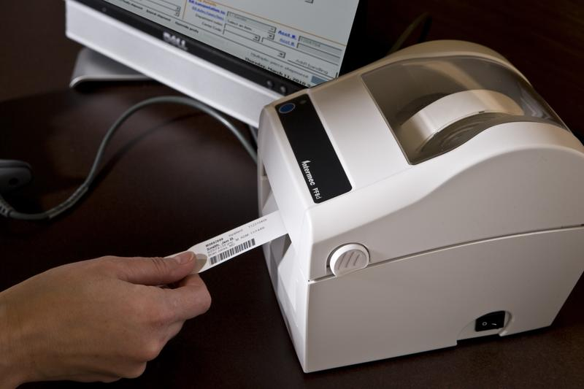
Patient Tracking & Administration
Applications: Patient ID/wristbands
Audience: IT (Buyer), Admissions (Influencer)
Target Printers: PF8 Desktop, PC41 Desktop, PD41/42 Commercial
Media: INband Wristband
Benefit | Feature
Increase patient confidentiality & security Comply with HIPAA privacy | Direct thermal (no ribbons to destroy) A leading range of wireless connectivity and security protocols compatible with hospital networks
Increase wristband efficiencies No media waste | Printer sensors for proper printing alignment every time Optimal solution – Intermec printer + INBand wristband Media designed to withstand moisture, soaps, foam, washes, hand sanitizer, extreme temps & repeated exposure while resting comfortable on patient’s wrist
Implement a worry-free, easy to use wristband solution | Small form factor, quiet, clean-look Minimal staff set-up and support needs PrintSet configuration tool for fast set-up and upgrades Free printheads for life with purchase of Intermec printer and media iFast Program –Support team dedicated to ensuring easy drop-in for any printer language environment

Slide 10
Point of Care & Bedside
Applications: Specimen, diet, in-home care labeling
Audience: IT (Buyer), Operations (Influencer), Nursing (Influencer)
Target Printers: PB22/32/50 Rugged Mobile Label Printers
Media: Duratherm III Paper Permanent; Duratherm III Synthetic Permanent
Benefit | Feature
Increase patient confidentiality & security | A leading range of wireless connectivity and security protocols compatible with hospital networks Direct thermal (no ribbons to destroy)
Enable faster patient care | The industry’s fastest time to first label Label patient specimens, blood bags, medications—and even food—right at the point of care eliminates chance for mislabel
Reduce errors, streamline processes & reduce TCO | Displays with easy-to-use controls, saves time for users and can prevent data entry errors and misprinted labels Label sensors minimize printing errors and reduce waste The industry’s only mobile smart printers –can direct a user’s actions; interact with other devices & applications; eliminate the need for host PC Media designed to label curved/irregular surfaces across a wide range of applications (such as vials and blood bags)
Implement a worry-free, easy to use mobility solution | Rugged and reliable Easy to wear/carry; removable batteries that last Optimized with Intermec Mobile Computers and Scanners

Slide 11

Security & Records
Applications: Patient medical records labeling
Audience: IT (Buyer), Admissions (Influencer)
Target Printers: PF8 & PC41 Desktop, PD41/42 Commercial, PM4i & PF2/4 Mid-Range, PX4i/PX6i High Performance
Media: Duratran II Label
Benefit | Feature
Increase patient confidentiality & security | Industry leading network connectivity and security protocols Industry’s only CCX and Wi-Fi certified for added security confidence (PD41/42, PM4i & PF2/4, PX4i/PX6i only)
Increase efficiencies No costly media waste | On-demand printing – print a label only when needed Designed for quick and easy media loading Media designed specifically for medical environments and conditions including common sterilization activities
Implement a worry-free, easy to deploy solution | Compatible with hospital networks for easy, seamless deployment Highly flexible as additional applications and systems are developed Highly reliable, minimal IT support Free printheads for life with purchase of Intermec printer and media iFast Program – Support team dedicated to ensuring easy drop-in for any printer language environment
Notes:
Printer choice depends on volume –
PF8/PC41= occasional printing (<2 rolls or 1K labels/day)
PD41/42 = light duty (1K-4K labels/day)
PM4i; PF2/4 = medium duty (2k – 7k labels/day)
PX4i/6i = high volume, 24x7 operations (5K-10K labels/day)

Slide 12
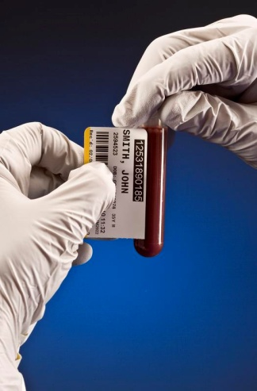
Pharmacy & Laboratory
Applications: Unit dose & prescription labeling
Audience: IT & Laboratory /Medical Management (Buyer), Operations (Influencer)
Target Printers: PF8 Desktop, PC41 Desktop, PM4i Mid-Range, PF2/4 Mid-Range, PX4i/PX6i High Performance
Media: Duratran II polyester & clean room polyester label; Duratran II clean room polypropylene label; Duratherm III paper, permanent & controlled removable label; Duratran S label; Duratran Kimdura label
Benefit | Feature
Increase patient confidentiality & security | Industry leading network connectivity & security protocols Industry’s only CCX and Wi-Fi certified for added security confidence (PM4i, PF2/4 and PX4i/6i only)
Reduce errors | High quality, long lasting output – small symbols suitable for vials, syringes, ampoules, IV bags, tablets & other forms Media designed to label curved/irregular surfaces across a wide range of applications (such as test tubes and slides) and environments (frozen storage, warming and chemical agents)
Implement a worry-free, easy to deploy solution | Compatible with hospital networks for easy, seamless deployment Highly flexible as additional applications and systems are developed Free printheads for life with purchase of Intermec printer and media iFast Program – Support team dedicated to ensuring easy drop-in for any printer language environment
Notes:
Printer choice depends on volume –
PF8/PC41= occasional printing (<2 rolls or 1K labels/day)
PM4i; PF2/4 = medium duty (2k – 7k labels/day)
PX4i/6i = high volume, 24x7 operations (5K-10K labels/day)

Slide 13
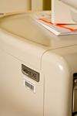
Supply Inventory & Asset Tracking
Applications: Shipping/receiving, materials & high value equipment labeling
Audience: IT & Operations (Buyer)
Target Printers: PD41/42 Commercial, PM4i Mid-Range, PF2/4 Mid-Range, PX4i/PX6i High Performance
Media: Duratran II Label; Duratran II Gloss Polyester Label; Duratran II Kimdura Label
Benefit | Feature
Increase patient confidentiality & security | Industry’s leading network connectivity & security protocols Industry’s only CCX and Wi-Fi certified for added security confidence
Reduce errors, streamline processes & reduce TCO | Smart printers – can direct a user’s actions; interact with other devices & applications; eliminate the need for host PC Designed for quick and easy media loading Media designed to remain firmly affixed and readable even after repeatedly enduring common sterilization methods
Implement a worry-free, easy to deploy solution | Proven track record of producing high quality labels for tracking as well as permanent automatic identification All-in-one programming languages enable quick deployment Printhead can be easily replaced without tools; free printheads for life with purchase of Intermec printer and media PrintSet configuration tool for fast set-up and upgrades iFast Program – Support team dedicated to ensuring easy drop-in for any printer language environment
Notes:
Printer choice depends on volume –
PD41/42 = light duty (1K-4K labels/day)
PM4i; PF2/4 = medium duty (2k – 7k labels/day)
PX4i/6i = high volume, 24x7 operations (5K-10K labels/day)

Slide 14
New! Healthcare Collateral and Tools
APPLICATION | TOOLS
Overall Healthcare Segment | Solutions brochure At-a-Glance Sales Presentation
 | White Papers: | Printer Case Studies: | Printer Media Application Briefs:
Patient Tracking/Administration (patient ID/wristbands) | Improve Patient Safety With a Quality Wristband Solution |  | Wristbands
Point of Care/Bedside (specimen, diet, in-home care) | Using Bedside Labeling to Reduce Errors and Improve Efficiency |  | Mobile Sample Labeling Blood Bag Labeling
Security & Records (patient, medical records) |  |  | Coming Soon
Pharmacy Labeling (unit dose & prescription) | Coming Soon | Massachusetts General Hospital Denco Data | Pill Bottle Labeling Pharmaceutical /Biotech Labeling
Laboratory (specimen, vial labeling) |  |  | Pharmaceutical /Biotech Labeling
Supply Inventory (materials, shipping/receiving) |  |  | Coming Soon
Asset Tracking (High value equipment labeling) |  | Medtronic | Coming Soon
For Partners: INsider>>Vertical Focus>>Healthcare
For Your Customers: www.Intermec.com/solutions/healthcare

Slide 15
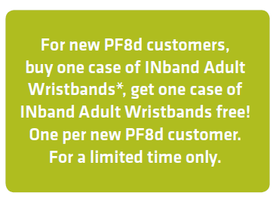
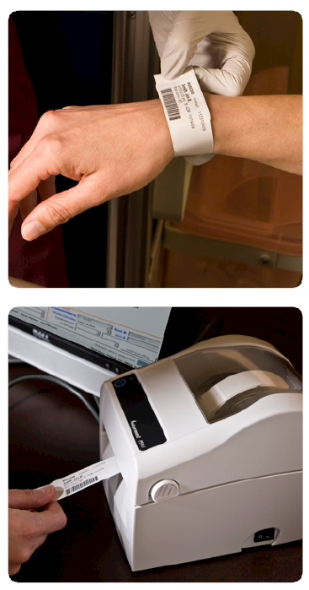
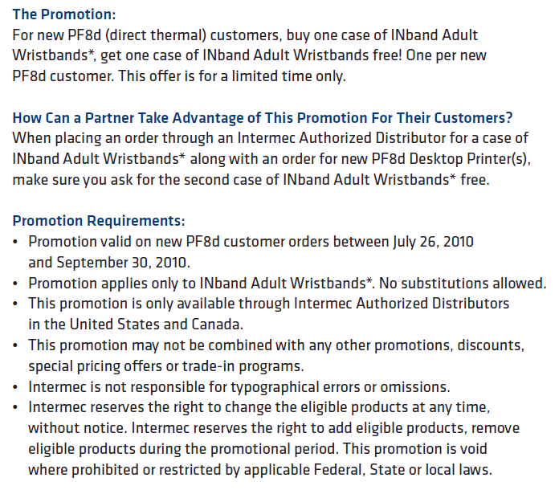
New! Intermec Wristband Promotion

Slide 16
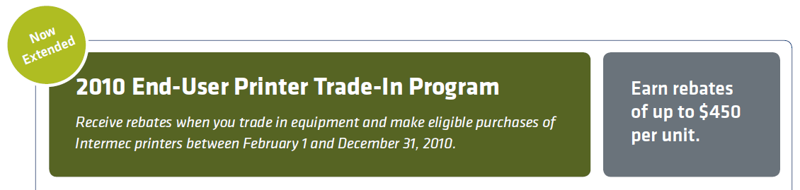
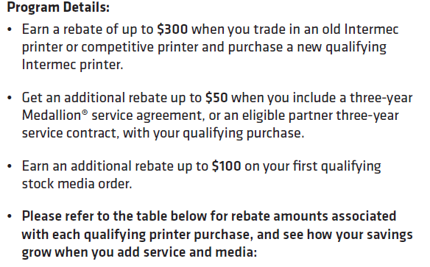
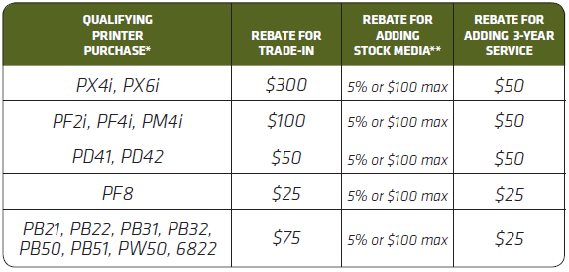

Notes:
16

Slide 17
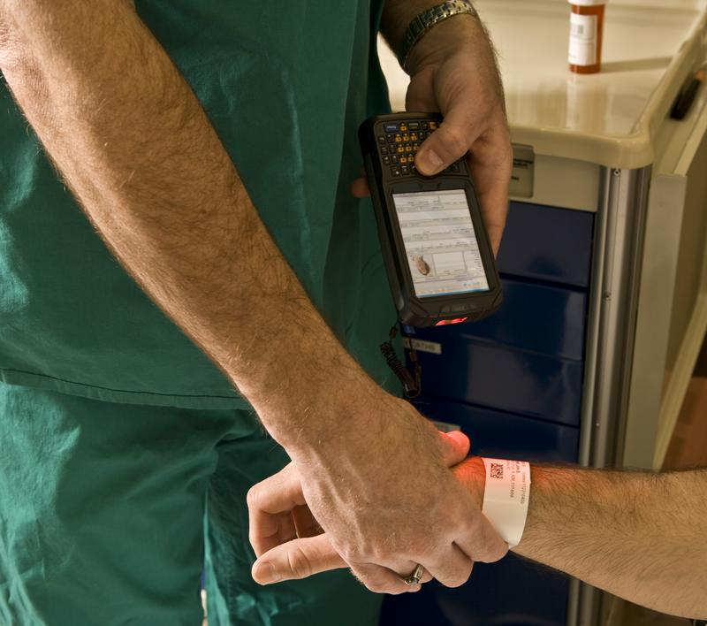
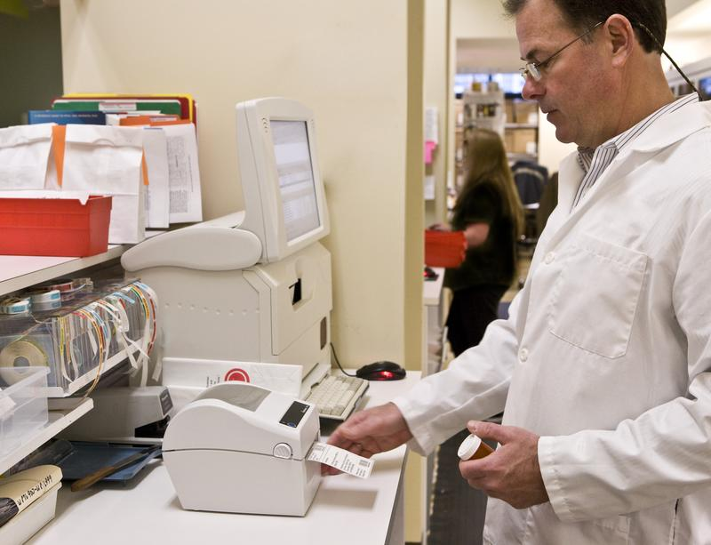
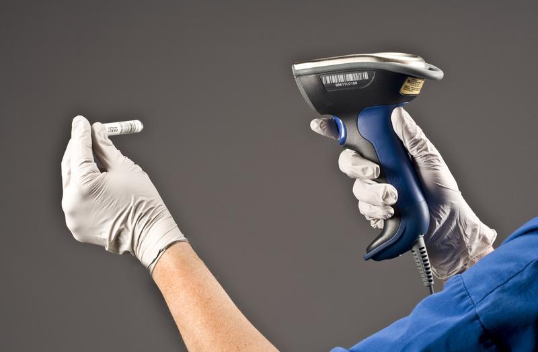
Intermec : The Total Healthcare Solution
From bar code printers and mobile computing solutions to scanning technologies, only Intermec can deliver the total system solution designed to increase patient safety, reduce errors and improve efficiencies.

Slide 18
How to Win in Healthcare
Take advantage of this high-growth category with Intermec’s well-positioned solutions
Identify customers in target customer segments in your territory:
    General Medical and Surgical Hospitals
    Medical Laboratories
    Offices & Clinics of Medicine
Pick 3 customers to educate on how Intermec’s Printers & Media can increase patient safety, reduce errors and improve efficiencies
Download, Read and Leverage our new healthcare focused sales tools and programs to win in this marketplace
Promote Intermec’s printing and media solutions in the target applications:
    Patient ID/Tracking
    Point of Care & Bedside
    Security & Recodes
    Pharmacy
    Laboratory
    Supply Inventory
    Asset Tracking

Slide 19
Intermec Contacts
Tom Roth - Director Product Strategy, Printers & Media
  tom.roth@intermec.com
Dan Bodnar – Director Mobile Printers
  dan.bodnar@intermec.com
Jill Ryan – Principal Product Manager (Desktop Printers)
  jill.ryan@intermec.com
Alex Babic – Principal Product Manager (Fixed Industrial Printers)
  alex.babic@intermec.com
Dan Albaum – Sr. Director Field Marketing, Americas
  dan.albaum@intermec.com
Wayne Waxman – Sr. Product Marketing Manager, Printers & Media
      wayne.waxman@intermec.com
Don Blanton – Manager Product Marketing, Media
    don.blanton@intermec.com

Slide 20
Thank You

Slide 21
APPENDIX

Slide 22

Easy to Sell – iFAST
48 Hour Response
GOAL: Remove printer command language
from the sales equation
iFAST Pre-sales Response Team Provides:
Complete understanding
Rapid escalation and response
Commitment for a solution
Confidence for a successful demonstration
Proven Success:
“The ability to emulate a competitive language in the customer’s
environment, with quick response for unsupported commands,
was key to winning this highly competitive opportunity.”
Notes:
iFast presents clear path towards complete compatibility of Intermec emulation and the code that exists on the hosts side. In the unlikely event if there are some incompatibilities between Intermec emulation and customer’s code, Intermec has dedicated software engineering team that will evaluate the incompatibilities and give immediate and clear answer on the schedule and timeline to make the code compatible. When case is logged we will respond within 48 hours with clear direction and estimates on when the issues will be solved.
Intermec ZSIM (Zebra emulation is up to date in relation to Z products). Intermec CSIM (CPCL emulation) will become part of this program when it is officially launched in Late Q3 2010
Key Take Away: iFAST is there to assist with making certain a solution is delivered…it’s a proven success.

Slide 23
Why Should You Lead With Intermec?
Intermec Printers: The Smart Choice
Extensive
Experience
Innovative & Integrated
Solutions
Best –In Class Localized Support
40 years of bar code printing leadership
Recognized brand in largest markets
Growing install base
Channel focused
Broad range of printing solutions - almost any application & environment
Focused product line. Strong value propositions
Innovation Leadership
Superior Integrated offerings
Opportunity to service – IPSP membership /certification
Unmatched support that drives business
Partnership throughout the entire customer lifecycle
Programs designed to remove selling barriers
Collateral & tools that communicate advantages
“Count on Intermec”
“Deliver more value
to customers”
“Spend more time
selling”
Notes:
As the smart choice for printers, Intermec has over forty years of printing experience and has strong brand awareness in the largest markets. With Intermec’s ever-growing install base and reliable printer products, customers know that purchasing Intermec printing solutions is money well spent! In delivering these solutions, you can count on Intermec for a partnership that enables you to deliver value-add printing solutions to your customers. Ultimately driving new revenue opportunities for you.
Intermec offers a broad range of printing solutions with competitive advantages for almost any application and environment. Intermec’s focused printer product lines provide you with strong value propositions to present to your customers. Over the years, Intermec has stayed on the leading edge, introducing breakthrough printer innovations such as smart printing, a wide range of network connectivity and security options, software and printer management capabilities, and single source purchasing of printers and media.
With Intermec’s global presence, best-in-class service and support are always available. Intermec will partner with customers throughout the entire lifecycle of the product to ensure success. Intermec offers a comprehensive suite of programs designed to remove selling barriers, including co-op funds, campaigns, tools, demos, promotions, discounts, and rebates. Regional partner programs are also available.

Slide 24
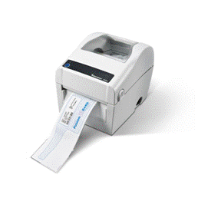
Intermec Desktop Printers
PF8, PC41
The Easy Choice.

Slide 25
Desktop Printer: PF8 - The Easy Choice
EASY | Features That Matter | Benefit To Customers
Right | PrintSet Configuration Software Tool One tool for all PF8 printers to configure the printer and network settings, download fonts and graphics, and/or upgrade firmware. | Speed time to deploy and maintain. Eliminate configuration guesswork. Simple webpage for networked printer to control from anywhere - Partners - fewer support calls - End Users – faster time to start printing
 | Industry Standard Connectivity Fast USB, Serial and Centronics Parallel are all standard. Optional internal Ethernet for networking. | Enable seamless and efficient implementation. No added cost for common legacy connectivity. Drop and go installation in existing environments. Industrial Network speeds ensure deployment is seamless.
 | Software Application Certifications Demonstrated compatibility with leading software applications. Certified with several leading healthcare software applications. | Reduce development time. Off the shelf compatibility with leading software applications.
 | Compact Size Smallest direct thermal printer footprint. | Optimize valuable workspace. Users can print labels where they need them without having to add more space.
 | Shared Media & Printer Language Common Media and Printer Language with other desktop printers | Stay up and running. Use current media and label formats. Compatible with all desktop printers using 0.5” (12.7mm) ribbon cores.
 | Intuitive Media Loading with Largest Capacity Drop-in label roll Largest ribbon capacity in a compact thermal transfer printer. | Save time and increase productivity. Quick and easy label replacement and fewer ribbon changes using 1” (25.4mm) core ribbon.
 | Quiet & Reliable Design optimized for quiet operation while printing professional looking labels. | More work. Less interruptions. Quiet printing, consistent print quality and reliable output every time.
To Deploy
To Install
To Use

Slide 26
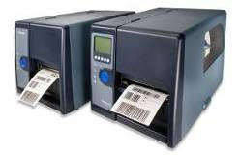
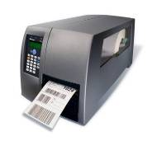
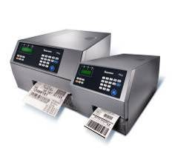
Intermec Fixed Printers
PD41/42, PF2i/4i, pm4i, px4i/6i
Smart. Strong. Secure.

Slide 27
What’s Smart?
S³
Feature | Benefit
Smart Printing Capabilities Fingerprint programming language | Eliminate PC expense Lower application complexity Reduce errors
All-in-One Printer Command Languages
IPL, Fingerprint/DP, ZSim, DSim in ALL Printers
and ESim in PD41/2
Broader choice,
shorter integration time
USB Host/Boot
Connect and control multiple peripherals or use
for memory extension
Increased productivity
MAC Address On-the-box
Faster deployment

Slide 28
What’s Strong?
S³
Feature | Benefit
Strong, all-metal construction For mission critical applications | Low TCO Perfect for harsh industrial environments Strong Performance
Enhanced Self-strip
Rugged tooling with tension control to
drive roller for liner rewind
Consistent performance across all
types of media
Variety of RFID media in
challenging applications
PF2i, PM4i, PX4i/6i RFID Capable and Upgradable
Print small barcodes, text and
images with precision and
pinpoint accuracy
PM and PX Printers with 400 dpi

Slide 29
What’s Secure?
S³
Feature | Benefit
Superrior Connectivity Up to 8 I/O ports Secure Device Management Avalanche and Smart Systems | Easily adapts to changing infrastructure environments Excellent ROI
Advanced Connectivity
CCX v 3 and WPA2 security
WiFi certification
IPv4 and IPv6 network protocols
Ethernet on-board – standard, with
Wireless connectivity options
The ONLY CCX and WiFi certified
printers on the market today
The ONLY standard IPv6
implementation on the market

Slide 30
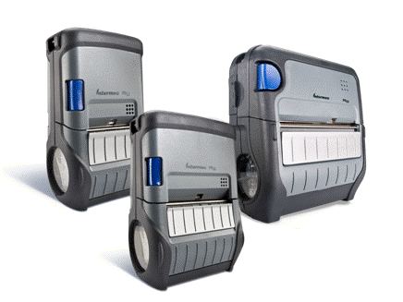
Intermec Mobile Label Printers PB 22/32/50
Fast. Rugged. Smart.

Slide 31
What’s Fast?
FRS
Enterprise Grade
Feature | Benefit
Fastest to print 4 ips (102 mm/sec) mechanism 16MB RAM/64MB Flash Labels in hand 2-3 times faster than competition | Greater productivity – Less Time No waiting for print jobs Less worker frustration Fewer devices required Improved throughput KPIs
Optimized for use with IN computers
Wireless printing wizard/IDL
Scan to connect/load
Integrated holders
Greatest productivity
Fastest printing
Quickest startup
Easiest charging and docking
Intuitive user interface
LCD Display
Ready to work indicator
Reduced support costs
Easy to troubleshoot
Easy to maintain
SmartSystemsTM
Auto Deploy firmware push
Reduced integration costs
Eliminates the need to touch each unit

Slide 32
What’s Rugged?
FRS
Enterprise Grade
Feature | Benefit
Rugged construction Mil-Std drop and vibration IP54 Sealing Tumble tested | Low TCO Reduce productivity loss due to hardware failure Reduce hardware replacement and maintenance costs Reduce lost revenue issues
Enterprise Grade accessories
Secure vehicle mounts
Multi-dock chargers
Shared with other IN hardware
Reduce system risk
Guaranteed system performance
Reduce system integration costs
Multiple media support
Self-strip mechanism for labels
Receipt
Flood coat and linerless
Increased application flexibility
Best fit choice for the application
Increased productivity and safety
Reduced waste-improved sustainability

Slide 33
What’s Smart?
FRS
Enterprise Grade
Feature | Benefit
Smart printing capabilities Fingerprint programming language 19 years of field tested applications | Simplified system Eliminate PC expense Lower application complexity
All-in-One printer command languages
IPL, Fingerprint/DP, ZSim and ESC-P
in PB2x/3x/5x printers
CSIM coming in Q3 2010
Broader choice,
shorter integration time
Bluetooth host
Connect and control Bluetooth peripherals
such as bar code scanners
Increased productivity
Cost effective mobile scan-print- apply solutions
Network address labels on box & printer
MAC address includes human readable and barcode
Easy scan-to-connect association of printer

Slide 34
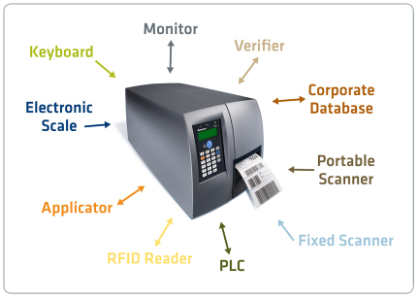
Intermec Smart Printing
Label Printers with Computing Power
Programmable
Proven
Interactive
Stand-alone
Connected
Low TCO & Quick ROI
Intermec does not charge for smart printing
Largest install base and partner community
Most advanced and integrated Smart Printing

Slide 35
The Best ‘Smart Printing’ on the Market
Adding value
Error-proof labeling
  Eliminate rework & penalties
  Higher productivity
Fast ROI, Low TCO
  Eliminate the pc
  Simpler, more reliable infrastructure
Simple, intuitive applications
  Easy to train
  Stable
Only Intermec offers “Smart” mobile printers
Notes:
35

